Slide 1

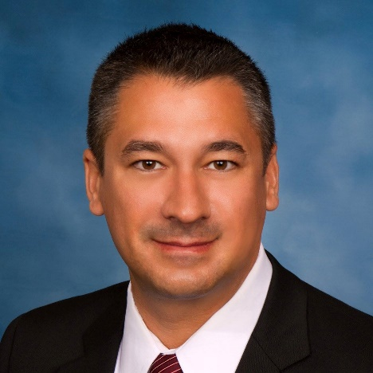
New condo regulations & rider
Aaron Bedy
Bedy Law, PLLC

Slide 2

New requirements
For Buildings 3 Stories or Higher – SB 4-D Building Safety
Mandatory Structural Inspection – A milestone inspection in 2 phases is required as defined in SB 4-D Building Safety
When? If a milestone inspection is required and the building’s certificate of occupancy was issued on or before July 1, 1992, the building’s initial milestone inspection must be performed before December 31, 2024, and earlier if the local government overseeing the Association notifies the Association.
The provisions allow the local governments to issue a notice requiring the inspection within 180 days from the date of the notice being issued.

Slide 3
Condominium – buyer considerations
* Frequency? Must have a milestone inspection performed on qualifying buildings by December 31 of the year in which the building reaches 30 years of age and every 10 years thereafter.
* If the Condominium is within 3 miles of a Coastline as defined in section 376.031, Florida Statutes (2021), then the condominium must have a milestone inspection performed on qualifying buildings by December 31 of the year in which the building reaches 25 years of age and every 10 years thereafter.

Slide 4
Buyer considerations - continued
* Local enforcement agencies will notify condominium associations whose buildings must have a milestone inspection. Within 180 days after receiving the written notice, condominium associations must complete phase one of the milestone inspection.

Slide 5
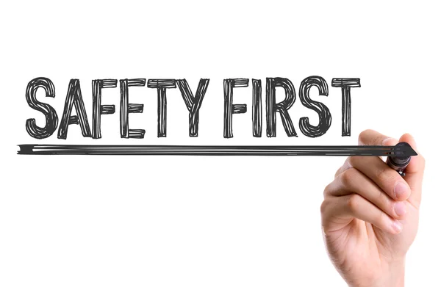
Condo safety checks my face difficulties
News Flash
News & Media
New Florida Condo Safety Standards raise the bar for about 2M owners and set an extremely short timeline – and there may not be enough engineers to get the job done.
      Derek Gilliam – Florida Realtors

Slide 6
Condominium – buyer considerations
Structural Integrity Reserve Studies
Associations existing on or before July 1, 2022 that are controlled by non-developer unit owners must complete a structural integrity reserve study for each building in an association that is 3 stories or higher in height.
A study of the reserve funds required for future major repairs and replacement of the common areas based on visual inspection of the common areas.

Slide 7
Condominium – buyer considerations
  * Additionally, associations annual budget must include reserve accounts for capital expenditures and deferred maintenance. The accounts must include, but are not limited to , roof replacement, building painting, and pavement resurfacing, regardless of the amount of deferred maintenance expense or replacement cost, and any other item that has a deferred maintenance expense or replacement cost that exceeds $10,000. The amount to be reserved for an item is determined by the associations' most recent structural integrity reserve.

Slide 8
Condominium – buyer considerations review
  When? A structural integrity reserve study must be completed by December 31, 2024.
  The frequency required is every 10 years for each building in an association that is 3 stories or higher in height.
  Effective December 31, 2024, the members of a unity-owner controlled association may not determine to provide no reserves or less reserves than required by this subsection for specific items.

Slide 9
Condominium – buyer considerations review
  New Roofing Requirements
  * If an existing roofing system or roof section was built, repaired, or replaced in compliance with the requirements of the 2007 Florida Building Code, or any subsequent editions of the Florida Building Code, and 25% or more of such roofing system or roof section is being repaired, replaced, or recovered, only the repaired, replaced or recovered portion is required to be constructed in accordance wht the Florida Building Code in effect, as applicable.

Slide 10
Condominium – buyer considerations
* Frequency? Must have a milestone inspection performed on qualifying buildings by December 31 of the year in which the building reaches 30 years of age and every 10 years thereafter.
* If the Condominium is within 3 miles of a Coastline as defined in section 376.031, Florida Statutes (2021), then the condominium must have a milestone inspection performed on qualifying buildings by December 31 of the year in which the building reaches 25 years of age and every 10 years thereafter.

Slide 11
Listing a condominium… what to consider
Have there been discussions or plans for any special assessments to the condominium development?
    * If yes, why?
Are any of the condominium reserves in the deficit?

Slide 12
Florida’s new mandatory condo inspection and reserves law
This can create special assessments to the condominium association for shortages in the reserves and for repairs
If an issue is found it can greatly affect the future of the development
Getting a loan may also be an issue

Slide 13
Condominium – buyer considerations
Request as a requirement in the sales contract to be provided on the effective date the last 12 months of the minutes from the condominium association meetings and carefully review.
  This would help disclose any red flags, deficiencies, discussions, problematic issues, or future plans.

Slide 14
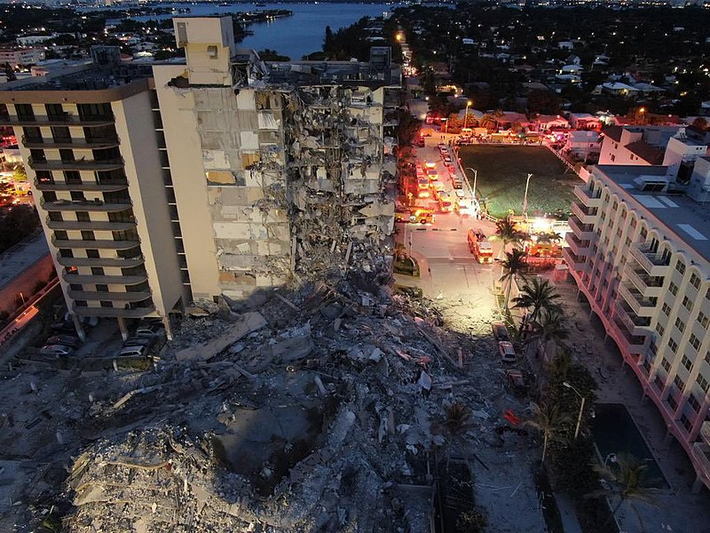
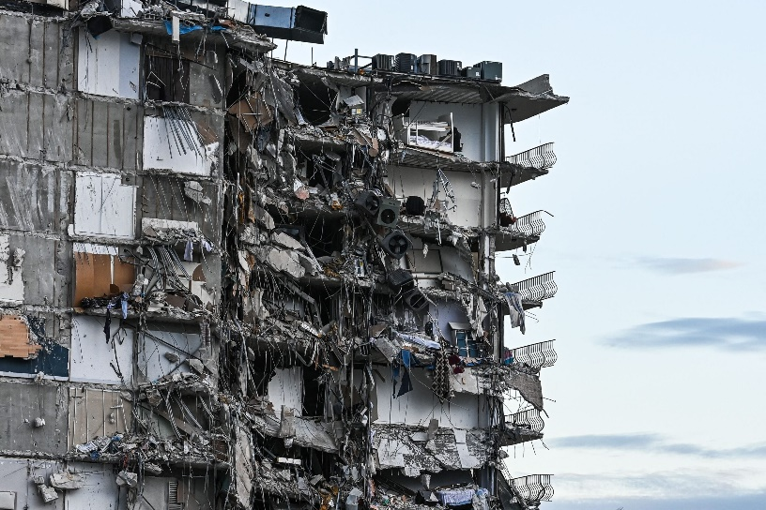
Owners asked to pay $175,000 Each toward Miami condo 40-year recertification

Slide 15
Miami – a shocking assessment
Owners are being asked to pay $175,000 each towards their 40-year recertification. This is a story we have been hearing more and more across South Florida.
Residents say something isn’t adding up and they are putting the blame on their homeowner’s association.
“I’m in shock in disbelief”, said Christian Murray.
  Murray has lived in the Palm Bay Yacht club condos since 2016. Now he and many other residents are worried if they’d be able to keep their homes.

Slide 16
So, residents hired a different engineer to do the same assessment, and they were told the building needed around $23 million in repairs, a fare cry from the initial $46 million.
“Asking for $46 million is really extraordinary”, said attorney Jane Muir.
Muir was hired by the residents to fight against the property managers.
The Problem
Upon further investigation, Muir said the initial engineer largely inflated the cost of repairs. Residents believe the property manager, called AKAM, is not only inflating numbers but also wants to hire their sister company, Project Management Group, to do the repairs.
“It’s going to ruin their lives, people are going to lose their homes”, said resident Sonia Przulji. “I cannot afford this. I’ve cried myself to sleep wondering what Id do.”

Slide 17
New condominium rider effective March/2023
Revisions to the NEW Condominium Rider CR-6x are effective March 1, 2023
The Changes are in clause – 10. Governance Form

Slide 18
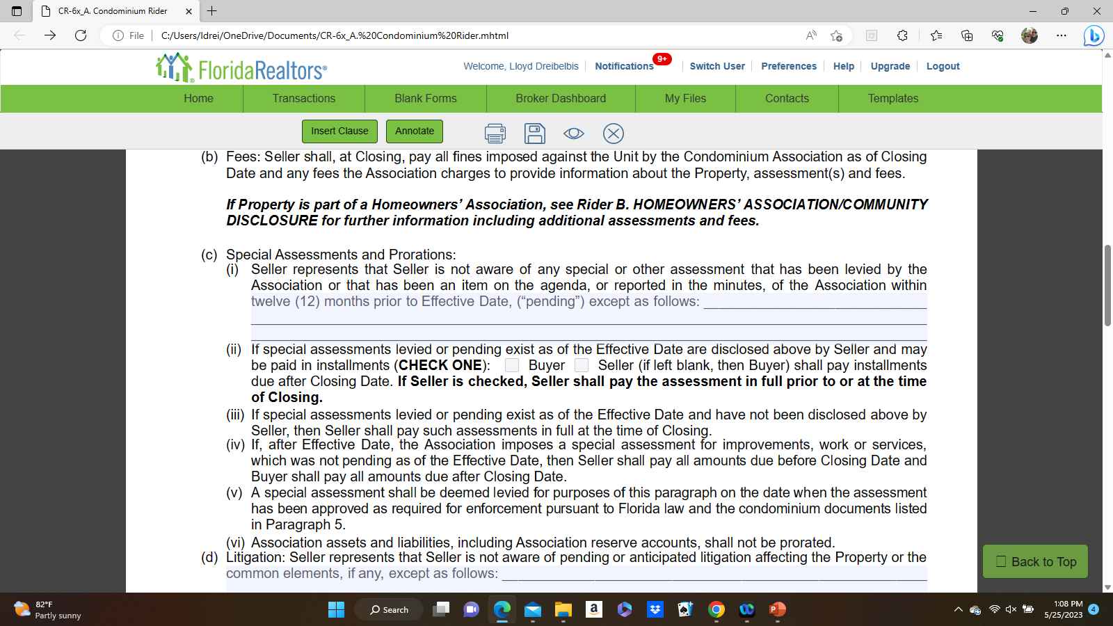
Fr/bar contract condominium rider

Slide 19
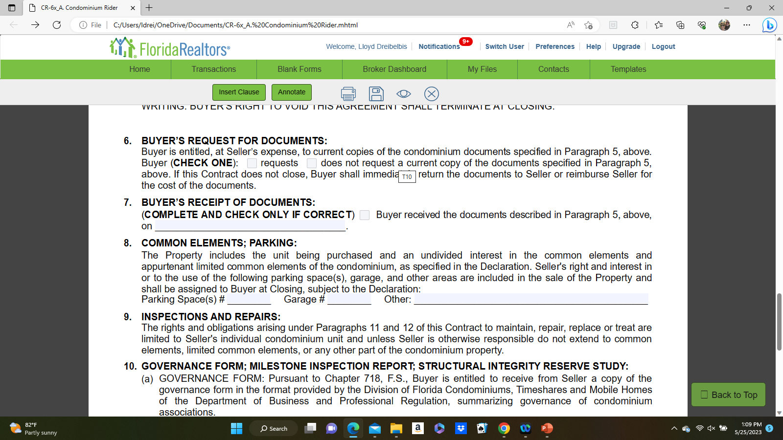
Fr/bar contract condominium rider

Slide 20
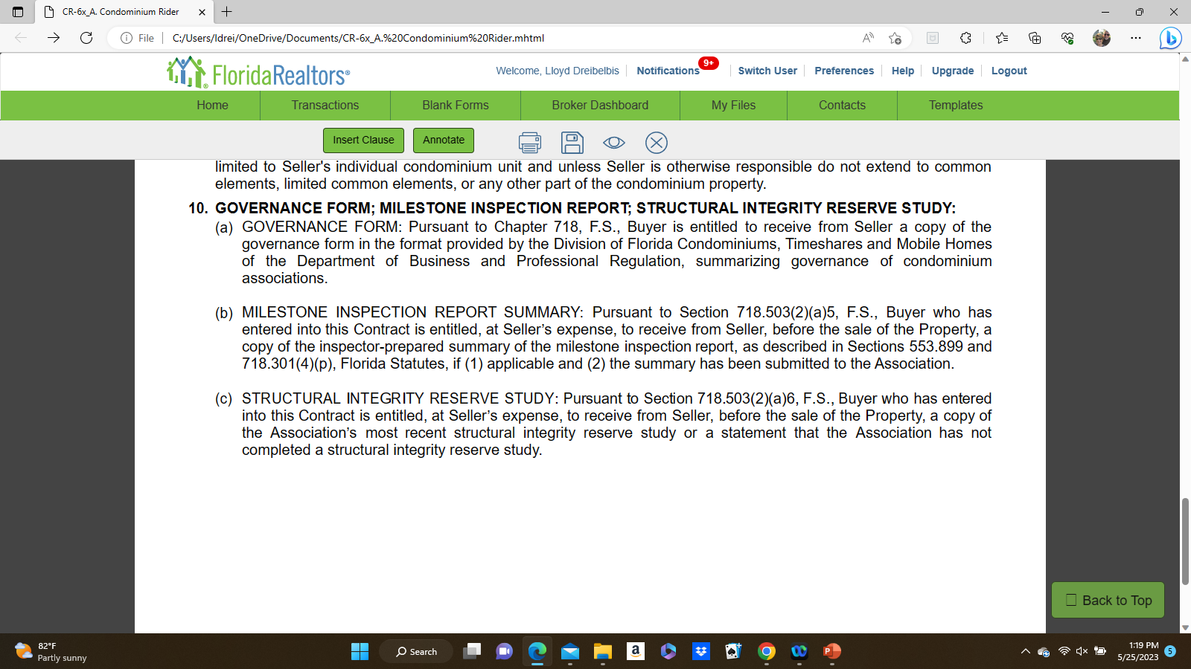
Fr/bar contract condominium rider

Slide 21


