Slide 1



RISK REDUCTION SEMINAR - 2022
An RMS Elite properties Annual conference

Slide 2


John Cappa, Esq.
Cappa Title Services

Slide 3

Wire Fraud
How can we avoid “issues” of wire fraud?
  Use of Co-Branded Flyer
What is the correct protocol / procedure?
How can we best educate our customers and clients?
Use Wire Fraud Addendum
  With Buyer Customers/Clients

Slide 4


Lloyd Dreibelbis, Broker
RMS Elite Properties

Slide 5
Caveat Emptor…
Let the Buyer Beware
DO NOT ALLOW YOUR SELLERS TO THINK THAT THEY HAVE NO RESPONSIBILITIES… Even if we use the “As Is” Contract
The Florida Supreme Court has decided that Caveat Emptor does NOT apply in cases of failure to disclose! When a Seller knows of facts materially affecting the value of the property, which are not readily observable and are not known to the buyer, the SELLER IS UNDER A DUTY TO DISCLOSE THEM

Slide 6
Caveat Emptor…
The Buyer’s Responsibilities
When a Buyer makes a “Failure to Disclose” claim, the Buyer must PROVE four essential elements:
1) The Seller had actual knowledge of the property defect;
2) The defect must materially affect the value of the property;
3) The defect must not be readily observable and was unknown to the buyer; and
4) The Buyer must establish that the Seller failed to disclose the defect to the Buyer!

Slide 7

Disclosure of Property Defects
The Seller’s Duties

Slide 8
Disclosure of Property Defects
The Seller’s Duties
In any residential contract, including the “As-Is” contract, the Seller must make mandated disclosures about the property to the potential Buyer if applicable. Put simply, a Seller cannot hide problems that may require repair work. This includes:
  Any potential or actual claims, complaints or legal proceedings
  Any boundary disputes
  Any environmental hazards
  Any termites or pest damage or infestations
  Any damage or potential damage from sinkholes
  Any know problems with important components including HVAC, plumbing, electrics, roofing, structural integrity, etc.
  Any condominium or homeowner association rules

Slide 9
The Importance of Disclosure
Caveat Venditor
Let the Seller Beware
  Legal history strongly supports a Buyers right to information being disclosed to him regarding the property.
  The Buyer may have a duty to inspect and discern readily observable issues, but it will likely remain very difficult for Sellers to completely release themselves of any liability to disclose known defects.
  Make sure the SELLER fills out the disclosure forms… NOT the REALTOR
    REALTOR should read the completed disclosure to make sure it is complete and accurate (to the best of their knowledge)
    The SELLER cannot legally ask you to withhold disclosable information

Slide 10


&
Lloyd Dreibelbis, Broker
RMS Elite Properties

Slide 11
Who do you represent in a transaction?
Florida’s Brokerage Law, the Brokerage Relationship Disclosure Act (BRDA) specifies four authorized “brokerage relationships”:
1) Transaction Brokerage
2) Single Agency
3) No Brokerage Relationship
4) Designated Sales Associate
“May NOT be used in a Residential Sale”
As of 2003, there is now the presumption that ALL licensees are operating as transaction brokers unless written disclosure of a single agency or no brokerage relationship is provided!

Slide 12
Transaction Brokerage
As a Transaction Broker (Agent), the real estate practitioner acts as a facilitator bringing the parties together and as a conduit through which offers, and information are passed back and forth
  The requirement to provide transaction brokerage disclosure expired on July 1, 2008, and the disclosure form is no longer required or recommended!
A Transaction Broker (Agent) does NOT represent either party in a fiduciary capacity or as a single agent!
A Transaction Broker (Agent) is a licensee who provides limited representation to a buyer, a seller, or both!
A Transaction Broker (Agent) basically represents the TRANSACTION

Slide 13
Duties of a Transaction Broker
Duties:
Limited Confidentiality
Deal Honestly and Fairly
Account for all funds
Use skill, care, and diligence in the transaction
Disclose all known facts that materially affect the value of residential property and that are not readily observable to the Buyer
Present all offers and counteroffers in a timely manner
You can’t tell the Buyer what the Seller is willing to accept
You can’t tell the Seller what the Buyer is willing to offer
You can’t discuss the Buyer’s or Seller’s “motivation” for buying or selling the property… unless you have the authority to do so IN WRITING

Slide 14
Single Agency a fiduciary relationship / offers true representation
A Single Agent represents, as a fiduciary, either the Buyer or the Seller. A fiduciary relationship is one of trust and confidence between the licensee as a single agent and the Seller or Buyer as the principal!
As a Single Agent, a licensee may NOT represent both Buyer and Seller in the same transaction. Proper written disclosure, in the form of a Single Agent Notice, must be made to establish a Single Agency Relationship. The disclosure MUST be made before or at the time of entering into a listing agreement or an agreement for representation or before the showing of property, whichever occurs first!

Slide 15

Duties of a Single Agent
Duties:
Dealing Honestly and Fairly
Loyalty
Confidentiality
Obedience
  Unless Illegal
Full Disclosure
Accounting For All Funds
Skill, Care, and Diligence in the Transaction
Presenting all offers and counteroffers in a timely manner
Disclosing all know facts that materially affect Value and are not readily observable

Slide 16

Transition to Transaction Broker
The license law allows a licensee representing a party as a Single Agent and is requested or desires to represent the other party in the same transaction, to transition from single agency to transaction broker. This transition requires a “Consent to Transition to Transaction Broker” form, which MUST be signed by the party or parties involved!

Slide 17


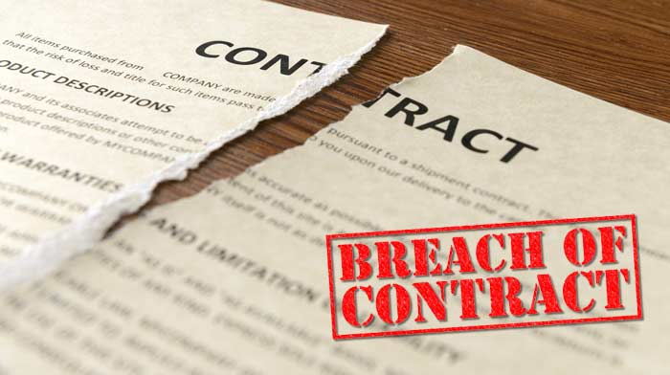

FAR-BAR Agreement of Sale Updates & Changes
Aaron Bedy, Esq.
In-House Council
REALTOR

Slide 18

Distribution of Deposit Money… should there be a dispute
John Cappa, Esq.
Cappa Title Services

Slide 19


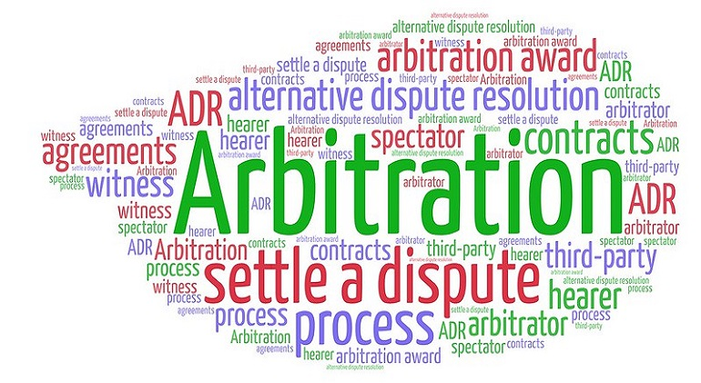
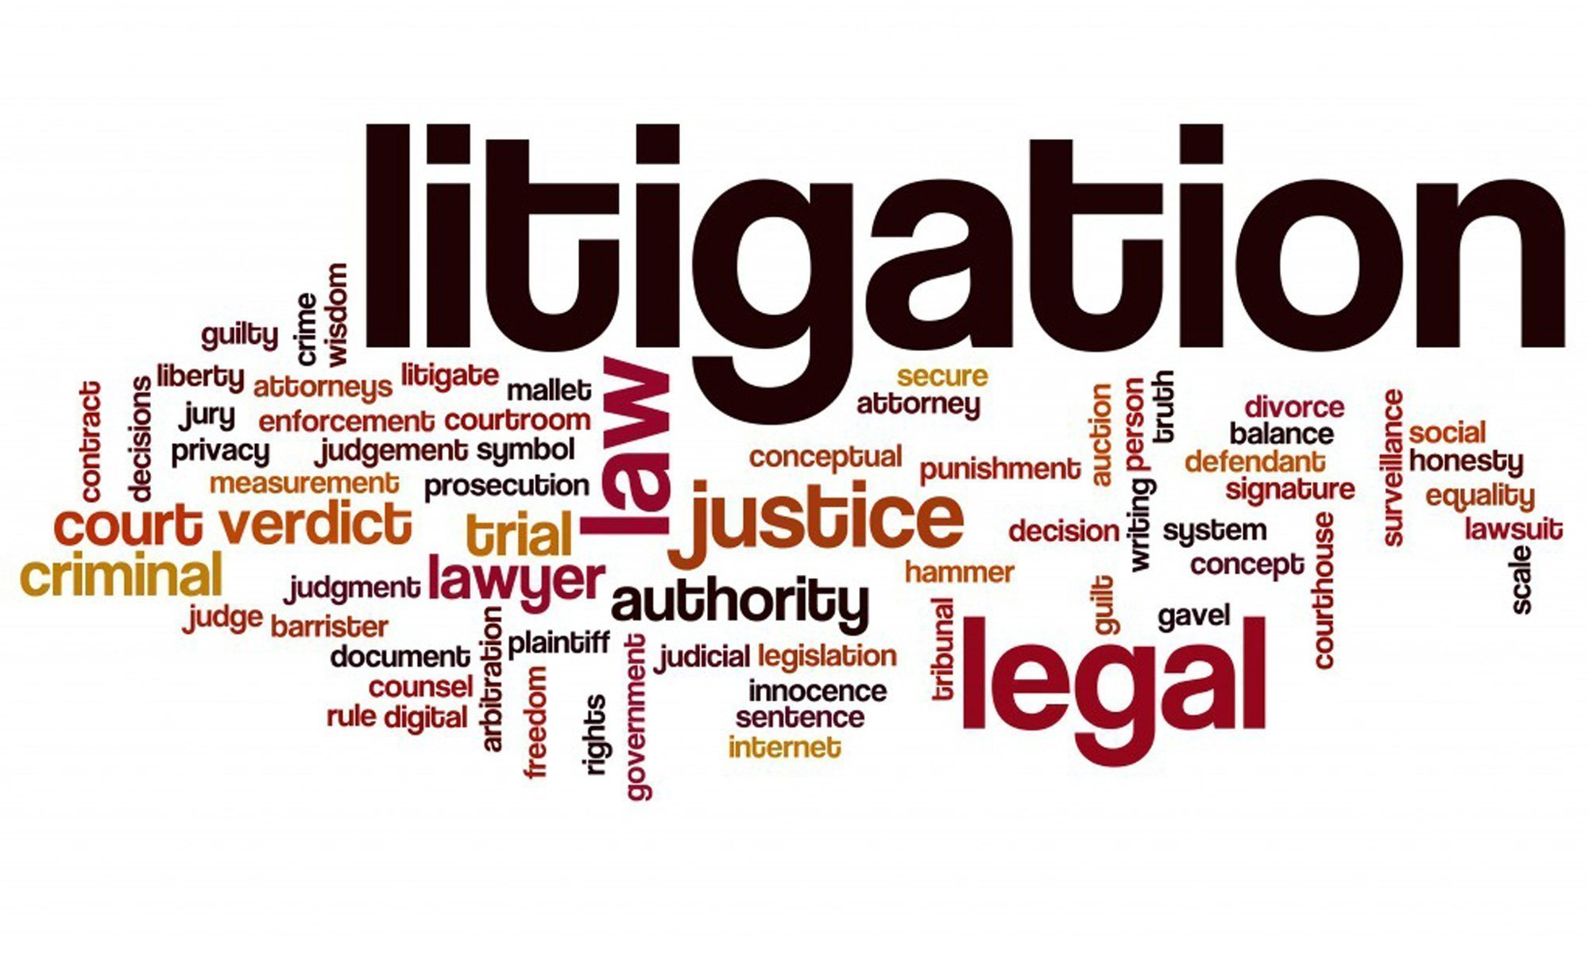

Slide 20
Dispute Resolution
Florida Realtors / Florida Bar – As Is – 6 Revised 10/21
  Paragraph 16. DISPUTE RESOLUTION: Unresolved controversies, claims and other matters in question between Buyer and Seller arising out of, or relating to, this Contract or its breach, enforcement or interpretation (“Dispute”) will be settled as follow:
    (a) Buyer and Seller will have 10 days after the date conflicting demands for the Deposit are made to attempt to resolve such Dispute, failing which, Buyer and Seller shall submit such Dispute to mediation under Paragraph 16 (b).
    (b) Buyer and Seller shall attempt to settle Disputes in an amicable manner through mediation pursuant to Florida Rules for Certified and Court-Appointed Mediators and Chapter 44, F.S, as amended (the “Mediation Rules”). The mediator must be certified or must have experience in the real estate industry. Injunctive relief may be sought without first complying with this Paragraph 16 (b). Disputes not settled pursuant to the Paragraph 16 may be resolved by instituting action in the appropriate court having jurisdiction of the matter. This Paragraph 16 shall survive Closing or termination of the Contract.

Slide 21
Cost of Dispute Resolution
Paragraph 17. ATTORNEY’S FEES; COSTS: The parties will split equally any mediation fee incurred in any mediation permitted by the Contract, and each party will pay their own costs, expenses and fees, including attorney’s fees, incurred in conducting the mediation. In any litigation permitted by this Contract, the prevailing party shall be entitled to recover from the no-prevailing party costs and fees, including reasonable attorney’s fees, incurred in conducting the litigation. This Paragraph 17 shall survive Closing or termination of this Contract.

Slide 22
Dealing with Dispute Resolution… a comparison
Mediation
Arbitration
Litigation
NON-BINDING
Lowest Cost Option
Relatively Informal / Outside the Court System
Non-Adversarial Process
Neutral Mediator is used to assist the parties in reaching a mutually acceptable agreement
Even if this does not resolve the dispute, it is still an effective way of narrowing areas of dispute making future proceedings more efficient and focused
BINDING
Low-Cost Option
Usually Private / Outside the Court System
Adversarial Process
Neutral Arbitrator ultimately renders a decision that is final
BINDING
Costly Option / Time consuming
Formal / Governed by rules and procedures of the Court
Adversarial Process
Judge &/or Jury make and impose a binding decision
Since it is adversarial, litigation is in effect a contest in which a winner and loser are selected

Slide 23






Stay in Your Lane
Aaron Bedy, Esq.
In-House Council
REALTOR

Slide 24


