Slide 1

A Millennial’s Guide
to Homeownership

Slide 2

Why Should You Read This eGuide?
The Millennial Generation is the largest generation in United States history. According to the
US Census Bureau:
“[Millennials] born between 1982-2000, now number 83.1 million and represent more than one-quarter of the nation’s population. Their size exceeds that of the 75.4 million baby boomers.”
If you are one of the millions of Millennials who has seen their peers begin to buy homes recently and are wondering what it would take for you to do the same... you’ve found the right eGuide!
There are many stereotypes and myths about the Millennial Generation as a whole, AND about what it takes to buy a home in today’s market.
These myths have prevented many Millennials from even considering homeownership as an option for them and their families.
The goal of this eGuide is to provide you with the information you will need to make the best decision for you and your family in regards to homeownership. We will break down the myths and stereotypes that have long been believed to be true, as well as shed light on the opportunity you have to build wealth using your monthly housing cost.

Slide 3

You’re Not Alone If You Haven’t Bought a Home Yet
If it seems like all your friends are buying a house... it’s because they are! But don’t worry, you’re not alone if you haven’t.
There has been a lot of talk about how, as a generation, Millennials have ‘failed to launch’ into adulthood and have delayed moving out of their family’s home. What doesn’t seem to be mentioned in the same context, however, is the large number of Millennials who have moved out of their family’s home, but have been renting an apartment, condo, or even a house!
Many experts have looked at the homeownership rate among Millennials and have questioned if they even want to own homes! The great news is that not only do Millennials want to own... they are flocking to the real estate market in larger numbers every year!
Buyers aged 18-34 years have comprised the largest share of first-time homebuyers at roughly 50-60% for the last few years. In 2017, buyers aged 25-34 years accounted for 65% of first-time home buyers, compared to 50% in 2005.
According to the National Association of Realtor’s latest Profile of Home Buyers and Sellers, the average age of a first-time home buyer in 2017 was 32. This generation will continue to be the topic of conversation A LOT when it comes to housing as more and more enter ‘average home buying age’.
Experts Need To Stop Lumping All Millennials Together
In a group of people with such a wide age range (18-36 according to the Census), it is impossible to draw conclusions about this generation as a whole, despite what many have tried to do.
Many experts have begun to realize that there is a noticeable difference between the behaviors and experiences of this generation, and have therefore divided them into ‘Young Millennials’ (18-26) and ‘Older Millennials’ (27-36).

Slide 4

No matter which group you find yourself in, you no doubt have peers that fit into the other category and may even identify with different characteristics from each group.
One of the many reasons that it has been easy for experts to lump all Millennials together is the fact that 66% of Millennials are under the age of 30, with 22% falling under the age of 25, according to a study by NerdWallet.
With the majority of the generation still in their 20s and either not ready to or not in a position to make huge life-changing decisions (such as buying a home or starting a family), it has been easy for those who follow trends to not notice the progress ‘Older Millennials’ have already made.
The ‘Responsibility Zone’ Is Calling
Whether pushed into the zone or a willing participant, many ‘Older Millennials’ are aging into the
‘Responsibility Zone,’ or the age range when responsibilities start to dictate behaviors, such as:
Moving out of the house
Getting married
Buying a home
Having children
And not necessarily in that order!
You may have noticed that many of your friends and family members have started to make pretty big decisions all at once. There are many Millennials who are crossing all four of these major life events off their list in a two-year span. If you blink you might miss it!

Slide 5
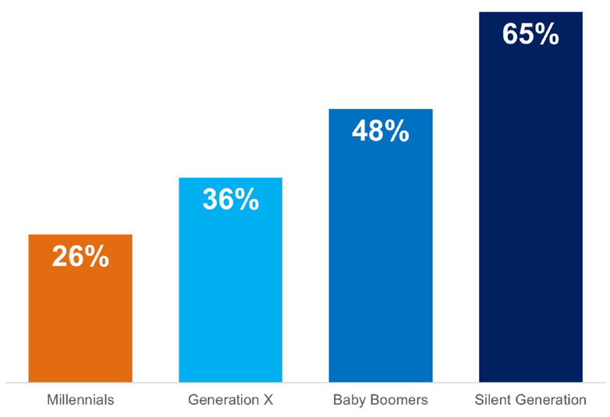
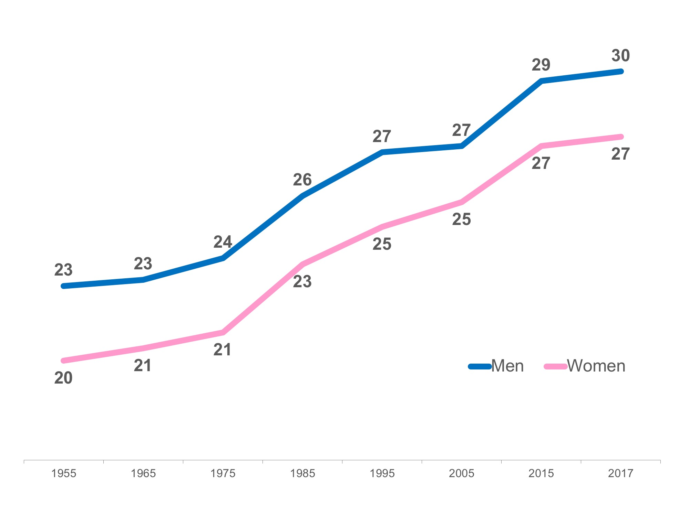
Over the last 60 years, the median age of first marriage for Americans has increased substantially. The graph on the top right shows the percentage of each generation that was married between the ages of 18-33. This age range fully encompasses the Millennial generation and you can see the drastic difference in the percentage that has married by age 33. The Silent Generation led the way with 65% married by this time.
The graph on the lower right was created using data from the Census Bureau. It shows that in 1955, the median age for men to be married was 23 and for women, 20.
In 2017, men were 30 and women were 27 at first marriage. Even though this difference doesn’t seem very large, (only 7 years), the resulting delay, or ‘failure to launch’ into adulthood, can be felt in the homeownership rate as well as other areas of the housing market.
% Married at ages 18-33
by generation
Median Age
at First Marriage
Simply put, the homeownership rate is the percentage of homes that are owned by their occupants. The homeownership rate is computed by dividing the number of owner-occupied housing units by the total number of occupied housing units.
As the economy has recovered from the housing market crash, more and more young professionals are moving out of their childhood homes and opting for a place of their own. At the same time, many who were impacted by the shake-up in the economy are beginning to rebuild their credit to a point where homeownership may again become an opportunity.
The current homeownership rate for all Americans is around 64.2%. The homeownership rate for Americans under the age of 35 was most recently reported at 35.3%, compared to those 35-44 years old at 69.5%.
Some economists have pointed to this as an indicator that young people do not believe in homeownership. What they really should point out is that there are more ‘households’ now than ever before, but the percentage of those households owned by their inhabitants is low.
The graphic on the following page, explains how the homeownership rate is calculated & the impact of renting first after moving out of their family’s home instead of buying a home.

Slide 6






How the Homeownership Rate is Calculated
If you had 12 friends and 6 of them owned their home, 3 rented and 3 lived at home with their parents, the homeownership rate amongst your friends would be: 67%
Own Their Home Rent Live At Home
# of friends who own ÷ total # of friends not living at home = the homeownership rate
6 ÷ 9 = 67%
If your friends who lived at home with their parents decided to move out and one bought a home, and the other two decided to rent the homeownership rate among your friends would be: 58%
Own Their Home Rent Live At Home
# of friends who own ÷ total # of friends not living at home = the homeownership rate
7 ÷ 12 = 58%
So even though all of your friends no longer live at home, and have taken big steps into adulthood, the homeownership rate went down because the ratio of your friends who own their own homes is too close to the number of those who rent.
Traditionally, getting married and having kids was a big reason many Americans began looking for a home to buy. According to NAR, 57% of first-time buyers and 69% of repeat buyers were married couples. A study by Fannie Mae stated that married renters are 27% more likely to buy on their next move than single renters.
Many experts believe that as Millennials age into the ‘Responsibility Zone,’ a Millennial Baby Boom is right around the corner.
The data shows that this generation has waited until later in life to become parents, as only 48% of Millennial women were mothers in 2016, compared to 57% of Generation X at the same age. A Pew Research Center article discussing the data points to social influences that may have contributed to the delay:
“The rising age at first birth is hardly limited to the Millennial generation. It has been a trend since at least 1970. Many factors may contribute, including a shift away from marriage, increasing educational attainment and the movement of women into the labor force.”

Slide 7


Do Millennials Want to be Parents?
“While Millennials may be delaying parenthood, it’s not for a lack of interest in eventually becoming moms and dads. Members of this generation rated being a good parent as a top priority in a 2010 Pew Research Center survey.
Some 52% said it was one of the most important goals in their lives, well ahead of having a successful marriage, which 30% said was one of their most important lifetime goals.”
Just because the decision to start their families has been delayed, the desire to become parents has never waned. A parallel can be made about the desire of Millennials to become homeowners as well. Delaying decisions does not mean that they’ve decided not to get married, have children or become homeowners.
What Does This Mean for the Housing Market?
Mark Fleming Chief Economist at First American explained:
“As more and more millennials marry and have children – among the strongest determinants for the desire to be a homeowner - demand for housing will remain robust.”
This generation has already begun to shift its focus to providing the best homes for their children to grow up in, the best school districts, and often to providing the stability that owning a home of their own allows.
Two-thirds of Millennials have not yet reached the average first-time home buying age of 32, as reported by the National Association of Realtors.
With the majority of the generation still outside the ‘Responsibility Zone,’ Millennials have a lot of catching up to do and the homeownership rate amongst Millennials has nowhere to go but up!

Slide 8

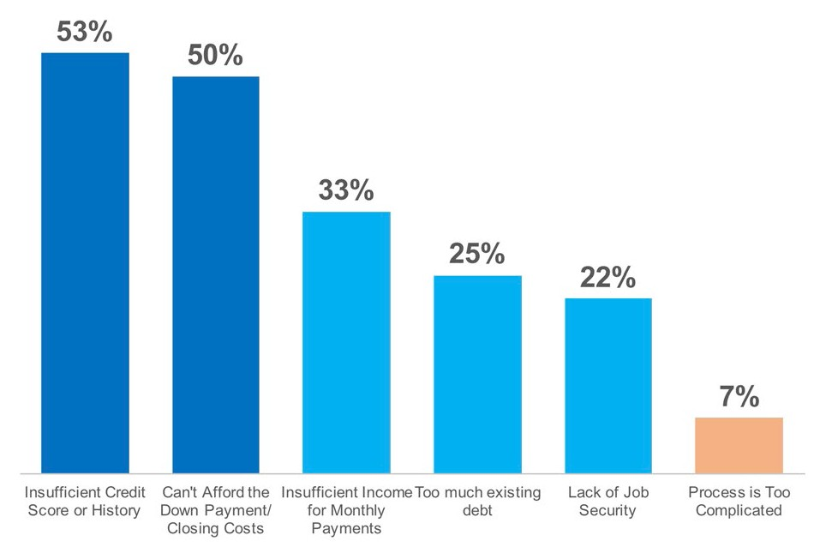
What's Holding Millennials Back from Buying?
The answer must be student loans, right? Wrong! While paying back an education is part of the equation for some, it is not the only factor that holds Millennials back from buying their first homes.
A survey of young renters by Fannie Mae found that the factor that delays the most potential buyers is
an insufficient credit score or history (53%), followed closely behind by “affording the down payment and closing costs (50%).”
The chart on the right showcases the top 6 reasons identified by the study.
Top 6 Reasons
Young Renters Delay Buying
There are many potential homebuyers who have delayed their purchase because they ‘believe’ that they do not qualify with the debt they have (debt-to-income ratio), their credit score or even the amount of savings they have.
The challenge is that many of those who delay their purchases are not aware of the opportunities available, and are not aware that they would qualify now. Instead of wasting time paying rent, they could be building their own wealth by putting their housing costs to work for them through the equity in their home.
Let’s Break Down the Top 3 Myths Holding Back Buyers:

Slide 9


Myth 1:
Student Loans are Preventing Millennials from Buying
Millennials are on track to becoming the most educated generation in history. This means they are also the generation with the most student debt. Depending on the type of degree earned, as well as the prestige of the institution attended, there are some Millennials who graduate college with what equates to a mortgage payment. But that’s not the case for all.
Here are some statistics about the average college graduate & their student loans:
The age of the average college graduate is 22 years old.
The average student graduates college with $25,000 in student loan debt.
The terms of the average loan are 10 years, with a monthly loan payment of $280, and an interest rate of 6.8%.
Looking at these stats, the average college graduate has what amounts to a 10-year car payment after graduation.
Is Earning a Degree worth the Debt?
According to a study by the Brookings Institute, the dividing line between haves and have-nots in homeownership is “education, not student debt.”
“This picture accords with what we know about the growing gulf in the economic fortunes of those with and without a college education. Men with a BA earn $35,000 more a year than those without, while for women the gap is $25,000.”
A study by Fannie Mae supports this fact as they go on to say:
“Those who completed at least a bachelor’s degree without student debt were 43% more likely to be homeowners than high school graduates who didn’t attend college and don’t have student debt.”
The College Board reports that “the typical bachelor’s degree recipient can expect to earn about 66% more during a 40-year working life than the typical high school graduate earns over the same period.”

Slide 10

Just like we saw earlier with the average age at first marriage, Millennials are delaying the social norms that many generations before them had set. According to NAR, Millennials who purchased a home last year delayed their home purchase by a median of 3 years, with 53% of those who delayed their purchase citing student loans as the debt that held them back the most.
Student loans have only delayed their ability to own their own home, not taken away the desire to do so.
Reasons Those with Student Loans Are Delaying Buying a Home:
85% - Can’t save for a down payment because of student debt
74% - Don’t feel financially secure enough because of existing student debt
52% - Can’t qualify for a mortgage due to debt-to-income ratio (DTI)
47% - Can’t afford their preferred house or neighborhood
18% - Don’t have the financial know-how to confidently navigate the housing market
Seems like there is some work to be done to educate those with Student Loan debt that they may be disqualifying themselves and may be able to buy now:
Can’t save for a down payment – What size down payment do they think they need?
Can’t qualify for a mortgage due to debt-to-income ratio (DTI) – There is a big difference between your front-end DTI and your back-end DTI. The front-end DTI measures the amount of your monthly income that you will be spending on your mortgage payment. The back-end DTI takes into consideration your entire monthly expenses (or debts) in comparison to your monthly income.
According to Ellie Mae’s Origination Report, loans closed over the last year had an average front-end DTI of 25% and an average back-end DTI of 39% which is much higher than many believe they need.
The last one is where your agent comes in: Don’t have the financial know-how to confidently navigate the housing market - Your agent should be your strategic partner throughout the home buying process. He or she is there to answer your questions and put your mind at ease about the big decisions that you will be making in order to make your dream of owning a home come true!

Slide 11

“With student debt on the rise, there’s been a lot of speculation about whether the cost of a college degree hurts an individual’s ability to buy a home,” says NerdWallet’s Chris Ling. “From what we’ve seen, getting a four-year degree or higher is actually positively associated with homeownership — even when accounting for debt.”
Thousands of ‘Older Millennials’ are reaching the 10-year mark after college and paying off their student loan debt every day. Many more who may have graduated with more than average debt are one or two years out from being able to lift that financial burden, and are daydreaming about what the future will bring.
46% of homebuyers in 2017 had student loan debt at the time of purchase.
In NAR’s Student Debt & Housing Report, 19% of those with student loans were already homeowners.
Many took advantage of the first-time homebuyers’ credit and are now looking to sell their homes and move on to accommodate their more ‘grown up’ lives. For example, some may now be married, with a better job, possibly with kids or one on the way, or aging parents that they will soon need to accommodate.
According to NAR’s Generational Study, 46% of all Millennial homebuyers in 2017 purchased their homes while still paying off their student loans. Although this is a larger percentage than the 26% of all buyers who had student debt at the time of their home purchase, the distribution of the amount of debt is consistent with all buyers.
% of All Buyers Millennials
With Student Loan Debt | 26% | 46%
Under $10,000 | 20% | 19%
$10,000 - $24,999 | 27% | 28%
$25,000 - $49,999 | 23% | 24%
$50,000 - $74,999 | 13% | 14%
$75,000 or More | 17% | 16%
Median Amount | $25,000 | $27,000

Slide 12

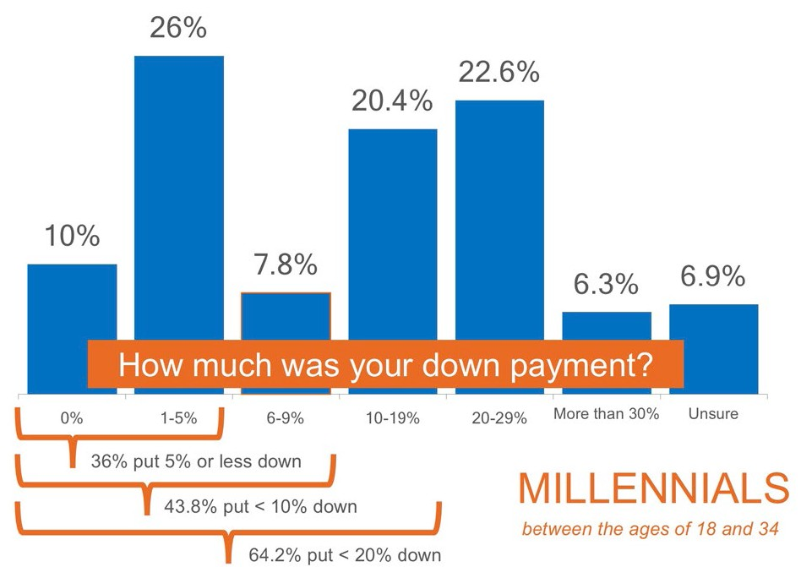
Myth 2:
You Need a 20% Down Payment to Buy a Home
Gone are the days of 20% down or no loan, but recent surveys reveal that many Americans are not aware that programs exist to put down less.
Fannie Mae’s article, “What Consumers (Don’t) Know About Mortgage Qualification Criteria,” revealed that “only 5 to 16 percent of respondents know the correct ranges for key mortgage qualification criteria.”
The survey results revealed that consumers often overestimate the down payment funds needed to qualify for a home loan; 76% of respondents either don’t know (40%) or are misinformed (36%) about the
minimum down payment
required.
Many believe that they need at least 20% down to buy their dream home, but many programs actually let buyers put down as little as 3%.
On the right are the results of a Digital Risk survey of Millennials who recently purchased homes.

Slide 13
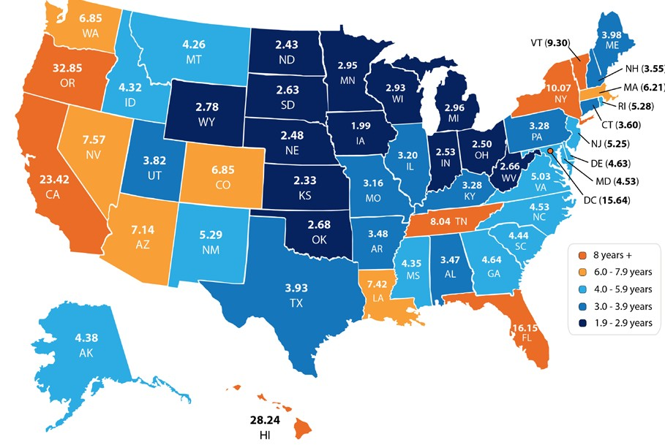
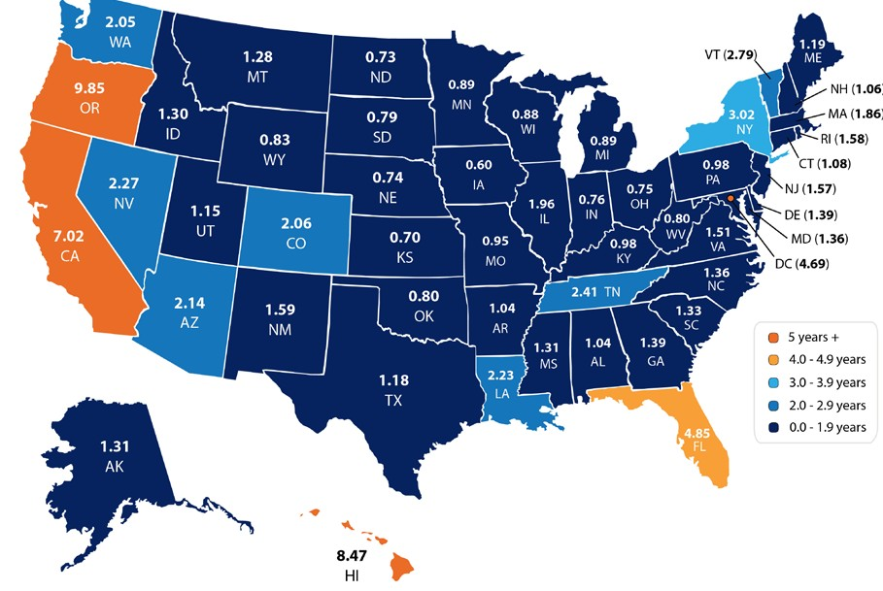
Since Millennials make up the largest share of first-time buyers, it should come as no surprise that 97% of this generation financed their home purchase, compared to 86% of all buyers.
What may come as a surprise to many who have not yet purchased, however, is that 16% of those who financed their home put 0% down!
61% of Millennials who purchased a home in 2017 put down 10% or less!
According to data from the last 12 months of Ellie Mae’s Millennial Tracker, the average down payment for a Millennial was 10%.
Your dream home could be within your reach much sooner than you ever thought if you only need to save up 3-10% instead of the 20% that you may have thought you needed!
Depending on where you live, median income, median rents and home prices all vary. So, we set out to find out how long would it take you to save for a down payment in each state?
By determining the percentage of income spent renting a 2-bedroom apartment in each state, and the amount needed for a 10% down payment, we were able to establish how long (in years) it would take for an average resident to save enough money to buy a home of their own.
On the right is a map created using the data for each state.
What if you only needed to save 3%?
What if you were able to take advantage of one of the Freddie Mac or Fannie Mae 3% down programs? Suddenly, saving for a down payment no longer takes 5 or 10 years, but becomes attainable in under two years in many states.
Shown on the map to the right.
Whether you have just started to save for a down payment, or have been saving for years, your dream home may be closer than you think!
10% Down
3% Down

Slide 14

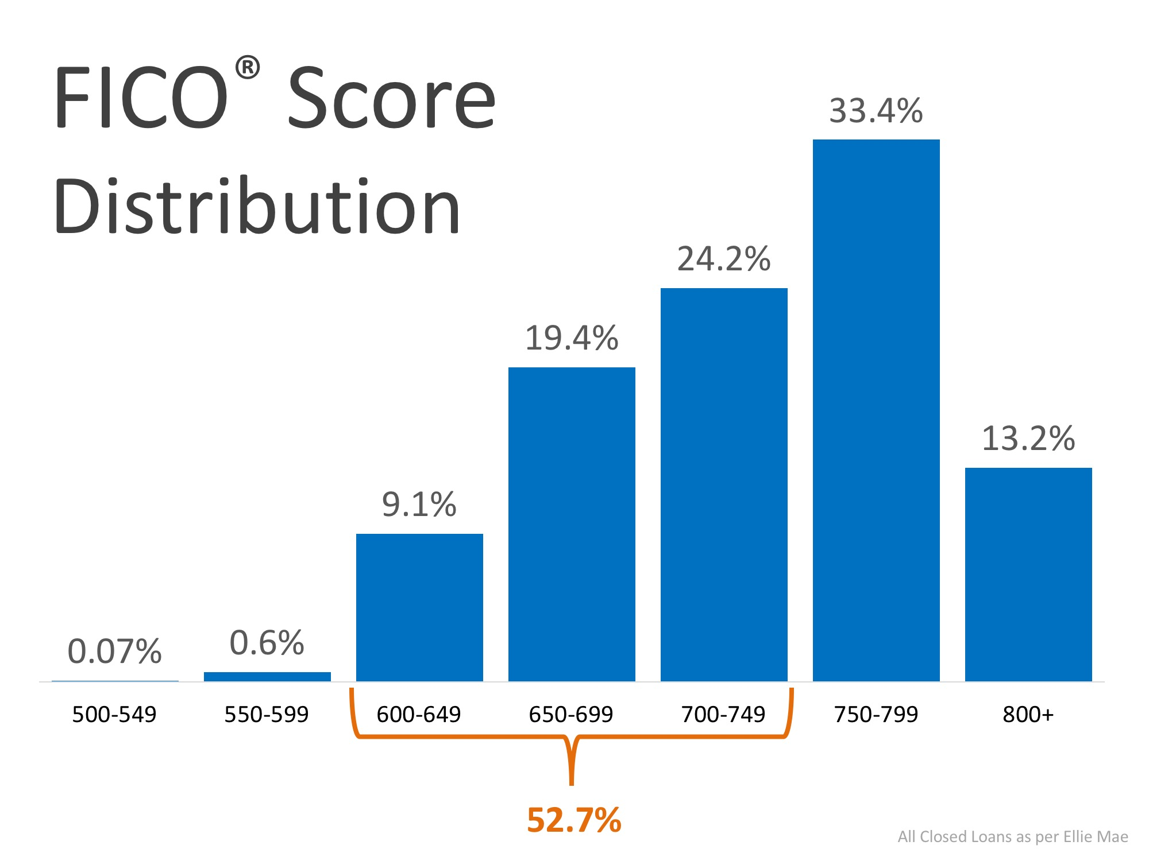
Myth 3:
You Need ‘Perfect Credit’ to Buy a Home
What is a credit score? According to Investopedia, “a credit score is a statistical number that depicts a person’s creditworthiness. Lenders use a credit score to evaluate the probability that a person repays their debts. Companies generate a credit score for each person with a Social Security number using data from the person’s previous credit history.
A credit score is a three-digit number ranging from 300 to 850, with 850 as the highest score that a borrower can achieve. The higher the score, the more financially trustworthy a person is considered to be.”
Fannie Mae’s survey also revealed that 59% of Americans either don’t know or are misinformed about what FICO® credit score is necessary to qualify. Many Americans believe a ‘good’ score is 780 or higher.
To help debunk this myth, let’s take a look at Ellie Mae’s latest Origination Insight Report, which focuses on recently closed (approved) loans. As you can see on the right, 52.7% of approved mortgages had a FICO® score between 600-749.
Over the last 12 months, the average FICO® Score for home purchases by Millennials was 723!
Don’t make the mistake of disqualifying yourself by thinking you need a 780 score.

Slide 15

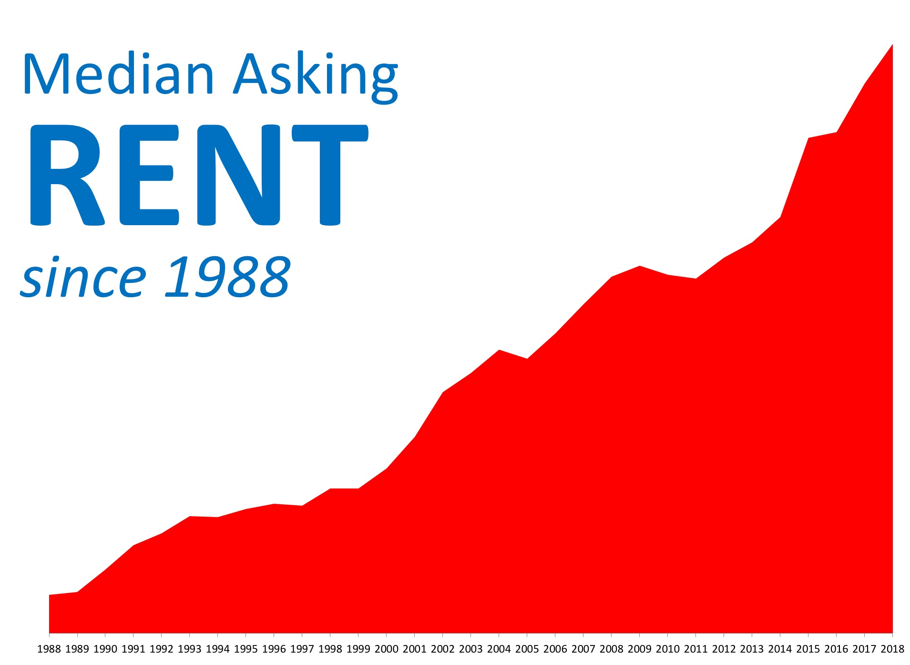
The Financial Benefits of Homeownership
According to a report by Trulia, “buying is cheaper than renting in 100 of the largest metro areas by an average of 37.4%.” That may have some thinking about buying a home instead of signing another lease extension, but does that make sense from a financial perspective?
In the report, Ralph McLaughlin, Trulia’s Chief Economist, explains:
“Owning a home is one of the most common ways households build long-term wealth, as it acts like a forced savings account. Instead of paying your landlord, you can pay yourself in the long run through paying down a mortgage on a house.”
The report listed five reasons why owning a home makes financial sense:
Mortgage payments can be fixed while rents go up.
Equity in your home can be a financial resource later.
You can build wealth without paying capital gains.
A mortgage can act as a forced savings account.
Overall, homeowners can enjoy greater wealth growth than renters.
Let’s expand more on #1 from this list: “mortgage payments can be fixed while rents go up.”
Don’t Get Caught in the Rental Trap
They say the only guarantees in life are death and taxes, but it seems like they should also add rent increases to that list.
A whopping $485.6 billion was spent on rents in the U.S. in 2017. This represents an increase
of over $17.7 billion from the year before. As shown in the chart on the right, rents have increased consistently over the last 20+ years.

Slide 16
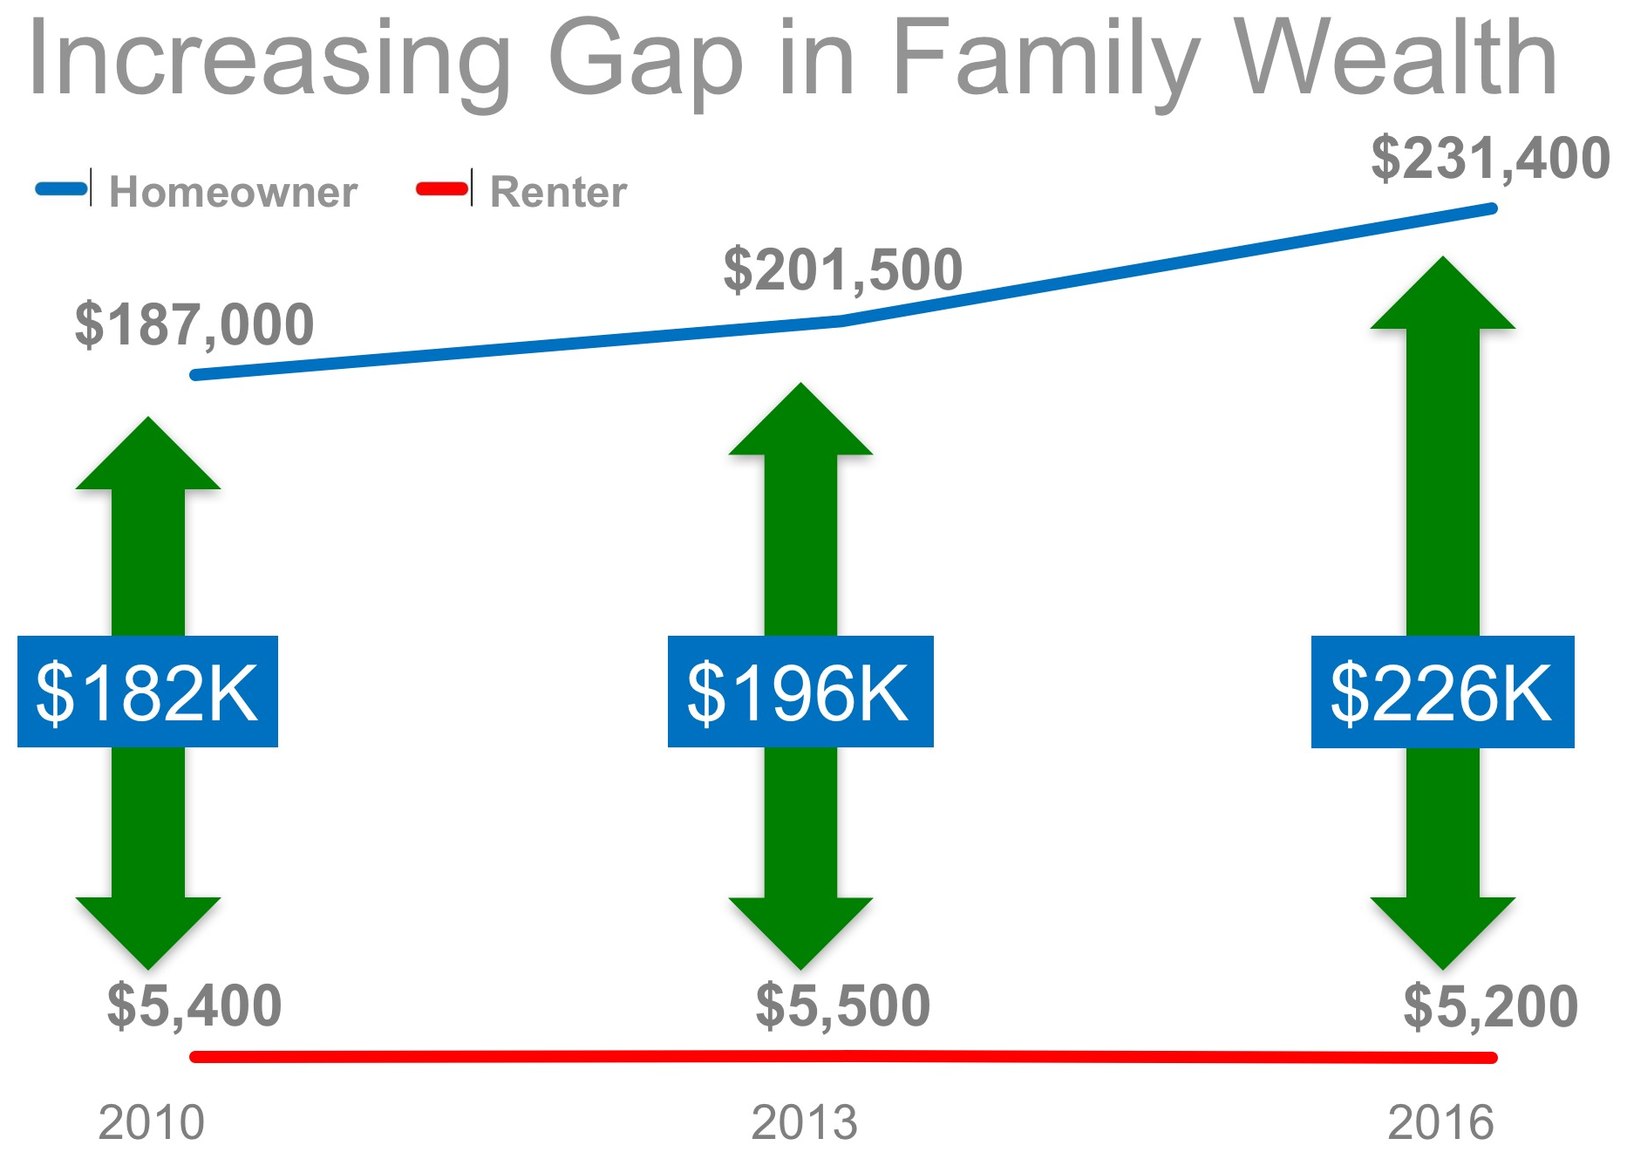
There are many benefits to homeownership. One of the top ones is being able to protect yourself from rising rents by locking in your housing cost for the life of your mortgage.
In an article by The Mortgage Reports, they report that “buying and owning a home is the essence of ‘The American Dream.’ Each month, your housing payments go toward owning your home instead of renting it; building your personal wealth and assets instead of someone else’s.
History has shown that homeownership is a clear path to wealth-building, with homeowners boasting a net worth [that is] multiples higher than the net worth of renters.”
That brings us to #5 from the list: “homeowners can enjoy greater wealth growth than renters.”
A Homeowner’s Net Worth is 45x Greater than a Renter
Every three years, the Federal Reserve conducts a Survey of Consumer Finances in which they collect data across all economic and social groups. The latest survey, which includes data from 2013-2016, reports that a homeowner’s net worth is 44.5 times greater than that of a renter ($231,400 vs. $5,200).
The graph on the right demonstrates the results of the last three Federal Reserve studies.
Put Your Housing Cost to Work for You
Homeownership is a form of ‘forced savings.’ Every time you pay your mortgage, you are contributing to your net worth. Every time you pay your rent, you are contributing to your landlord’s net worth.
The latest National Housing Pulse Survey from NAR reveals that 85% of consumers believe that purchasing a home is a good financial decision. Yun comments:
“Though there will always be discussion about whether to buy or rent, or whether the stock market offers a bigger return than real estate, the reality is that homeowners steadily build wealth. The simplest math should not be overlooked.”

Slide 17

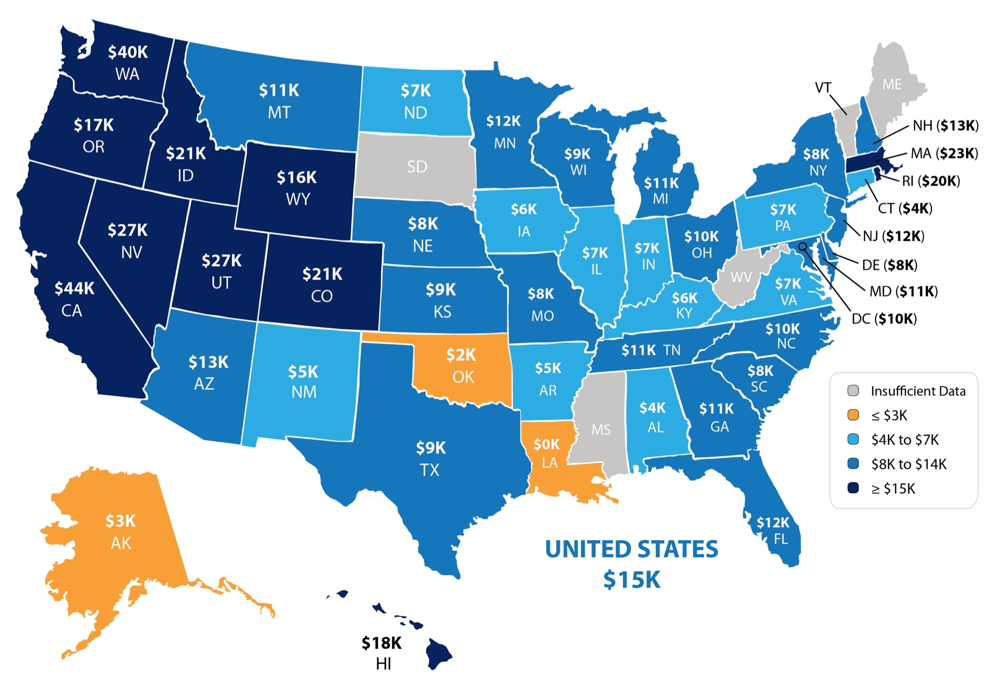
Your Home Is an Asset You Can Borrow Against in the Future
According to CoreLogic’s Equity Report, the average American household gained over $15,000 in equity over the course of the last year, largely due to home value increases.
The map below was created using the same report from CoreLogic and shows the average equity gain per mortgaged home over the last 12 months.
As we mentioned earlier, as you pay your mortgage, you build equity in your home. With prices rising, the value of your home
rises too, therefore building on the equity you have.
The equity built in your home can be borrowed against in the form of a home equity loan or home equity line of credit. Simply put, a home equity loan
is essentially a ‘second mortgage’ that uses your home as collateral as you borrow an exact amount of money.
As with any mortgage, if the loan is not paid off, the home could be sold to satisfy the remaining debt. One of the most attractive features of a home equity loan is that they come with low interest rates, allowing responsible homeowners to complete renovations, pay off high-interest credit cards, or consolidate other debts.
Many families chose to use the equity they have in their homes to put their children through college, invest in starting small businesses, pay off their mortgages sooner or move up to a home that better suits their needs.

Slide 18





Why Millennials Choose to Buy
According to NerdWallet’s Millennials & Homebuying Study, the top 5 reasons young renters choose to own are:
To Have Control over Their Living Space - 93%
1
Many Millennials who rent a home or apartment prior to buying their own homes, dream of the day that they will be able to paint the walls whatever color they'd like, or renovate an outdated part of their living space.
Many others who have waited to add a pet to their families daydream about the day that they’ll be able to go pick out their ‘furever’ friend. Owning your own home gives you the freedom to make those choices.
To Have a Sense of Privacy & Security - 90%
It is no surprise that having a place to call home, with all that means, in comfort and security, is the #2 reason. As a homeowner, you have control over who has access to your home, and you are able to secure it how you see fit.
To Live in a Nicer Home - 81%
Similar to the #1 reason, when you purchase a home, you can choose to live in a nicer home or choose to renovate a home & restore its glory. Owning also allows you to accommodate your growing family or a family member who may need to move in.
To Feel Engaged in Their Community - 75%
Owning a home in a community is one of the major reasons why residents become more civically involved. The stakes are raised once your home value is directly tied to the neighborhood and community in which you live.
To Have Flexibility in Future Decisions - 53%
As we mentioned earlier, owning a home allows you to use your monthly housing cost as a savings account that can be borrowed against in the future. Having this option available during uncertain times is just one of many reasons why homeowners feel more secure in their homes.
2
3
4
5
“The majority of millennials said they consider owning a home more sensible than renting for both financial and lifestyle reasons — including control of living space, flexibility in future decisions, privacy and security, and living in a nice home.”
NAR’s Generational Study found that 86% of Millennials believe homeownership is a good financial investment, with 45% believing it is a better investment than the stock market.

Slide 19


Tips for Preparing for Homeownership
Realtor.com shared '5 Habits to Start Now if you Hope to Buy a Home.' Below are the top three from their list with a brief description.
#1 - Automate Your Down Payment Savings
One way to jump start your down payment savings is to automate your checking account to automatically save a small amount of your paycheck into a separate savings account or ‘house fund’.
“Amassing enough for a down payment takes discipline & perseverance, but setting up automatic savings can make it easier. If you never see the cash, you won’t spend it.”
#2 - Build Your Credit History & Keep It Clean
When you go to apply for a mortgage, lenders will want to see that you have been able to pay off past debts. This means staying on top of your student loans, credit cards, and car loans and paying them on time! Credit bureaus recommend using no more than 30% of the credit available to you.
#3 - Practice Living on a Budget
Downsizing your spending now will allow you to save more for your down payment & pay down other debts to improve your credit score. A study by Bank of America showed that “95% of first- time buyers were willing to make sacrifices to buy their home faster.” The top 3 sacrifices cited by Millennials when saving for a home are: cutting back on new clothes, a new car, and travel.
Know Your Credit Score
Knowing your credit score and getting a recent copy of your credit report is one of the first steps that you can take toward knowing how ready you are to start the home buying process.
Make sure all the information listed on your report is accurate and work to correct any mistakes. The higher your credit score, the more likely you will be to receive a better interest rate for your mortgage, which will translate into more ‘home for your money.'
Here are some tips for improving your credit score:
Make payments, including rent, credit cards, and car loans, on time.
Keep your spending to no more than 30% of your limit on credit cards.
Pay down high-balance credit cards to lower balances, and consider balance transfers to free up credit.
Check for errors on your credit report and work toward fixing them.
Shop for mortgage rates within a 30-day period — too many spread-out inquiries can lower your score.
Work with a credit counselor or a lender to improve your score.

Slide 20

Show Sellers You Are Serious... Get Pre-Approved
In many markets across the country, the number of buyers searching for their dream homes greatly outnumbers the number of homes for sale. This has led to a competitive marketplace where buyers often need to stand out. One way to show you are serious about buying your dream home is to get pre-qualified or pre-approved for a mortgage before starting your search.
Even if you are in a market that is not as competitive, knowing your budget will give you the confidence of knowing if your dream home is within your reach.
Freddie Mac lays out the advantages of pre-approval in the 'My Home' section of their website:
“It’s highly recommended that you work with your lender to get pre-approved before you begin house hunting. Pre-approval will tell you how much home you can afford and can help you move faster, and with greater confidence, in competitive markets.”
One of the many advantages of working with a local real estate professional is that many have relationships with lenders who will be able to help you with this process. Once you have selected a lender, you will need to fill out their loan application and provide them with important information regarding “your credit, debt, work history, down payment and residential history.”
Freddie Mac describes the 4 Cs that help determine the amount you will be qualified to borrow:
Capacity: Your current and future ability to make your payments
Capital or cash reserves: The money, savings, and investments you have that can be sold quickly for cash
Collateral: The home, or type of home, that you would like to purchase
Credit: Your history of paying bills and other debts on time
Getting pre-approved is one of the key steps that will show home sellers that you are serious about buying, and it often helps speed up the process once your offer has
been accepted.
Ask Your Lender About Down Payment Assistance Programs
When you meet with your lender to become pre-approved, also ask them if there are any down payment assistance programs that you may qualify for. There are hundreds of different programs throughout the country.
Eligibility requirements vary depending on your location, and are generally limited to first-time and/ or low- and moderate-income homebuyers. Several programs specifically benefit veterans, Native Americans, and workers employed in education, health care, law enforcement, and firefighting.
The U.S. Department of Housing and Urban Development (HUD) gives grants to state and local organizations nationwide. These organizations, in turn, use these funds to help homeowners bridge the down payment gap.
Every little bit helps when accumulating the funds needed to get you into your dream home.

Slide 21

What to Look for in Your Real Estate Team
By now, you’re probably pretty pumped and really want to find your dream home. So how do you select the members of your team that are going to help you make that dream a reality?
What should you be looking for? How do you know if you’ve found the right agent or lender?
The most important characteristic that you should be looking for in your agent, is someone who is going to take the time to really educate you on your choices and your ability to buy in today’s market.
As Dave Ramsey, the financial guru, advises:
“When getting help with money, whether it’s insurance, real estate or investments, you should always look for someone with
the heart of a teacher, not the heart of a salesman.”
Do your research. Ask your friends and family for recommendations of professionals that they have used in the past and have had good experiences with.
Look for members of your team to be honest and trustworthy, after all, you will be trusting them with helping you make one of the biggest financial decisions of your life.
Whether this is your first or fifth time buying a home, you want to make sure that you have an agent who is going to have the tough conversations with you, too, not just the easy ones. If your offer isn’t accepted by the seller, or they think that there may be something wrong with the home that you’ve fallen in love with, you would rather know what they think than make a costly mistake.
According to a Consumer Housing Trends Study, Millennials have already started to prefer a more hands-on approach to their real estate experience:
“While older generations rely on real estate agents for information and expertise, Millennials expect real estate agents to become trusted advisers and strategic partners.”

Slide 22

Look for someone to invest in your family’s future with you. You want an agent that isn’t focused on the transaction but is instead focused on helping you understand the process while helping you find your dream home.
In this world of Google searches, where it seems like all of the answers are just a mouse-click away, you need an agent who is going to educate you and share the information that you need to know before you even know you need it.
Happy House Hunting!
Now that you know what is required to own a home in today’s market, as well as what to look for in your real estate team, are you ready to own your own home?
In many areas of the country, owning a home is still significantly less expensive than renting and could actually save you money every month. Real estate is hyperlocal. Having an agent on your team who is an expert in your area will ensure that you get the best advice and are educated on the opportunities available to you now.

Slide 23




CONTACT ME TO TALK MORE
I’m sure you have questions and concerns about buying a home.
I would love to talk with you about what you read here, as well as help you on the path to buying your new home. My contact information is below. I look forward to hearing from you!
YOUR NAME
Title
Company
City, State
Email Address
Website
(000) 000-0000
Equal Housing Opportunity

