Slide 1
BUYING A HOME
THINGS TO CONSIDER WHEN
SUMMER 2021
EDITION

Slide 2
TABLE OF CONTENTS
3
Buying a Home This Summer
Expert Insights for Homebuyers
Patience Is Key in a Competitive Market
3 Reasons We Aren’t in a Housing Bubble
Why Listing Prices Are Like an Auction’s Reserve Price
Owning a Home Is Still More Affordable Than Renting One
Key Terms to Know in the Homebuying Process
The Path to Homeownership
Do I Really Need a 20% Down Payment?
Things to Avoid after Applying for a Mortgage
5 Tips for Making a Successful Offer
Reasons to Hire a Real Estate Professional
5
6
7
9
11
12
13
14
16
17
19
2

Slide 3
Buying a Home This Summer
The weather isn’t the only thing that’s going to be hot this summer – the housing market will be as well. Not only has residential real estate made a full recovery from last year, but households that delayed their plans during the height of the health crisis are ready to regroup. If you’re thinking of buying a home, this summer may be your moment. Here’s a dive into some of the biggest wins for homebuyers this season.
1. Mortgage Rates Are Still Low
Last year, we saw the lowest mortgage rates in recorded history as they fell below 3% for the first time ever. This season, they’re inching up slightly, but are still incredibly low compared to the historic norm. According to Freddie Mac:
“We forecast that mortgage rates will continue to rise through the end of next year. We estimate the 30-year fixed mortgage rate will average 3.4% in the fourth quarter of 2021, rising to 3.8% in the fourth quarter of 2022.”
Today’s low mortgage rates are creating a great opportunity for buyers, but it’s unlikely they’ll last much longer. Buying this summer is the best way to secure a home with an impressively low rate.
2. Buying Is More Affordable Than Renting
With today’s low mortgage rates leading the way, buyer purchasing power is strong. According to Mike Loftin, author of Homeownership Is Affordable Housing from the Urban Institute:
“Contrary to popular belief, owning one’s own home is frequently more affordable than renting. It is cheaper to buy a home than it is to rent in 2/3 of American counties.”
Buying a home now instead of renting one may be the game-changer that amplifies long-term savings for renters who are ready to become homeowners. When paying a mortgage as opposed to paying rent, that money is reinvested back in your favor, so you’re contributing to your own net worth when you own a home. This is a term called equity, and it’s one of the biggest financial benefits of homeownership.
3
Notes:
http://www.freddiemac.com/research/forecast/20210414_quarterly_economic_forecast.page?
https://www.urban.org/sites/default/files/publication/104214/homeownership-is-affordable-housing_0.pdf

Slide 4
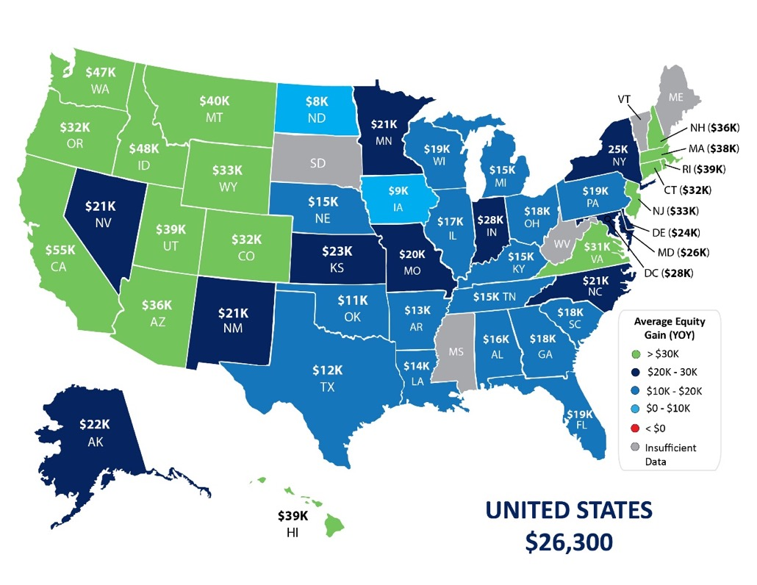
3. Equity Is Growing
The latest Homeowner Equity Report from CoreLogic notes that the average homeowner gained $26,300 in equity over the past year. With equity growing so significantly, you can feel confident that homeownership is a sound investment in your future.
4. Home Prices Are Appreciating
According to many leading experts, home prices are expected to appreciate through 2022. When home values rise, it’s another factor that increases your equity. According to the same report:
“As competition for the dwindling supply of for-sale homes drove prices up, average annual homeowner equity gains in the fourth quarter of 2020 reached the highest level since 2013. For current owners, these gains have created a buffer against financial difficulties brought on by the pandemic.”
Knowing home values are increasing while mortgage rates are so low should help you feel confident that buying a home this year is advantageous from a price perspective and as a strong long-term investment.
Bottom Line
If you’re considering buying a home, this may be your moment, especially with today’s low mortgage rates. Let’s connect to discuss your changing needs and set you up for success in the homebuying process.
Homeowner Equity Gains over the Last Year
CoreLogic
4
Notes:
https://www.corelogic.com/insights/homeowner-equity-report.aspx

Slide 5
Expert Insights for Homebuyers
Here’s a look at what several industry leaders have to say about what homebuyers can expect from the housing market this summer and into next year.
Lawrence Yun, Chief Economist at NAR
"As mortgage rates increase, the frenzied multiple-offer situation will become less prevalent by year's end.”
Greg McBride, Chief Financial Analyst at Bankrate
“There’s no reason to procrastinate, so long as you expect to remain in your home more than a few years so that you can break even on the closing costs… Keep in mind: If someone offered today’s rates to you this time last year, you would have jumped all over it.”
Danielle Hale, Chief Economist at realtor.com
“Surveys showed that seller confidence continued to rise… Extra confidence plus our recent survey finding that more homeowners than normal are planning to list their homes for sale in the next 12 months suggest that while we may not see an end to the sellers’ market, we might see the intensity of the competition diminish as buyers have more options to choose from.”
Bottom Line
The experts are very optimistic about the housing market right now. If you pressed pause on your real estate plans last year, let’s chat to determine how you can re-engage in the homebuying process this summer.
5
Notes:
https://www.bankrate.com/mortgages/mortgage-rate-forecast-for-june-2021/
https://www.nar.realtor/newsroom/consumer-spending-will-propel-2021-economic-growth-says-nar-chief-economist
https://www.realtor.com/research/weekly-housing-trends-view-data-week-may-8-2021/

Slide 6
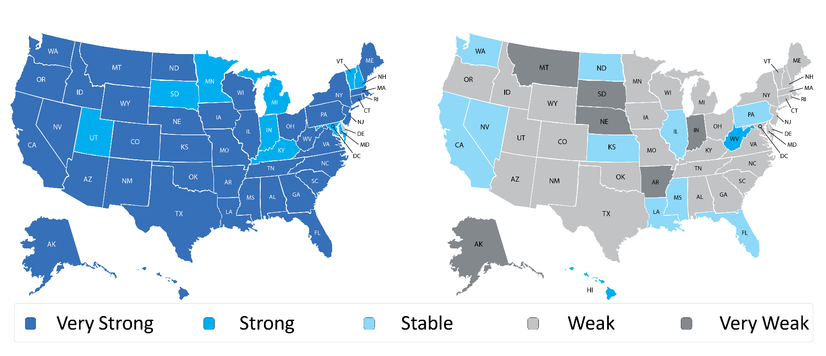
Patience Is Key in a Competitive Market
According to the Realtors Confidence Index Survey from the National Association of Realtors (NAR), buyer demand across the country is incredibly strong. That’s not the case, however, on the supply side. Seller traffic is simply not keeping up, making it challenging in many areas for buyers to find homes to purchase. Here’s a breakdown by state:
Buyer Traffic Index
Seller Traffic Index
NAR
NAR also reports that the actual number of homes for sale stands at 1.16 million units. Unsold inventory sits at a 2.4-months’ supply at the current sales pace. In a normal market, that number would be 6.0 months of inventory – significantly higher than it is today.
What does this mean for you?
If you’re ready to buy and you’re having trouble finding a home, remain patient in the search process. At the same time, be ready to act immediately once you find the right home since bidding wars are more common when few houses are up for sale.
Bottom Line
Let’s connect so you have an expert guide to help you balance patience and persistence in the homebuying process.
6
Notes:
https://www.nar.realtor/research-and-statistics/research-reports/realtors-confidence-index
https://www.nar.realtor/research-and-statistics/housing-statistics/existing-home-sales

Slide 7
3 Reasons We Aren’t in a Housing Bubble
Home values appreciated by over ten percent in 2020, and they’re forecast to continue rising this year. This has some voicing concerns that we may be in another housing bubble like the one we experienced a little over a decade ago. Here are three reasons why that’s not the case and the market is completely different today.
1. This time, housing supply is extremely limited.
The price of any item is determined by supply and demand. If supply is high and demand is low, prices normally decrease. If supply is low and demand is high, prices naturally increase.
In real estate, this balance is measured in months’ supply of inventory, which is based on the number of current homes for sale compared to the number of buyers in the market. The normal months’ supply of inventory for the market is about six months. Anything above that defines a buyers’ market, indicating prices will soften. Anything below that means it’s a sellers’ market in which prices normally appreciate.
Between 2006 and 2008, the months’ supply of inventory increased from just over five months to 11 months. The months’ supply was over seven months in 27 of those 36 months, yet home values continued to rise. Months’ inventory currently stands at 2.4 months – near historic lows. Remember, if supply is low and demand is high, prices naturally increase.
2. This time, housing demand is real.
During the housing boom in the mid-2000s, there was what Robert Schiller, a fellow at the Yale School of Management's International Center for Finance, called irrational exuberance. The definition of the term is, “unfounded market optimism that lacks a real foundation of fundamental valuation, but instead rests on psychological factors.” Without considering historical market trends, people got caught up in the frenzy and bought houses based on an unrealistic belief that housing values would continue to escalate.
The mortgage industry fed into this craziness by making mortgage money available to just about anyone, as shown in the Mortgage Credit Availability Index (MCAI) published by the Mortgage Bankers Association. The higher the index, the easier it is to get a mortgage; the lower the index, the more difficult it is to obtain one. Prior to the housing boom, the index stood just below 400. In 2006, the index hit an all-time high of over 868, meaning nearly everyone could qualify for a mortgage. Today, the index stands at 128.1, which is well below even the pre-boom level.
7
Notes:
https://www.nar.realtor/research-and-statistics/housing-statistics/existing-home-sales
https://www.investopedia.com/terms/i/irrationalexuberance.asp#:~:text=Irrational%20exuberance%20is%20unfounded%20market,bubble%20in%20the%20stock%20market.
https://www.mba.org/news-research-and-resources/research-and-economics/single-family-research/mortgage-credit-availability-index

Slide 8
In the current real estate market, demand is real, not fabricated. Millennials, the largest generation in the country, have come of age to marry and have children, which are two major drivers for homeownership. The health crisis also challenged every household to redefine the meaning of home and re-evaluate whether their current home met that new definition. This desire to own, coupled with historically low mortgage rates, makes purchasing a home today a strong, sound financial decision. Therefore, today’s demand is very real. Remember, if supply is low and demand is high, prices naturally increase.
3. This time, households have plenty of equity.
Again, during the housing boom, it wasn’t just purchasers who got caught up in the frenzy. Existing homeowners started using their homes like ATMs. There was a wave of cash-out refinances, which enabled homeowners to leverage the equity in their homes. From 2005 through 2007, Americans pulled out $824 billion in equity. That left many homeowners with little or no equity in their homes at a critical time. As prices began to drop, some homeowners found themselves in a negative equity situation where their mortgage was higher than the value of their home. Many defaulted on their payments, which led to an avalanche of foreclosures.
Today, the banks and the American people have shown they learned a valuable lesson from the housing crisis. Cash-out refinance volume over the last three years was less than a third of what it was compared to the 3 years leading up to the crash.
This approach has created levels of equity never seen before. According to the U.S. Census Bureau, over 38% of owner-occupied housing units are owned ‘free and clear’ (without any mortgage). In addition, the ATTOM Data Solutions first quarter 2021 U.S. Home Equity Report reveals:
“17.8 million residential properties in the United States were considered equity-rich, meaning that the combined estimated amount of loans secured by those properties was 50 percent or less of their estimated market value… The count of equity-rich properties in the first quarter of 2021 represented 31.9 percent, or about one in three, of the 55.8 million mortgaged homes in the United States.”
If we combine the 38% of homes that are owned free and clear with the 19.8% of all homes that have at least 50% equity (31.9% of the remaining 62% with a mortgage), we see that 57.8% of all homes in this country have a minimum of 50% equity. That’s significantly better than the equity situation in 2008.
Bottom Line
This time, housing supply is drastically lower. Demand is real and rightly motivated. Even if prices were to drop, homeowners have enough equity to be able to weather a dip in home values. This is nothing like 2008. In fact, it’s the exact opposite.
8
Notes:
http://www.freddiemac.com/research/datasets/refinance-stats/index.page
https://constructioncoverage.com/research/where-residents-have-paid-off-homes
https://www.attomdata.com/news/market-trends/home-sales-prices/attom-data-solutions-q1-2021-u-s-home-equity-underwater-report

Slide 9
Why Listing Prices Are Like an Auction’s Reserve Price
For generations, the homebuying process never really changed. The seller would try to estimate the market value of the home and tack on a little extra to give themselves some negotiating room. That figure would become the listing price of the house. Buyers would then try to determine how much less than the full price they could offer and still get the home. The asking price was generally the ceiling of the negotiation. The actual sales price would almost always be somewhat lower than the list price. It was unthinkable to pay more than what the seller was asking.
Today is different.
The record-low supply of homes for sale coupled with very strong buyer demand is leading to a rise in bidding wars on many homes. Because of this, homes today often sell for more than the list price. In some cases, they sell for a lot more.
According to Lawrence Yun, Chief Economist at The National Association of Realtors (NAR):
“For every listing there are 5.1 offers. Half of the homes are being sold above list price.”
9
Notes:
https://www.cnbc.com/2021/05/21/april-existing-home-sales-drop-marking-three-straight-months-of-declines.html

Slide 10
You may need to change the way you look at the asking price of a home.
In this market, you likely can’t shop for a home with the former mentality of refusing to pay full price or more for a house.
Due to the low supply of houses for sale, many homes are now being offered in an auction-like atmosphere in which the highest bidder wins the home. In an actual auction, the seller of an item agrees to take the highest bid, and many sellers set a reserve price on the item they’re selling. A reserve price is the minimum amount a seller will accept as the winning bid.
When navigating a competitive housing market, think of the list price of the house as the reserve price at an auction. It’s the minimum the seller will accept in many cases. Today, the asking price is often becoming the floor of the negotiation rather than the ceiling. Therefore, if you really love a home, know that it may ultimately sell for more than the sellers are asking. So, as you’re navigating the homebuying process, make sure you know your budget, know what you can afford, and work with a trusted advisor who can help you make all the right moves as you buy a home.
Bottom Line
Someone who’s more familiar with the housing market of the past than that of today may think offering more for a home than the listing price is foolish. However, frequent and competitive bidding wars are creating an auction-like atmosphere in many real estate transactions. Let’s connect so you have a trusted real estate professional on your side to provide the best advice on how to make a competitive offer on a home.
10

Slide 11
Owning a Home Is Still More Affordable
Than Renting One
If the pandemic and the changes we’ve faced recently have made you seriously think about buying a home instead of renting one, you’re not alone. You may, however, be wondering if the dollars and cents add up in your favor as home prices continue to rise. According to the experts, in many cases, it’s still more affordable to buy a home than to rent one. Here’s why this is the case today.
ATTOM Data Solutions released the Q1 2021 Rental Affordability Report, which states:
“Median home prices of single-family homes and condos in the first quarter of this year were more affordable than historical averages in 52 percent of counties with enough data to analyze.”
How is this possible?
The answer: historically-low mortgage interest rates. ATTOM Data Solutions explains:
“Rising wages and falling mortgage rates still compensated for near-20 percent spikes in home prices over the past year, helping to keep median home prices affordable for average wage earners around the country.”
These low rates are a big factor in driving affordability. The report also notes:
“With workplace pay rising and home mortgage rates continuing to hit historic lows, major expenses on a median-priced home nationwide still consumed just 23.7 percent of the average wage across the country in the first quarter of 2021… It remained well within the 28 percent standard lenders prefer for how much homeowners should spend on those major expenses.”
Bottom Line
If you’re considering buying a home this year, let’s chat today to discuss the options that match your budget while it’s still such a good time to buy.
11
Notes:
https://www.attomdata.com/news/market-trends/home-sales-prices/attom-data-solutions-q1-2021-u-s-home-affordability-report/

Slide 12
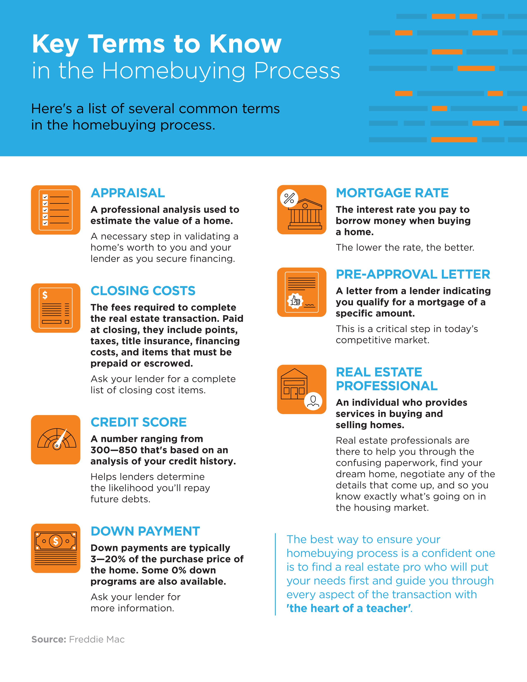
12

Slide 13
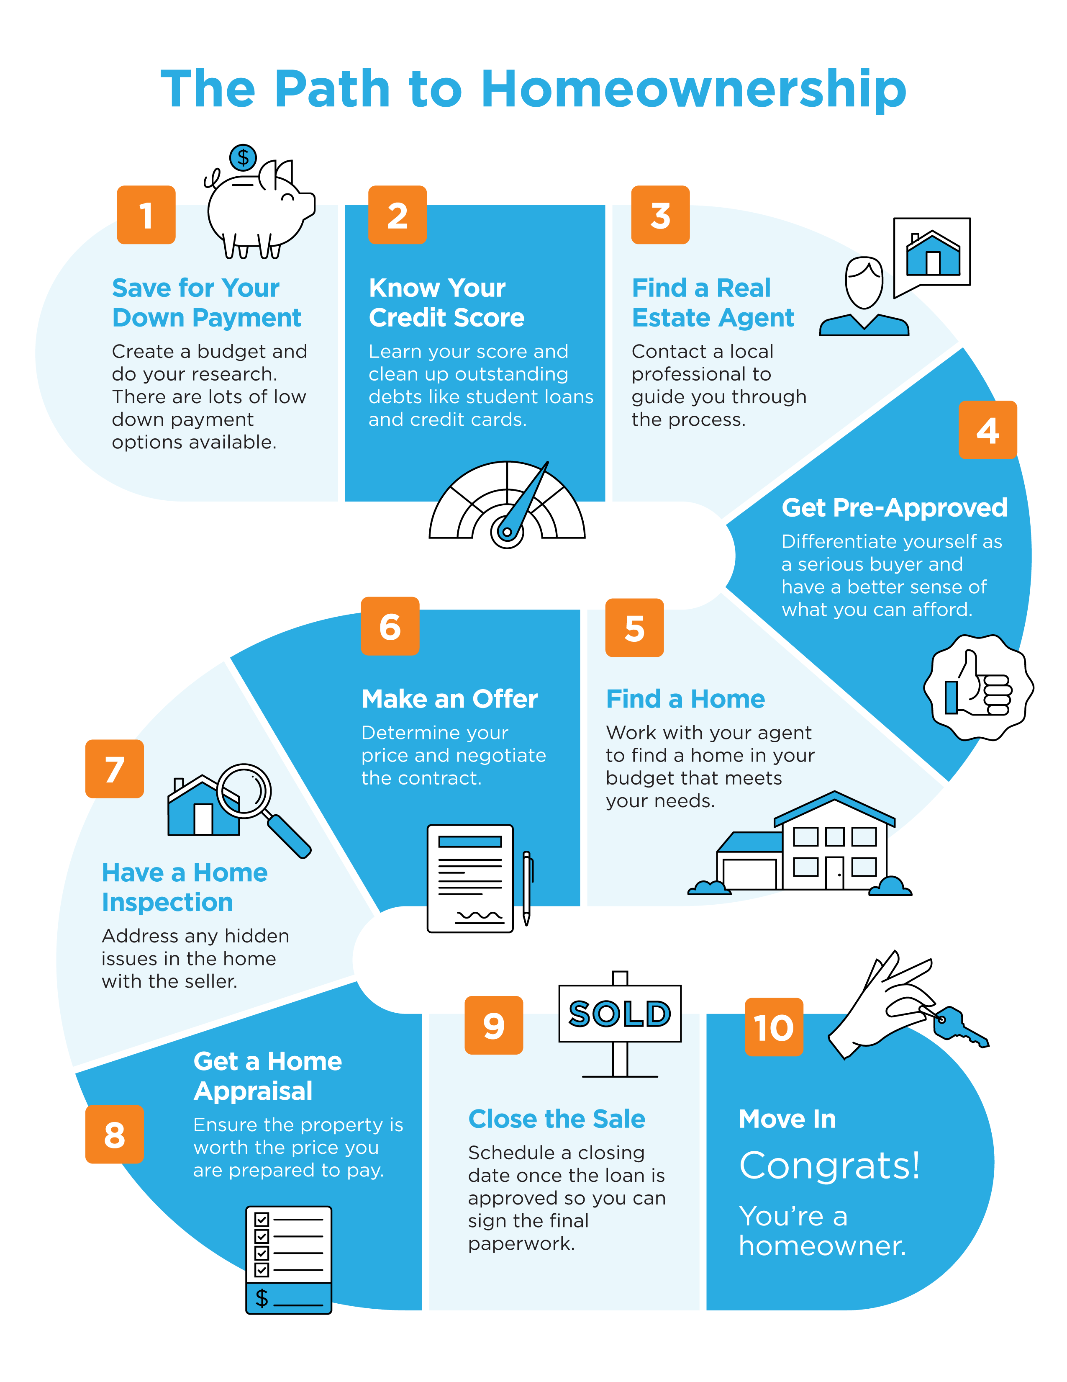
13

Slide 14
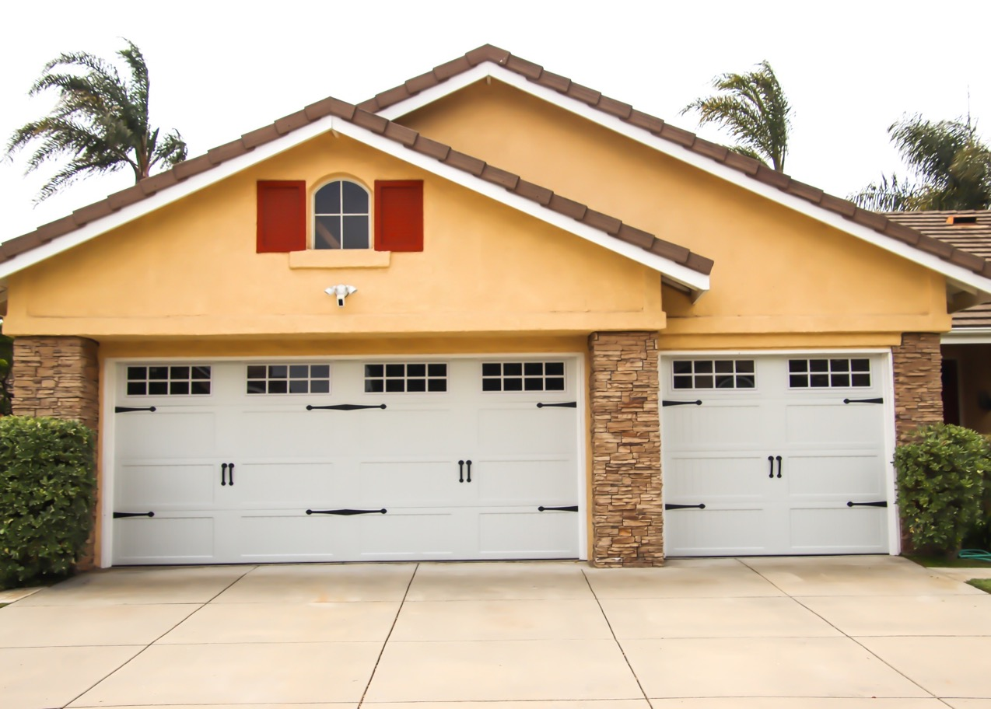
Do I Really Need a 20% Down Payment?
Is the idea of saving for a down payment holding you back from buying a home right now? You may be eager to take advantage of today’s low mortgage rates, but the thought of providing a large down payment might make you want to pump the brakes. Today, there’s still a common myth that you need to come up with 20% of the total sale price for your down payment. This means people who could buy a home may be putting their plans on hold because they don’t have that much in the bank yet. The reality is – whether it’s your first home or you’ve purchased one before – you most likely don’t need a 20% down payment. Here’s why.
According to Freddie Mac:
“The most damaging down payment myth—since it stops the homebuying process before it can start—is the belief that 20% is necessary.”
If saving that much money sounds daunting, potential homebuyers might give up on the dream of homeownership before they even begin – but they don’t have to.
The 2020 Profile of Home Buyers and Sellers from the National Association of Realtors (NAR) notes how the median down payment hasn’t been over 20% since 2005, and even then, that was only for repeat buyers, not first-time homebuyers.
14
Notes:
https://sf.freddiemac.com/articles/insights/down-payments-helping-future-borrowers-bridge-the-awareness-gap
https://www.nar.realtor/research-and-statistics/research-reports/highlights-from-the-profile-of-home-buyers-and-sellers

Slide 15
As the image below shows, today’s median down payment is clearly less than 20%.
What does this mean for potential homebuyers?
If you’re a first-time buyer and putting down 7% still seems high, understand that there are programs allowing qualified buyers to purchase a home with a down payment as low as 3.5%. There are even options like VA loans and USDA loans with no down payment requirements for qualified applicants.
It’s important for potential homebuyers to know they likely don’t need a 20% down payment, but they do need to do their homework to understand the options available. When you’re interested in learning more about down payment assistance programs, information is available through sites like downpaymentresource.com. Be sure to also work with trusted professionals from the start to learn what you may qualify for in the homebuying process.
Bottom Line
Don’t let down payment myths keep you from hitting your homeownership goals. If you’re hoping to buy a home this year, let’s connect to review your options.
Today’s Median Down Payment Is Less Than 20%
Common Misconception: 20%
NAR
15
Notes:
https://www.nar.realtor/research-and-statistics/research-reports/highlights-from-the-profile-of-home-buyers-and-sellers
https://www.hud.gov/buying/loans
https://www.benefits.va.gov/homeloans/index.asp
https://www.rd.usda.gov/newsroom/news-release/usda-rural-home-loans-offer-100-financing-and-no-down-payment
https://downpaymentresource.com/

Slide 16
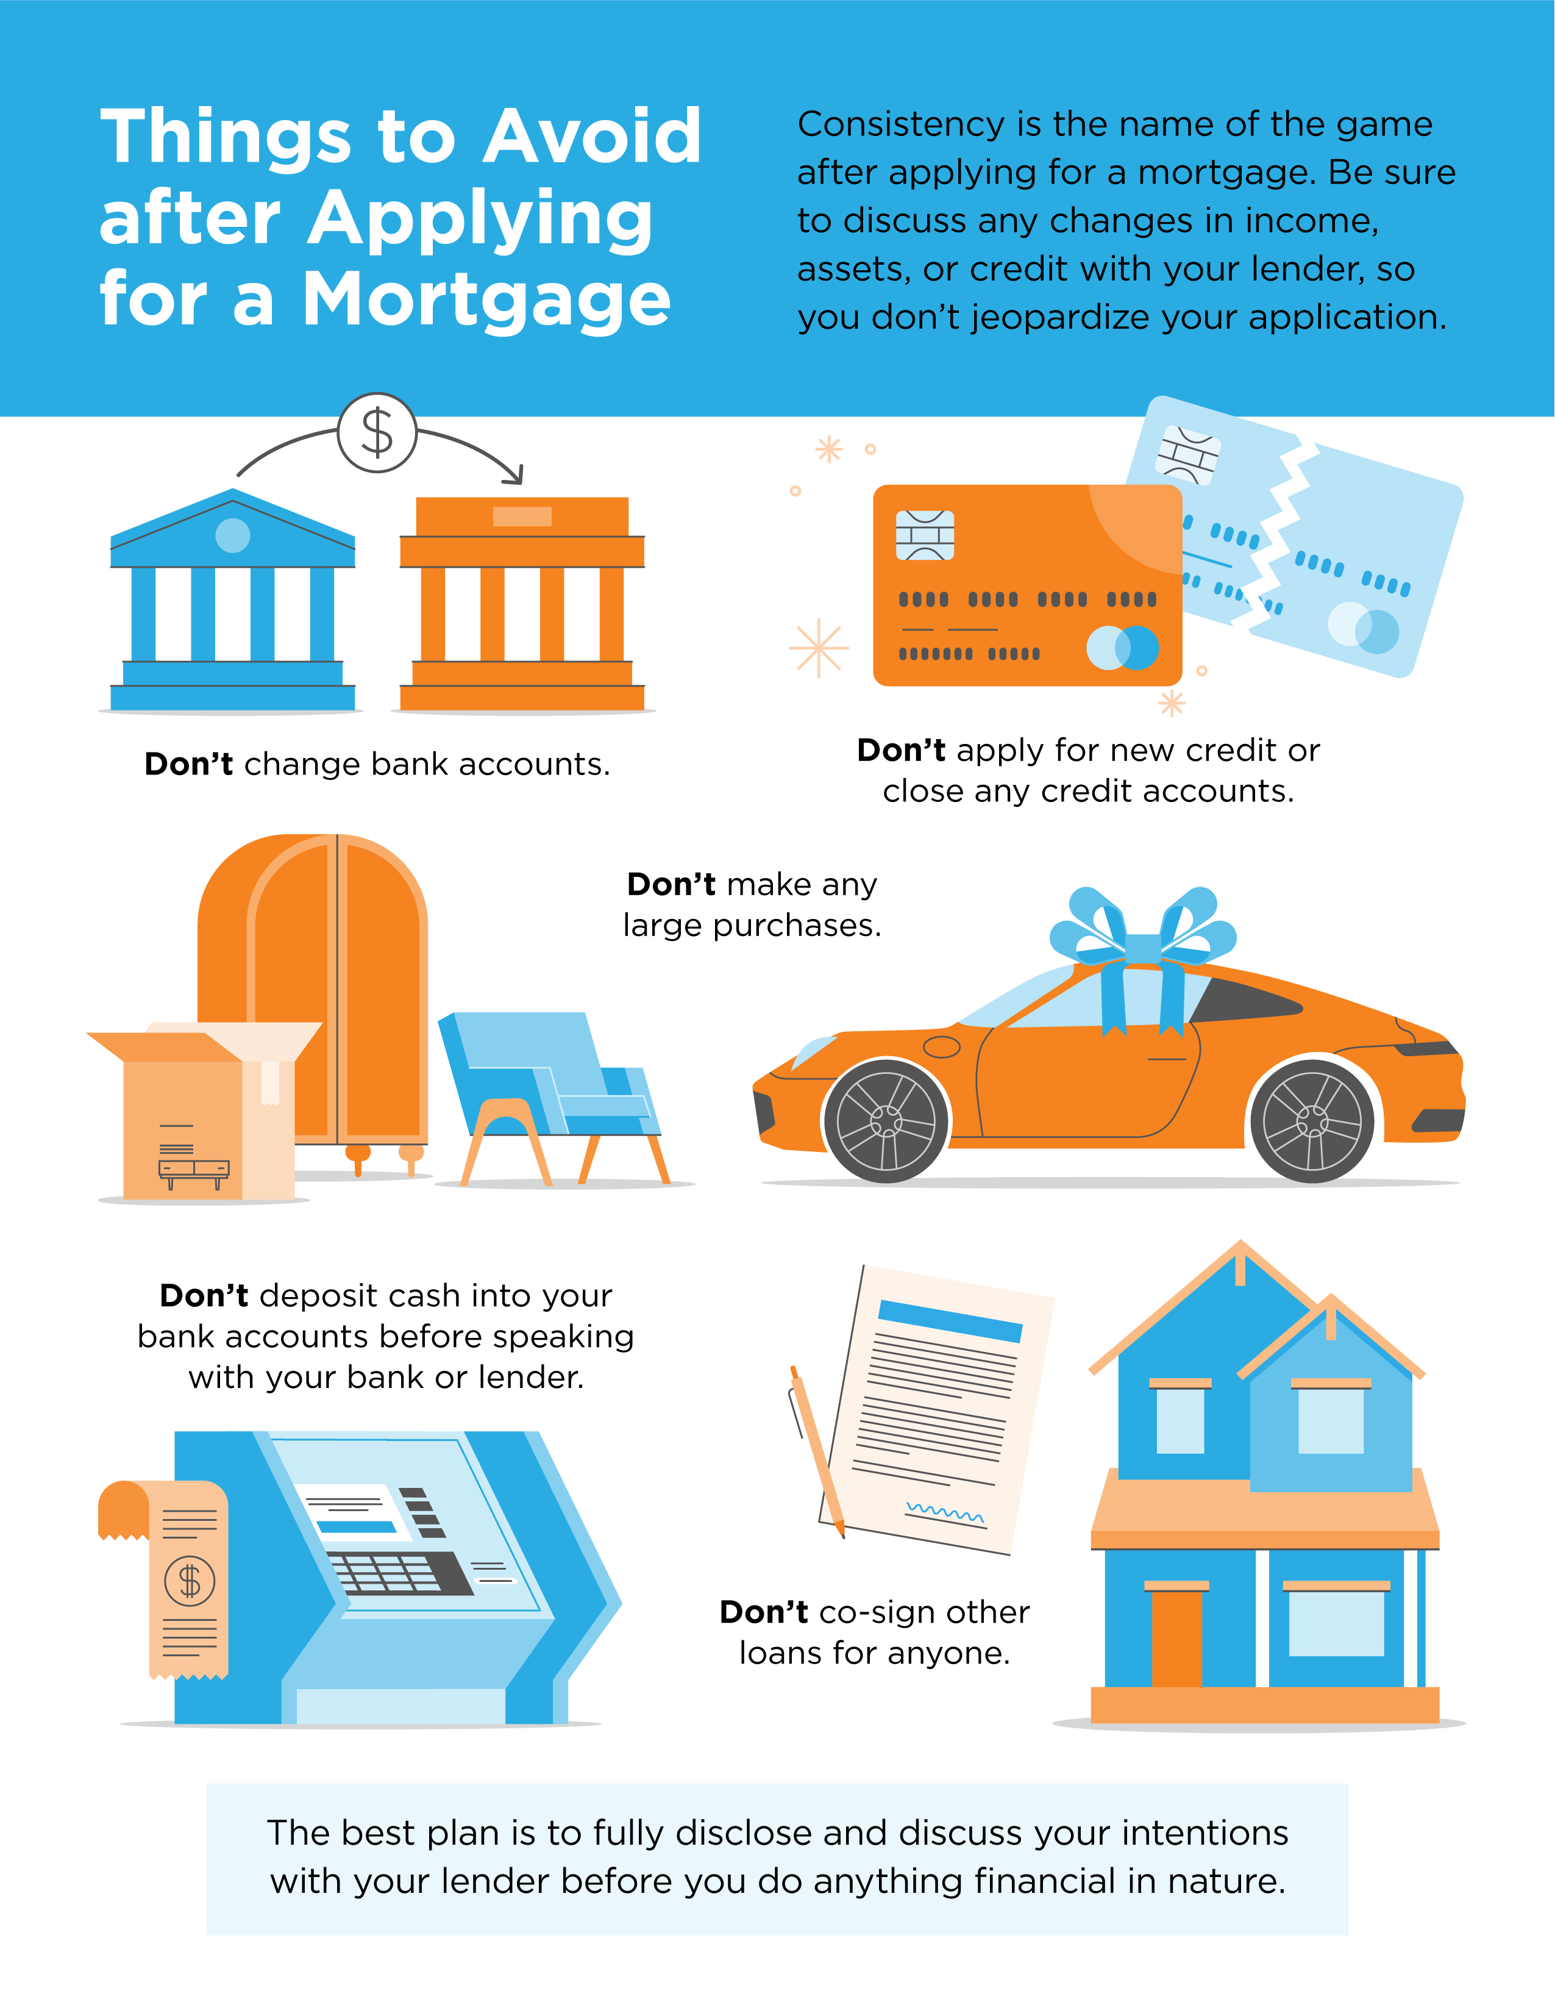
16

Slide 17
5 Tips for Making a Successful Offer
Today’s real estate market clearly has high homebuyer interest and low housing inventory. With so many buyers competing for a limited number of houses for sale, it’s more important than ever to know the ins and outs of making a confident and competitive offer. Here are five keys to success for this important stage in the homebuying process.
1. Listen to Your Real Estate Advisor
An article from Freddie Mac offers guidance on making an offer on a home today. Right off the bat, it points out how emotional this can be for buyers and why your trusted agent can help you stay focused on the most important things:
“Remember to let your homebuying team guide you on your journey, not your emotions. Their support and expertise will keep you from compromising on your must-haves and future financial stability.”
Your real estate professional should be your primary source for answers to the questions you have when you’re ready to make an offer.
2. Understand Your Finances
Having a complete understanding of your budget and how much house you can afford is essential. The best way to know this is to get pre-approved for a loan early in the homebuying process. Be sure to take this step so you stand out from the crowd. It shows sellers you’re a serious and qualified buyer and can give you a competitive edge if you enter a bidding war.
17
Notes:
http://www.freddiemac.com/blog/homeownership/20201019_5_rules_for_making_an_offer_on_a_home.page

Slide 18
3. Be Ready to Move Quickly
According to the Realtors Confidence Index, published monthly by the National Association of Realtors (NAR), the average property sale today receives five offers and is on the market for just a few weeks. These are both results of today’s competitive market, showing how important it is to stay agile and vigilant in your search. As soon as you find the right home for your needs, be prepared to submit an offer as quickly as possible.
4. Make a Fair Offer
It’s only natural to want the best deal you can get on a home. However, Freddie Mac also warns that submitting an offer that’s too low can lead sellers to doubt how serious you are as a buyer. Don’t submit an offer that will be tossed out as soon as it’s received. The expertise your agent brings to this part of the process will help you stay competitive:
“Your agent will work with you to make an informed offer based on the market value of the home, the condition of the home and recent home sale prices in the area.”
5. Be a Flexible Negotiator
After submitting an offer, the seller may accept it, reject it, or counter it with their own changes. In a competitive market, it’s important to stay nimble throughout the negotiation process. You can strengthen your position with an offer that includes flexible move-in dates, a higher price, or minimal contingencies (conditions you set that the seller must meet for the purchase to be finalized). Freddie Mac explains that there are, however, certain contingencies you don’t want to forego:
“Resist the temptation to waive the inspection contingency, especially in a hot market or if the home is being sold ‘as-is’, which means the seller won’t pay for repairs. Without an inspection contingency, you could be stuck with a contract on a house you can’t afford to fix.”
Bottom Line
Today’s competitive landscape makes it more important than ever to make a strong offer on a home. Let’s connect to make sure you rise to the top along the way.
18
Notes:
https://www.nar.realtor/research-and-statistics/research-reports/realtors-confidence-index
http://www.freddiemac.com/blog/homeownership/20201019_5_rules_for_making_an_offer_on_a_home.page

Slide 19
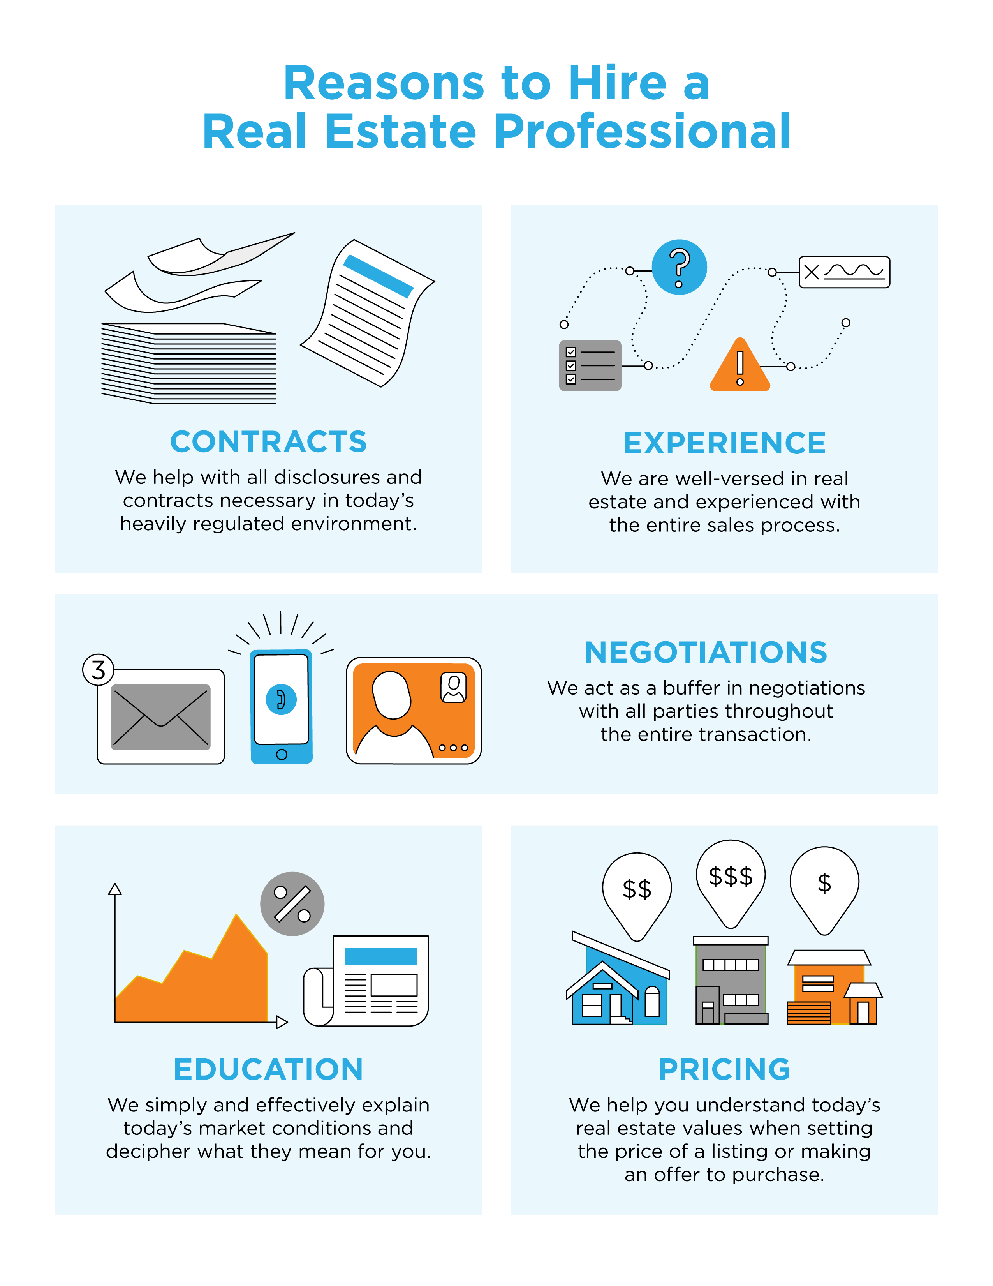
19

Slide 20
CONTACT ME TO TALK MORE
I’m sure you have questions and concerns about the real estate process.
I’d love to talk with you about what you read here and help you on the path to buying your new home. My contact information is below, and I look forward to working with you.
YOUR NAME
Title
Company
City, State Email Address
Website (000) 000-0000
Equal Housing Opportunity

