Slide 1


Working With Today’s Sellers
RMS Career Development Training 2018

Slide 2
Seller… a definition
“A Seller is someone who is sufficiently motivated to go through the challenges of marketing and selling their home in order to make a move.”
  “A Seller must me motivated to move in order to minimize the challenges.”

Slide 3

National Association of REALTORS
2018 Profile of Home Buyers and Sellers

Slide 4
Home Sellers &
Their Selling Experience
Most Common Reasons for Selling
  Home was too small (15%)
  Desire to move closer to friends/family (14%)
  Job Relocation (13%)
  Downsizing
Sellers typically lived in their home for 9 years
91% of Sellers worked with a Real Estate Agent
Recently Sold homes were on the market for a median of three weeks

Slide 5
Home Selling &
Real Estate Professionals
63% of Sellers found their agent through a referral or used an agent they worked with in the past
75% of Sellers contacted only one agent
The typical Seller has recommended their agent once since selling their home
  32% of Sellers recommended their agent 3 or More times since selling their home
85% said that they would definitely (69%) or probably (17%) recommend their agent for future services

Slide 6
What does the Seller Want?
According to the N.A.R. Survey
  They want to know “the process”
  They want to know “what” YOU will do to market their home
  They want “Checklists”
  They want to be Educated
  They want Communication
    The biggest complaint a Seller has about his/her agent
      “My Agent doesn’t communicate with me!”
        Probably not True… The correct statement should be… “My Agent doesn’t communicate with me the way I expected them to!” (An expectation issue!!)

Slide 7

Downsides to Working with a Seller
A lot of pressure to perform
The pricing tug of war
Relational Friction during the listing
Expectation of financial outlay
Sellers are emotionally attached to their homes
It’s all about education
It’s all about communication

Slide 8

Upsides to Working with a Seller
Most optimal way to leverage yourself in the business
Listings are working even when you’re not
Other agents are working for you
Listings help you acquire buyers
Establishes your presence in the neighborhood
“He who has the listings Wins!!

Slide 9
Working Strategically with Sellers
The Approach
  Pre-Listing
  Ask Good Questions
The Presentation
  The Listing Presentation
  The Pricing Presentation
  The Listing Contract
The Expectations – WE need to set the expectations!!

Slide 10
The Approach –
Preparation for the Listing
Pay attention to the details
Ask Questions
  Including… “The Question”
Educate !!!!!
Constantly measure the motivation
  “No Mo… No Go…”

Slide 11
Questions that Uncover the Details
How did you hear about me?
Why are you moving?
Where are you moving?
Have you ever sold a home before?
How was your experience?
Is there any mortgage information of which I need to be aware?
Are you the sole decision maker or is there another person joining you in making the decision to sell your home?
How soon do you want to have your home on the market?
What needs to happen before you put the home on the market?
Educate
Listen
Ask More Questions**

Slide 12

The Big Question… The Big Three!
#1
  What are your biggest fears or concerns about selling your home?
    Fears are emotional
    Concerns are logical
Write them down!!
Listen
Taking Notes Shows You Care

Slide 13

#2 & #3 – Set the Expectations!!
#2
  How would you like me to communicate with you??
    Phone
    E-mail
    Text
    In Person
#3
  How Often would you like me to communicate with you?
    Once a month
      Never wait that long
    Once a week
      Minimum
    Twice a week
    Every day
Get on the Same Page
Don’t Assume you Know

Slide 14
Education – It’s what they want!!
Before or At the Beginning of a Listing (& every step along the way!!)
“5 Things to do Before You Sell Your Home”**
“Home Selling 101”**
“Things to Consider when Selling Your House”**

Slide 15
The Presentation
It’s all about Respect
  Mutual Respect & Trust
The Listing / Marketing Presentation
  Listing Presentation
    What are you using??
      Here’s a place to start…
        RMS Listing Presentation**
        “The Complete Home Marketing Plan”
Pricing Presentation**
  Always Last
The Listing Contract

Slide 16

The Three Questions
Every Seller Has
This is Critical…
1. Can I Trust You?
2. What do you do that others don’t?
3. What will you do to sell my home?
How are you different?
What WILL You Do?

Slide 17

The Listing Presentation
Knowing What’s Important to the Seller
  Concentrate on THIS
Set the Expectations
Seller Checklist
The Selling Process
Your Marketing Plan
  Is it in writing?
Pricing Specifics
Be Prepared
Be Specific

Slide 18

The Complete Home Marketing Plan**
Property Enhancement Checklist**
Comprehensive promotion and marketing plan**
Crystal clear Communication
Negotiating and structuring the sale
Comprehensive transaction management
In-depth market analysis
Client Appreciation Program

Slide 19
Education – During the Listing
Weekly Phone Calls**
  Seller Check-In Calls (see “follow-up” dialogues**)
    1 call / week at a Minimum
      ASK… “How Often” and “How” they would like you to communicate with them (Set the Expectations)
Monthly Discussions about Activity & Possible**
  Price Adjustments
    Use “New” CMA’s every month to show them what’s happening in their market and with their competition
    Use “follow-up” dialogues WITH “new” CMA
    Set the Expectation!!

Slide 20
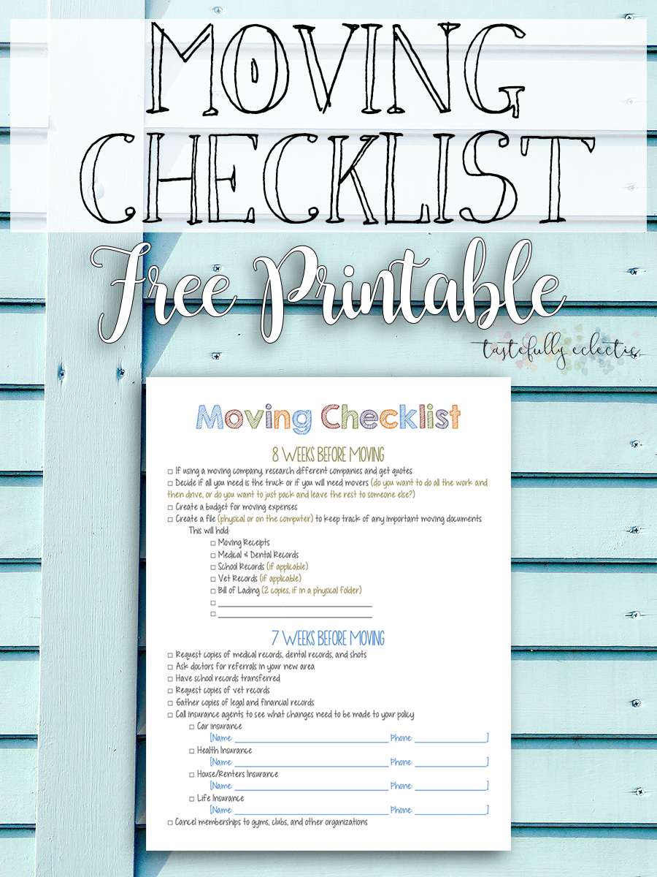

One More Checklist**…
Do the Unexpected Extras
Give the Unexpected Extras

