Slide 1

Using Your Database
Without Abusing Your Database

Slide 2


Top of Mind Awareness

Slide 3

Business Focused Conversations
Don’t Confuse being Busy with being Productive!!

Slide 4
I Believe…
I believe that every person in your database is a potential lead &/or a potential source of referrals
  We need to continually GROW our database
I believe that every person in your database needs to be contacted on a “regular” basis
  For Personal Reasons
  To Ask for a Referral
    Can be done discretely at the end of a face-to-face or phone call
  Top of Mind Awareness
I believe that every person in your database is more than willing to help you if they know you need and appreciate the help

Slide 5
How Much Contact is Too Much Contact??
In my opinion…
  Everyone in your database should be contacted by phone (or text) once a quarter
    Leaving a message is OK
  Everyone in your database should be sent a personal handwritten note once a quarter
    Make sure you separate the phone call and the note during the quarter…
    You could also write the note as a follow-up to the call
      Especially if you just left a message.
For a Database of 120 Contacts…
  Two phone calls a day, five days a week, would allow you to contact Everyone during the quarter
  Two personal handwritten notes a day, five days a week, would allow you to make another contact to Everyone during the quarter

Slide 6
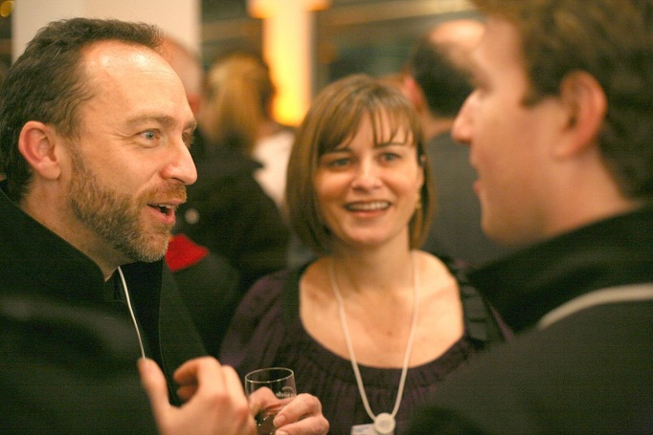


Factoids
It takes 40 Business Related Conversations to generate “1” Closed Transaction
  Face-to-Fact or Voice-to-Voice
    Let’s do some Math

Slide 7
Math
Financial Goal = $100,000
Average Commission = $6000
$100,000 ÷ $6000 = 17 Closed Transactions
17 Transactions X 40 Business Related Conversations means that you will need to make 680 Face-to-Face/Voice-to-Voice contacts a year… Asking for business or referrals, and REMINDING those contacts that you are “never too busy for them or any of their referrals”!!

Slide 8
Math
680 Business Related Phone Calls / Year =
  57/month
    14 / week
      3 / day
Three Per Day
  Face-to-Face
  Voice-to-Voice

Slide 9

There’s Always a Reason to make a call or send a note!!
To get missing info for your database
To just say Hello… how are you…
Your affiliation with RMS Elite Properties
A Special Life event
  Birthday
  Anniversary
  New Baby

Slide 10
Top 24 Contacts…
Your Top 24 Contacts should be the 24 most likely contacts in your database to give you a referral during the course of a year
  Two per week allows you to be face-to-face or voice-to-voice with all 24 during a quarter
  These folks, most likely your best friends!! Contact them for:
    Coffee, Lunch
    Pop-By Visit
    Golf, Tennis, etc.
    Going out with your Significant Others to a movie or dinner
    The conversation at some point will turn towards “work”
      A perfect opportunity to ASK for a referral or to REMIND them that you are “never too busy for them or any of their referrals”

Slide 11


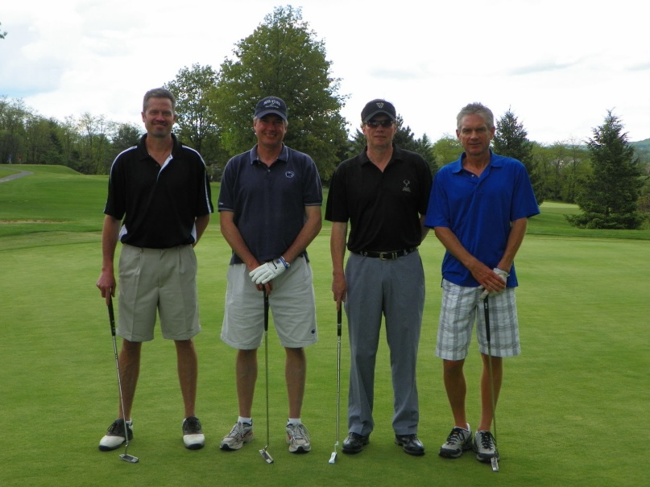
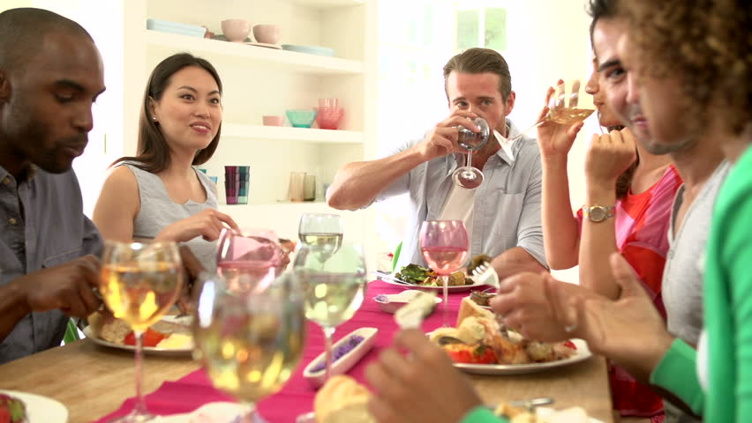
Top 24

Slide 12
Monthly Top of Mind Awareness Database Activities
A Monthly email with an “Item of Value” attached with…
  A Short/Simple Message
  A Nicely Constructed email Signature with all your contact information, Company Logo, etc.
A Monthly Blog… perhaps from Keeping Current Matters, customized with all your information
  Professional & Informative
  Image Builder
A Monthly Holiday email
  Personal
    Your email signature makes this a Top of Mind Awareness activity as well
A Monthly Newsletter
  Professional & Informative
  Image Builder

Slide 13
Top Of Mind Awareness…
Item of Value Mailing to your entire database
  Via email
Monthly Blog to your entire database
  Via email
Holiday Mailing to your entire database
  Via email
  Top 24 should receive a “Hallmark” card
Monthly Newsletter to your entire database
  Via email

Slide 14

Most Effective Way to Get Results
Face-to-Face
  THE most effective Way to Work
Voice-to-Voice
  The most time effective Way to Work
  Make it SHORT… Make it PERSONAL
    ASK “the question” / REMIND them of what you do with the greatest of all closes… “Remember, I’m never too busy for you or any of your Referrals”
Consistency
Persistence
  Stick with the “plan” every quarter
Make it Personal
  “Socialize with a Purpose”… Tara Cook
Don’t Be Pushy
  Soft Sell

Slide 15
Do You Market?? Do You Make Contact??
“The few who ‘do’ are the envy of the many who ‘watch’.”
          Jim Rohn
“Do ‘the thing’, and you will Have ‘the power’!”
          Ralph Waldo Emerson

