Slide 1

Treating Your Listing Like an Asset!!

Slide 2
Asset (‘aset)
NOUN
  a useful or valuable thing, person, or quality.
  "quick reflexes were his chief asset"
  “a beautiful listing is an asset for a professional REALTOR”
    synonyms:
    benefit · advantage · blessing · good point · strong point · strength · forte · talent · gift · strong suit · long suit · virtue · recommendation · attraction · attractive feature ·

Slide 3
Educating the Seller…
It’s their Asset too!!
Educating them about the Process… About the Importance of their Cooperation & Participation… About how their Asset will be more valuable with a better understanding of what it will take to Sell their Home (Asset) for the most money in the shortest amount of time!!
  Using a Pre-Listing Package
  Using Keeping Current Matters’ “Selling Your Home” Seller Guide
  At the Listing Presentation
    Suggestions
      Landscaping
      Staging
      Fresh Paint
  “Five Things to Do Before you sell your Home”
  “Make Your Home Attractive to Buyers”

Slide 4

Education…
Use Checklists…
“Home Enhancement Checklist”
&/OR
“Show Off Your Home
Every-Time” Checklist
&/OR
“Preparing Your Property For Sale”

Slide 5

What Makes a Good Listing a More “Saleable” Asset??
Well Priced
Great Condition
First Impressions
  Exterior Impressions
  Interior Impressions
Accessibility

Slide 6
Well Priced…
Priced to be competitive in the Market
  What’s the competition look like
    Active Competition
    Pending Competition
    Sold Competition
Priced to Sell… Not to Sit…
  Pricing the Property to “Sit” just doesn’t make sense
    What does it say about the Listing Agent?
    What does it say about the Seller?

Slide 7
Great Condition…
Have the Seller consider a Home Inspection before the property goes on the market
  If something needs to be corrected, do it ahead of time
  If everything is good, it will give everyone the confidence to move forward with:
    Showings
    Negotiating
    Selling the property knowing that the condition of the property is Top Notch
      And that nothing will come back on your Seller (or YOU) after settlement

Slide 8
First Impressions…
Exterior
  Help the Seller by using Checklists:
    Clean
    Neat
    Landscaped
    Attractive & Appealing
Interior
  Help the Seller by using Checklists:
    Clean
    Neat / Clutter free
    Smell
    Light
    Attractive & Appealing

Slide 9
Accessibility…
Don’t make it difficult to Show
  Use a Lockbox
  Be Ready for Short Notice Showings
    (as much as possible)
  Move the Pets & Yourself from the property before and during showings
    Give the potential Buyer and their agent “space”… the ability to “chat”… etc.

Slide 10
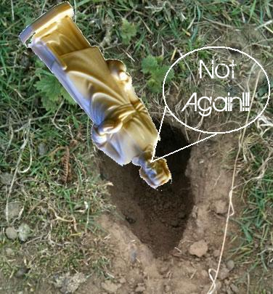

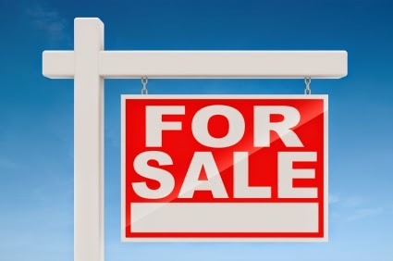

Marketing Your Asset
Marketing to many agents consists of three (or four) things:
  Put a Sign in the Yard
  Put it in the MLS
  PRAY
Bury St. Joseph Upside Down in the Yard…

Slide 11
Marketing Your Asset
Signage
Professional Photography
MLS
  Lots of Photos
  Video
  Well Written Description
  Websites like REALTOR.com, Zillow, etc.
Additional Websites
  Company
  Personal
  Facebook Account
    Include Photos and Videos
eFlyers
  Flyer@AdvertiseRE.net
Printed Flyers
  www.Xpressdocs.com
Just Listed Postcards / Just Listed Door Hangers
  www.Xpressdocs.com

Slide 12
More Asset Management…
Tell 50
  Introduce Yourself as the Listing Agent
  Leave Something of Value Behind
  Ask if they know someone who would like to be in the neighborhood
Open Houses
  Broker’s Open Houses
    Area Agents and Brokers
  Neighborhood Open Houses
    Open before a regular Open House or on a weeknight
  Mega Open Houses
    Ask Good Questions
    Provide Something of Value / Get Database Information
    Add New People to your Database
      Open Houses are as much for YOU as they are the SELLER
Tell 50 Again & Again
  Every Open House
  Price Reduction
  SOLD

Slide 13

My Personal… Written…
“20 Point Marketing Plan”
20 Point Marketing Plan
Competitively Price Your Home
Provide Knowledge, through Education, throughout the Sales Process
Be Accessible to your questions and concerns throughout the Process
Optimize Condition and Viewing of the Home
We’ll strategically place your home online
  Multiple M.L.S.
    List
  Websites
    List
Professional Photographs of your home
Professionally Written Description of your home
  Your input is important
Create a Professional Brochure on your home
  Your input is important
Tell 50 Program
Notify Agents in my office
  Network with the best agents in the area
  Promote your home to my extensive database
Hold Open Houses
  Personally invite your neighbors to the open house
I Prospect for two hours a day to find Buyers
Aggressive follow-up with Prospective Buyers
Hold Broker Open House
Advertise
  MLS
  Print
  Social Media
  Personal Contact
Communicate
  Minimum Contact – Once a Week
  Review Market Analysis – Minimum Once a Month
I’ll send you feedback from all showings
I’ll send you email with any and all new listings, new pendings, new solds
Complete Transaction Management from Listing to Closing to Moving
Add you to my Client Appreciation Program

Slide 14

Home Warranty??

Slide 15
Constant Communication
Constant Communication with Seller
  Weekly Phone Contact
    Discuss Activity or lack thereof
  Feedback at EVERY opportunity
    After Showings
    After Open Houses
    After Broker’s Open
  Pricing Discussions every 30 days
  Set the Expectations of providing these things up front!!
    Most agents will just sit back until the Seller decides to do something OR until the Seller gets Frustrated and/or Disgusted

Slide 16


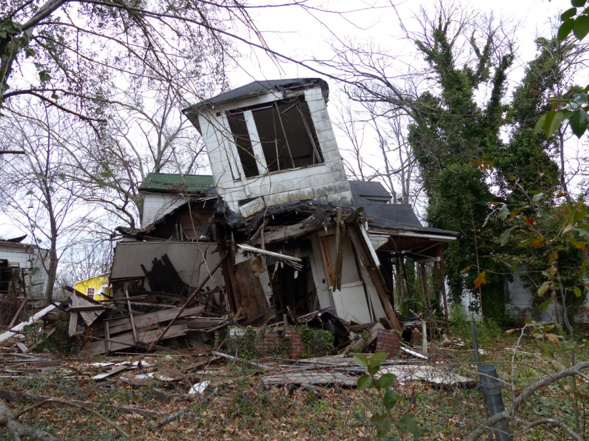
A SOLD Asset vs. An UNSOLD Asset

