Slide 1
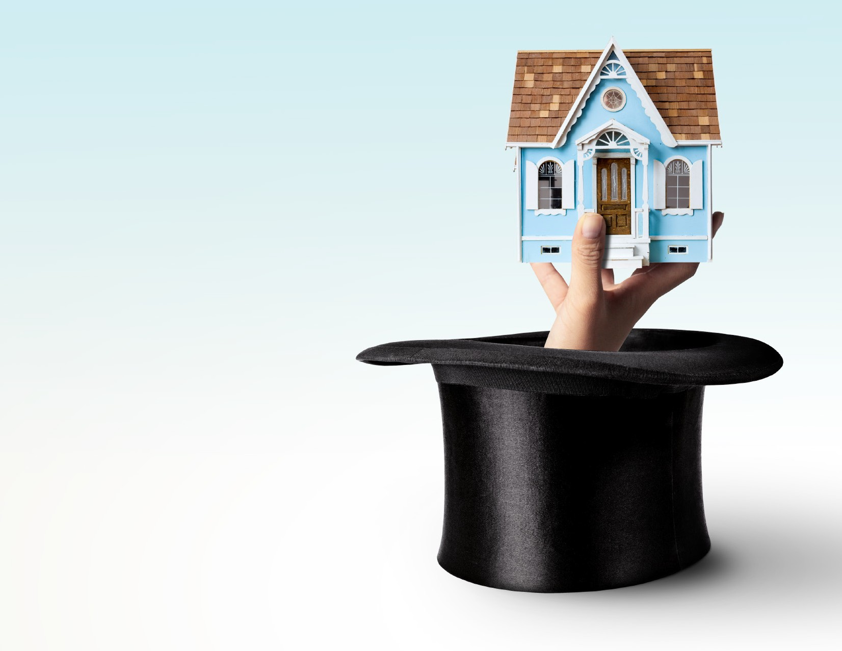


^{The}Magic
^{of} Owning
ª Home
Have you been renting and thinking about buying a home? The benefits of owning a home go beyond having something to call your own!
Typically considered one of the safest investments a person can make, there are several other benefits of homeownership. If you’re feeling financially secure, the time to act is now.
© 2020 Buffini & Company. All Rights Reserved.

Slide 2
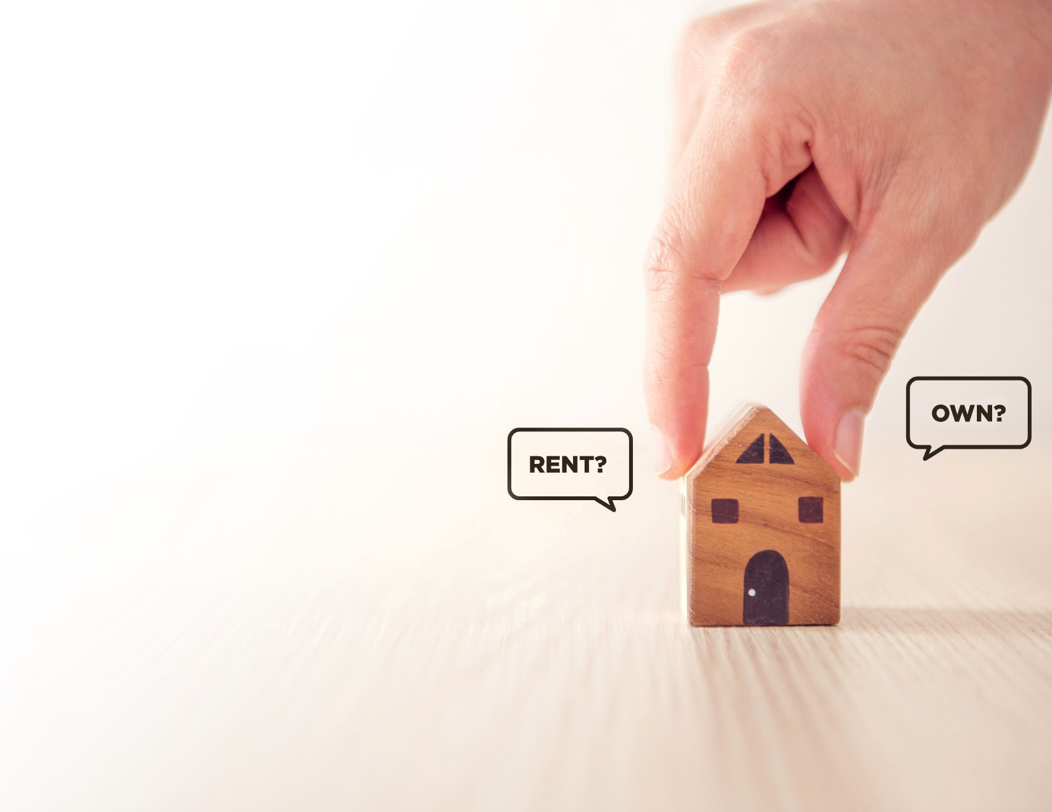
Rent vs. Own
In at least 50 cities in the United States and Canada, it is cheaper to buy than rent. Before we dive in, take a look at what happens when people rent instead of own.
Rent | Own
Increasing your landlord’s wealth | Increasing your own wealth.
Monthly payment is subject to increase year-to-year. | A fixed mortgage keeps your monthly payment constant.
Constant payment that never goes away. | In the United States, pre-pay- ing parts of your mortgage can reduce your debt.
The space belongs to someone else. | Your own space to customize and design however you want.
At the will of your landlord for changes or updates. | You are your own landlord!
Source: Yahoo Finance
1

Slide 3

75United States consider buying a
Homeownership
% of non-homeowners in the
and Your Dreams
home to be part of their American dream, and they plan to jump in eventually.
Homeownership Provides…
A Place to Call Your Own
Your home creates a sense of security and belonging in your community, knowing that you have a piece of the neighborhood that’s all yours.
A Reminder of Your Achievements Whenever you walk through the front door, you are reminded of the effort that went into obtaining that home in the first place and achieving that goal.
National Association of REALTORS®
2

Slide 4

Homeownership
Get into the market to get into increased wealth over time!
and Your Wealth
Financial Benefits of Homeownership:
Grow Your Personal Fortune
The average homeowner has 44 times the net worth of a renter. Owning your home boosts your own worth and lets you accumulate more wealth over time.
Get More Tax Benefits
You can write-off mortgage interest and property taxes in most cases, saving you money come tax time.
Secure an Investment That Isn’t Going Anywhere Whether you fix it up, rent it out or re-sell it, real estate’s value tends to increase the longer you have it, and are often less volatile than stock investments.
SOURCE: Federal Reserve Survey of Consumer Finances 2013-2016, The Balance
3

Slide 5

Homeownership
Not only does homeownership benefit you, but it also impacts the world around you!
Creates Stronger Families
When you have a home base that’s all yours, studies show that emotional stability increases among family members.
and Your Family
Kids Perform Better in School
Children raised in a home that’s owned by the family find more success in math and reading and have fewer behavioral problems.
Stronger Sense of Community
People who own homes are more active in their community, doing more to ensure that their property remains in a neighborhood that is supportive, safe and beautiful.
SOURCE: Joint Center for Housing Studies of Harvard University, National Association of Home Builders
4

Slide 6


Homeownership:
A Smart Decision
The magic of homeownership affects your dreams, wealth and family life. Investing in a home is a smart decision for anyone looking to increase their net worth and become more active in their community. Contact me to get started on your journey to homeownership!
Lloyd Dreibelbis, BROKER
CRB, CRS, GRI
RMS Elite Properties
4700 9th Ave. N.
St. Petersburg, FL 33713
484-529-2977
t
5

