Slide 1

Life’s a Beach…
Enjoy the Waves!!

Slide 2

A Morning Routine…

Slide 3
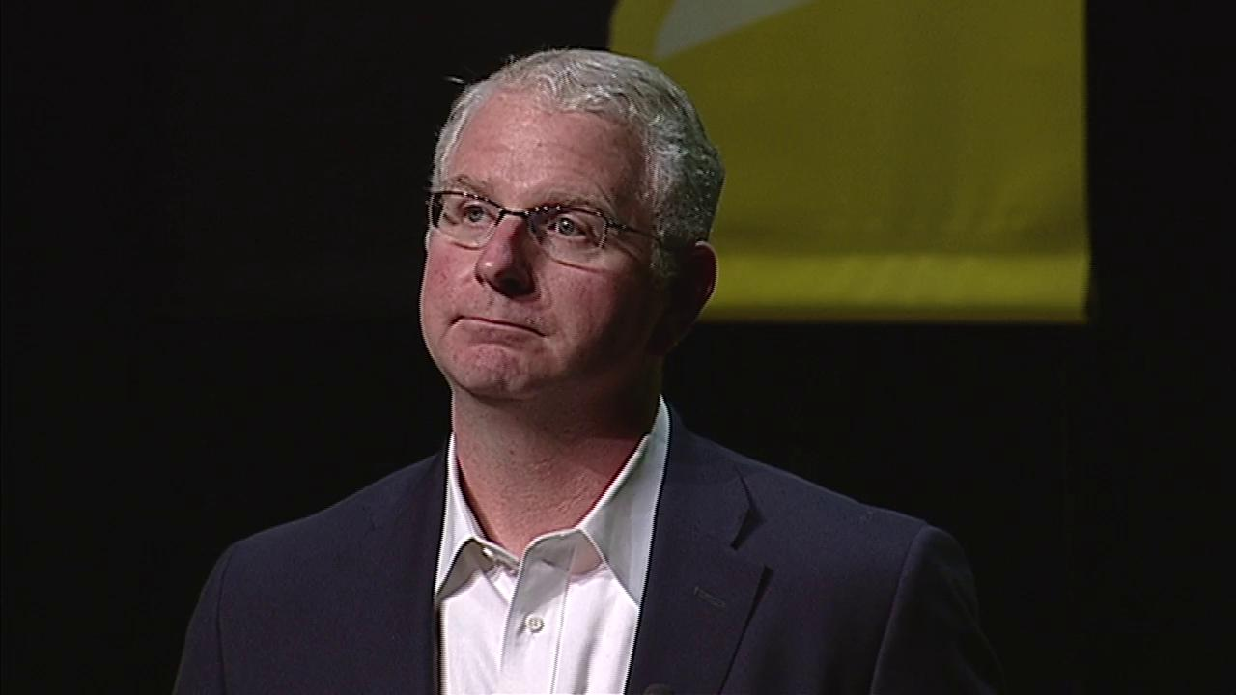
Bob Bowman, Coach
(Michael Phelps)
“The Key to Victory for Michael was creating the right routines!” Bob Bowman

Slide 4
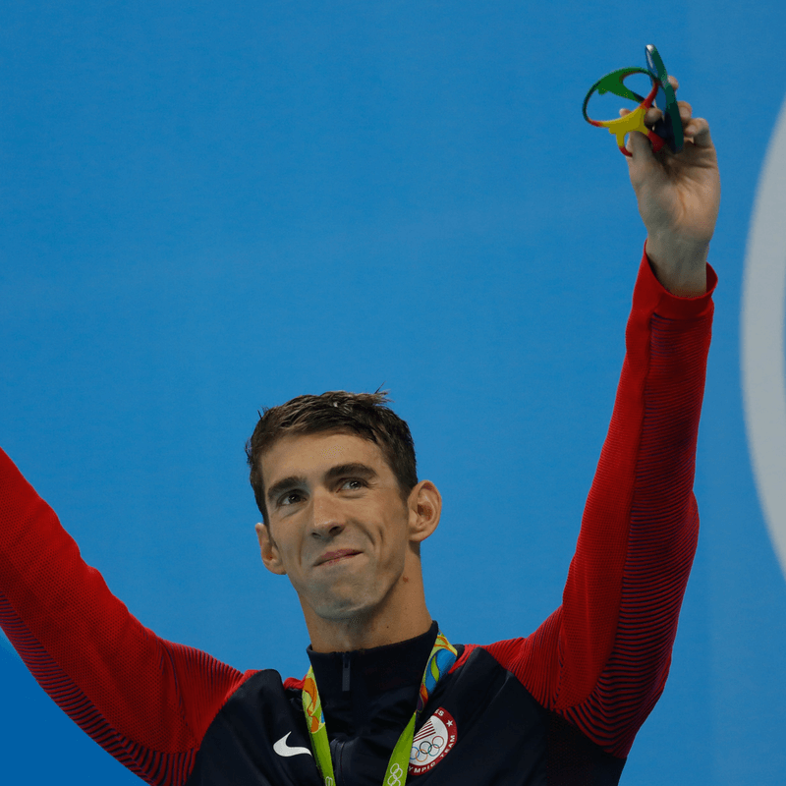
Routines & Habits
Synonyms for Routines/Habits
  Customs
  Traditions
  Patterns
  Schedule
  Practice
  Everyday
  Regular
  Habitual

Slide 5
Day in the Life: Michael Phelps
The Routine…
6 AM – Wake Up
7 – 9 AM – Swim
9 – 10 AM – Weight lift
10 – Noon – Eat!!
Noon – 1 PM – Nap
4 – 6 PM – Swim
6 – 8 PM – Dinner
8 – 10 – Time with fiancé
10 – Bed
*

Slide 6
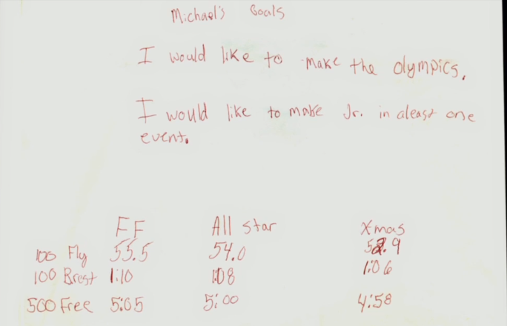

Slide 7
My Belief…
“I believe the key to victory in the real estate business (or any business for that matter) is creating the right routines!” Lloyd D.
  In listening to some of my mentors & friends; Brian Buffini, Tom Ferry, Anthony Robins, Zig Ziglar, Gino Blefari, Rick Doyle (my coach & mentor for many years)… I learned:
    In order to succeed in real estate, and in life, I needed to work harder on myself than on my job
    I needed to change my mindset to one of gratitude
    I needed a routine that would create balance in my life… all of which would allow me to find the mental and physical strengths to succeed when others around me failed

Slide 8
Life…
Words of Wisdom…
  “I always thought that work was my life! Then I found out, the hard way, that work was only a part of my life! Don’t wait too long to learn this life lesson!”
      Lloyd Dreibelbis
  “Your life gets better… ONLY after YOU get better!”
      The Miracle Morning for Real Estate Agents

Slide 9

The Five Circles of Life Balance
Spiritual
Personal
Physical / Emotional
Family & Relationships
Financial
Business

Slide 10
A Morning Routine…

Slide 11
The Seven Principles of Success
From a Seminar by Gino Blefari, CEO
HSF Affiliates LLC

Slide 12
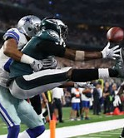
Principle 1
Play Full Out!!
Requires:
  A) A Game Plan
    A Business Plan
  B) A Play Book
    An Action Plan
  C) Teamwork
    T.E.A.M.

Slide 13

Principle 2
Have a Good Morning Routine
Develop Keystone Habits
    M.E.D.S.
We’ll Come Back to This Principle!!

Slide 14
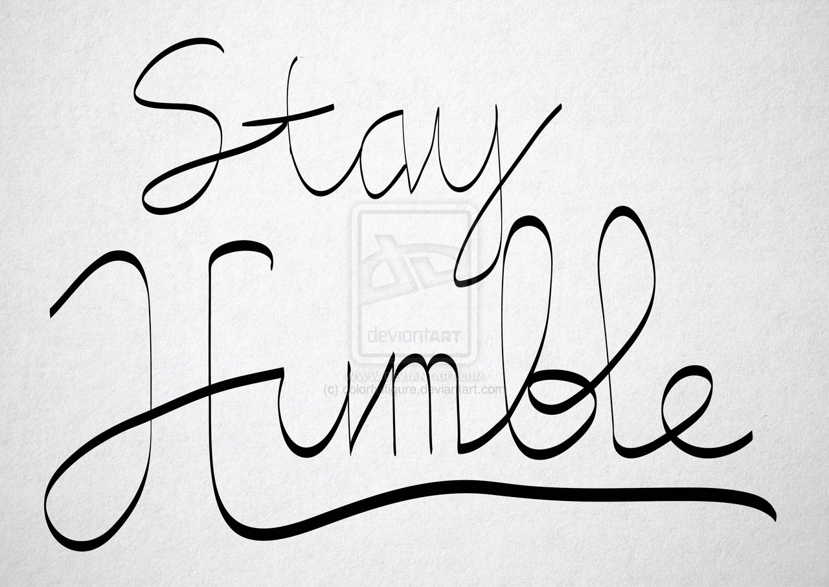
Principle 3
Be Humble
Humble:
  “Having or showing a consciousness of one’s shortcomings”
  “Modest”
  “Unpretentious”

Slide 15

Principle 4
Build a Great Team
T.E.A.M.
  “Together Everyone Achieves More”
  “A Team becomes more than just a collection of people when a strong sense of mutual commitment creates synergy, thus generating performance greater than the sum of the performance of it’s individual members”

Slide 16
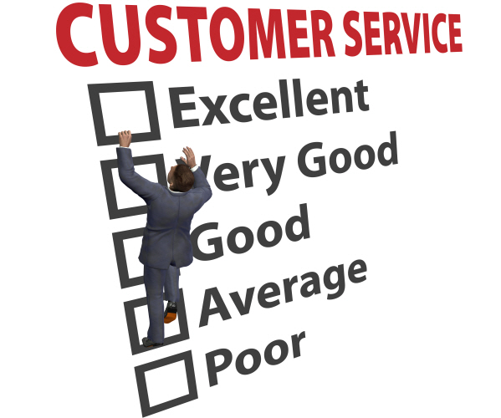
Principle 5
Provide Excellent Service
Set the Standard for Excellence
  Excellence is your ticket to Repeat & Referral Business

Slide 17
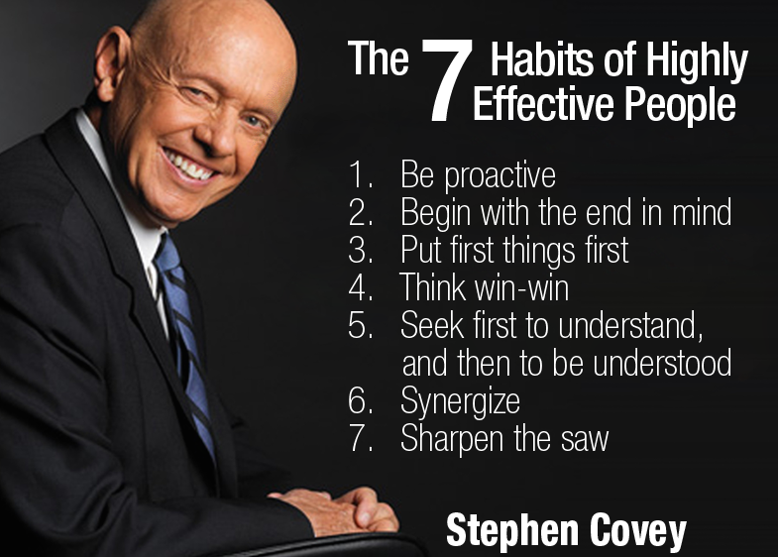
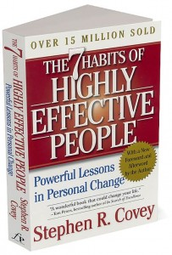
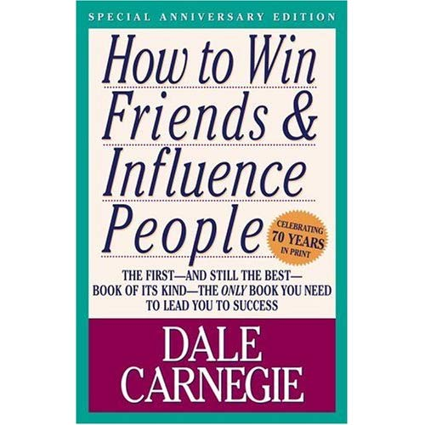
Principle 6
Read
Sharpen the Saw
  “The man who does not read good books has no advantage over the man who can’t read.”
      Mark Twain

Slide 18

Principle 7
Continuous Improvement
Reflect
Track
Learn
Share
Grow

Slide 19
Some Great “Reflection” Questions
How did the day go?
What success did I experience?
What challenges did I endure?
What did I learn about myself & about others?
What do I plan to do differently, or the same, tomorrow?
With whom did I interact? Do I need to update, thank, ask a question of, or share feedback with?

Slide 20
Principle 2
Have a Good Morning Routine
Develop Keystone Habits
    M.E.D.S.

Slide 21



Morning Routine: Keystone Habits
M.E.D.S.
  Meditation / Prayer
    What you think about, you bring about
  Exercise
    Your Health is Your Wealth
  Diet
    You are what you eat… Who are you going to be today?
  Sleep
    “Fatigue makes cowards of us all.”
      Vince Lombardi

Slide 22
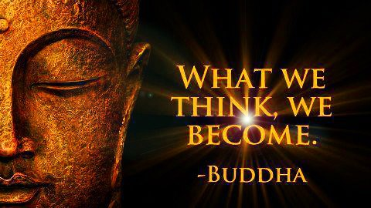
Morning Routine –
Meditation /Reading
“IF” by Rudyard Kipling
“The Seeds of Success”
by Og Mandino
“The Power of Positive Thinking” by Norman Vincent Peele

Slide 23

Morning Routine - Journal
1) Write 10 things you are grateful for
2) Write 3 things that made you happy in the last 24 hours
3) Write “I am” affirmations 25 times

Slide 24
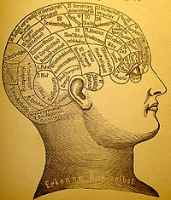
Repeated Affirmations
“I am earning $______ or more in the next 12 months”
  Write 25 times, saying it as you write it!!
Program the non-conscious part of your brain…
  It has no perception of past or future…
    The non-conscious brain is servile: it sets no goals of its own, but instead executes the goal it is provided with
    The non-conscious brain does not judge the merits or values of results, only whether or not they match the given goals!!

Slide 25
M. E. D. S.
Meditation
Exercise
Diet
Sleep

Slide 26
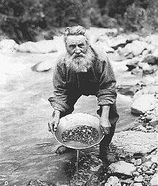
Morning Routine -
Work your Action Plan
Work from a To-Do List
  Program your Action Plan into your Daily Schedule
  Use Your Power Hour(s) to Prospect EVERY DAY

Slide 27
The Miracle Morning It’s Your Time to Rise and Shine
By Hal Elrod, Michael J. Maher, Michael Reese & Jay Kinder

Slide 28
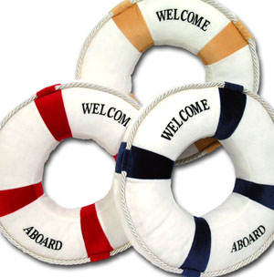
The Life S.A.V.E.R.S.
Silence/Affirmations/Visualization/Exercise/Reading/Scribing

Slide 29

“S” is for Silence
Enjoy the Beauty of “Quiet Time”
Meditate
Pray
Reflect
Quiet Your Mind

Slide 30

“A” is for Affirmations
Affirmations Program Your Mind
“I am committed to doing _____ NO MATTER WHAT so that I can _____ by _____”
**********
“ I am committed to doing 5 phone calls to contacts in my database today NO MATTER WHAT so that I can earn $75,000 by the end of the year!”

Slide 31
Affirmations…
“I am committed to writing 5 personal handwritten notes today, No Matter What, so that I can touch someone in my database in a very relational way”
“I am committed to finding at least one new lead this week, No Matter What, so that I can build my business for the future!”

Slide 32


A Powerful Question…
“If you knew, without a doubt, that what you wrote for an affirmation was what you would become, what would you write?”

Slide 33
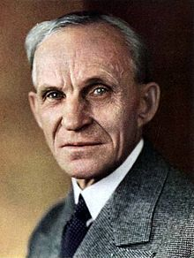

Great Quote…
“Whether you think you can or think you can’t, you’re right either way!”
Henry Ford

Slide 34

“V” is for Visualization
Visualize:
  What you really want…
  Who you need to be…
  What you need to do…

Slide 35

“E” is for Exercise
Your Health is Important! Without your Health, what do you really have?
The Benefits of Morning Exercise are undeniable, and something you can’t skip if you’re committed to peak performance in your life and business!

Slide 36
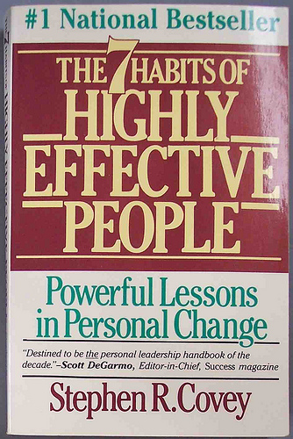
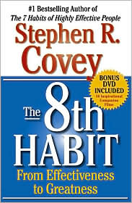
“R” is for Reading
Feed Your Mind…
“There is very little difference between someone who is illiterate and someone who can read and yet doesn’t!”

Slide 37

“S” is for Scribing
Document your insights, ideas, breakthroughs, realizations, successes & lessons learned.
Write down those people or things that you are most grateful for.
Write down a few of your affirmations.

Slide 38
The Not-So-Obvious Secrets
Real Estate Super-Achiever
  Secret #1: Stay consistently connected. Communicate with your Customers, Clients & Circle of Influence!
  Secret #2: Hire a Coach, Find a Mentor
  Secret #3: Develop self-confidence and an unstoppable positive attitude. Attitude is Everything!**
  Secret #4: Start each year with a plan and work that plan!
  Secret #5: Have a Daily Schedule!

Slide 39
Commit to Being Better…
“Your life gets better only after you get better!”
“SAVE” Yourself…
Silence…
Affirmations…
Visualizations…
Exercise…
Reading…
Scribing…

Slide 40
The Five Minute Journal
Intelligent Change

Slide 41
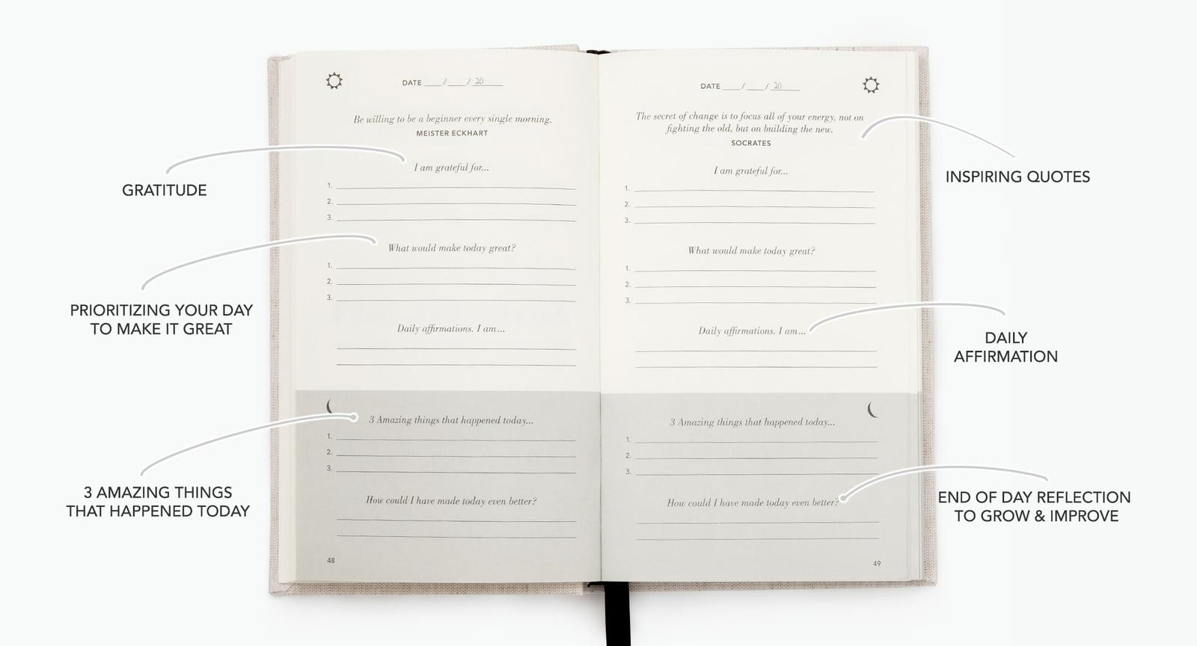

Slide 42
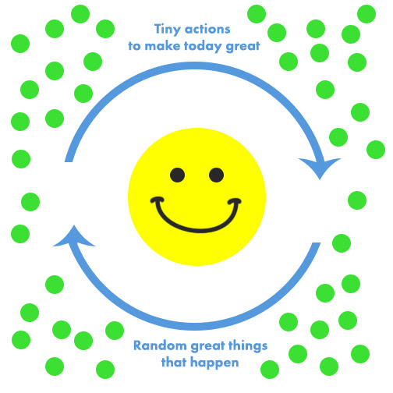

Slide 43
Are You Ready To Start Your Day… Differently??
Develop Keystone Habits
  M.E.D.S.
    From “The 7 Principles of Success
The Life S.A.V.E.R.S.
  From “The Miracle Morning”
  www.MiracleMorning.com
The Five Minute Journal
  From “Intelligent Change”
  www.IntelligentChange.com

Slide 44
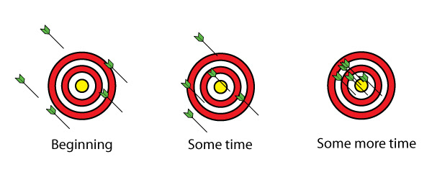

Slide 45


Slide 46
Next Week:
Doing the Unexpected Extras
How to get MORE REFERRALS by GIVING MORE than expected & MORE than anyone else!!

