Slide 1
The Pop-By
Get Face-to-Face

Slide 2
Do You Believe…
That Real Estate is a “Relational” business??
That Working By Referral is Better than Cold Calling??
That Your Circle of Influence is Integral to Your Success??
That a Well Structured Database Will Help Your Business Grow??
That You need a Plan of Action that will allow you to USE (not abuse) your Database… to Improve your relationships… to Help Your Business GROW??

Slide 3


Slide 4
Personal Contact…
Face-to-Face
  Pop-Bys
  Coffee
  Lunch
  Golf
Voice-to-Voice
  Phone
  Text
Heart-to-Heart
  Personal Handwritten Notes
Have that One Lead a Week Mentality
Remember that it takes 40 Personal Contacts to create a lead
Are you making 40 Personal Contacts every week?
Are you asking for business 40 times a week?
Are you getting a lead every week??

Slide 5

Definition…
“A Pop-By is a short visit to one of your valued clients during which you give them a small “Item of Value”. It is a great way to get face-to-face with your clients… and when you’re working by referral, face-to-face communication is by far the best.”

Slide 6
Pop-Bys Will Help You…
Cultivate deeper relationships with the very best people in your database
  Pop-Bys should be reserved for your very best contacts
Keep your clients constantly aware of your services
  Top of Mind Awareness
Ask for and receive referrals
  If you don’t ASK you will NEVER get
Stay on top of the needs and wants of your clients
  Pop-Bys are GREAT if you know of a “special” opportunity
  There’s ALWAYS a REASON!

Slide 7
How-Tos…
Make a list of your TOP 24 Clients
  Those people who are most likely to give you a referral
Map out where those people live
  Try to “pop by” when you plan to be in that area
Call Ahead to let them know you’re stopping by with a little something for them (or for the kids)
  “I’m going to be in your area tomorrow between 2 & 3; I’d love to Pop-By and see how you’re doing”
    Or be prepared to leave a note along with the gift if no one is home
Visit for no more than 15 minutes
  More than 15 minutes is a “Plop-By”

Slide 8


The “Plop-By”…
Don’t do that!!

Slide 9
Always Ask for the Referral…
“Do you know of anyone who is thinking about buying or selling a home?”
  “Who do you know” is even a more specific question
And Always Close with…
  “Remember… I’m never too busy for you or any of your referrals!!”
  Follow-Up with a Personal Handwritten Note!!

Slide 10

Coach’s Tips:
Go see the people you like BEST… FIRST!!
  Two Pop-Bys a Week =
  8 Pop-Bys a Month =
  24 Pop-Bys a Quarter!!!

Slide 11
Coach’s Tips:
Keep a supply of “generic” Pop-By gifts in your trunk at all times
  You never know when an opportunity may arise
If scheduling a block of time to do Pop-Bys is a challenge, fit them in while traveling to and from your other appointments
  Make your trip work for you!!
Bring someone with you and keep the car running: this will ensure you make the visit short
Do Pop-Bys at your client’s workplace! You’ll be able to meet more people and create excitement among their coworkers

Slide 12

The Pop-By Gift…
The Pop-By Gift is a TOKEN of appreciation
  Let’s watch a “Bit ‘O Brian Buffini” talking about the Pop-By

Slide 13
Some Pop-By Gift Ideas:
Holidays Gifts
Homemade treats
Small tools for use around the house
Plants, bulbs or seeds to plant
Popcorn and movie tickets
Home emergency kits
Gas cards / Car wash coupons
Smoke detector batteries
Be creative…

Slide 14



Small Tools…
Small Tools for use around the house…

Slide 15
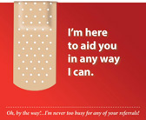


Health…

Slide 16


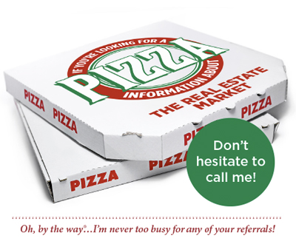
Food & Drink…

Slide 17


Bulbs, Seeds, Plants…

Slide 18

Holidays…

Slide 19

Happy Valentine’s Day

Slide 20

Happy St. Patrick’s Day

Slide 21

Happy Mother’s Day

Slide 22

Happy Easter

Slide 23


Happy Father’s Day

Slide 24

Happy 4th of July

Slide 25

Happy Labor Day

Slide 26
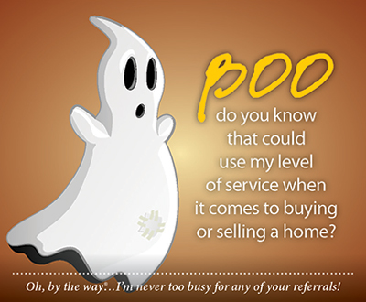
Happy Halloween

Slide 27

Happy Thanksgiving

Slide 28


Merry Christmas

Slide 29
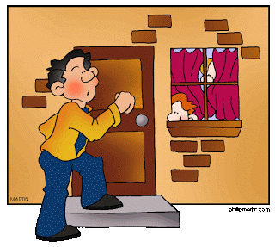
Let’s watch a Great Pop-By

Slide 30
Personal Contact…
Face-to-Face
  Pop-Bys
  Coffee
  Lunch
  Golf
Voice-to-Voice
  Phone
  Text
Heart-to-Heart
  Personal Handwritten Notes
Have that One Lead a Week Mentality
Remember that it takes 40 Personal Contacts to create a lead
Are you making 40 Personal Contacts every week?
Are you asking for business 40 times a week?
Are you getting a lead every week??

Slide 31
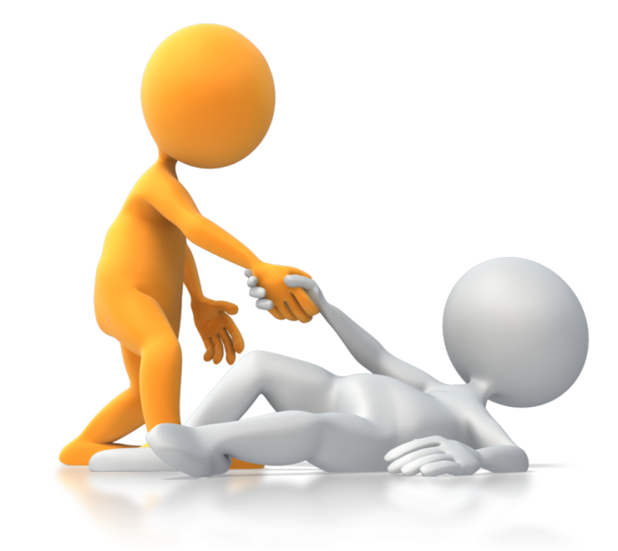

You Need A Plan…
Without a plan, the likelihood of getting a lead or two a week is VERY unlikely!!
If you have a plan… Work It…
If you’re struggling with your plan… Get a Coach…
If you don’t have a plan… I can help!!

Slide 32
Career Development
“Third Thursday” Business Meeting
  Next Thursday, April 18 @ 10 AM
    Home Inspections will be the Topic
  Holiday Inn, St. Pete
Career Development Training
  Wednesday, April 24th (Clearwater) 11 AM
    Mike D’Aloia will be “Special Instructor” of the Day talking about incorporating Property Management into your Real Estate Business Plan

Slide 33


