Slide 1
The Buyer Presentation
Every Bit As Important as Your Listing Presentation

Slide 2

Downsides to Working with a Buyer
Very demanding of your time & energy
No guaranteed income
Lack of loyalty
They get cold feet
When deals fall apart you can lose the client

Slide 3

Time… Let’s make it work for us!!
We need a PLAN…
We need to be in CONTROL…
We need to make sure the Buyer is on the SAME PAGE…
We need to COMMUNICATE…
Time is far too valuable to WASTE…

Slide 4

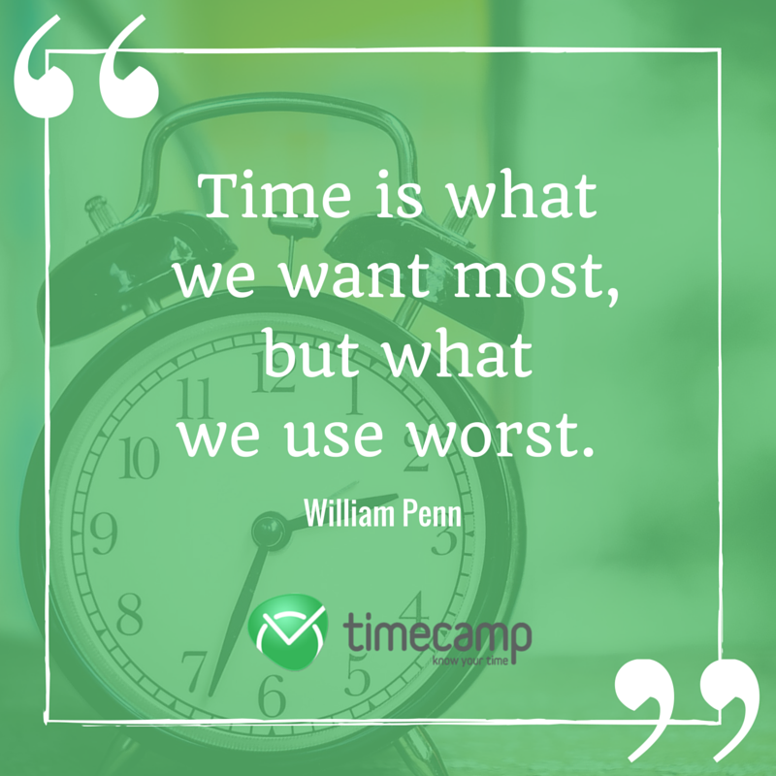
Great Quotes…

Slide 5
Ring… Ring… Ring…
What happens when we get the phone call… “I’d like to see the property at 1234 Main Street in Sarasota!!”
Typical Agent Response…
“OK”
“When would you like to see the house?”
You have a planned family outing at that time, BUT you change everything to accommodate the Buyer
You meet the Buyer at the Property
He says… “Let’s write it up!”
Typical Agent Response…
“OK”… and puts in the agreement

Slide 6
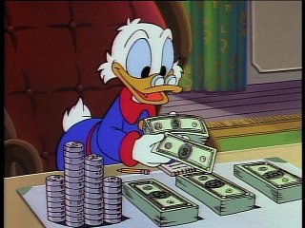
I’m counting the money from my commission
What happens when you find out that the Buyer doesn’t qualify for the loan?
How many steps did we miss along the way?

Slide 7
Ring… Ring… Ring…
What should happen when we get the phone call… “I’d like to see the property at 1234 Main Street in Sarasota!!”
  “May I ask who I’m speaking to?”
  “How did you hear about the property?”
  “Will you be using Financing to Purchase a Home?”
  “Do you have a home to sell?”
  Use the C.I.T.O. Dialogue…
I’d like to see the property tomorrow at 2!! (You have a planned family outing at that time), what might you say
  I have another appointment tomorrow at 2. I am available at 5 tomorrow or perhaps the following day at 10 AM.

Slide 8

Ring… Ring… Ring
How to Handle an Incoming Buyer Call…
Role Play…

Slide 9
Let’s Take A Look At the Right Way to Work with Buyers
The Purchasing Pathway

Slide 10
The Purchasing Pathway
Take Control… Educate… Follow the Steps that lead to a Successful Sale & a Happy Buyer

Slide 11
The Initial Appointment
Get them to Come Into the Office (C.I.T.O.)
  If they don’t come into the office they’re NOT a real Buyer
    This is the time and place to discuss:
      What the Buyer is interested in & where
      The Importance of Pre-Qualification
      Showing the Buyer how YOU work when helping a Buyer find, see, negotiate & purchase a home

Slide 12
The C.I.T.O. Dialogue
“Hi Mr. & Mrs. Buyer,
From my experience in this industry, I’ve seen buyers try to jump straight into the decision-making process without all the tools and information they need. At the end of the day, buying a home is a big deal for you, and it’s a big deal to me. And I certainly don’t want any self-inflicted wounds to occur during the process!”
(Continue with Buffini C.I.T.O. Dialogue Sheet)

Slide 13

Offer to Drop Off Some Important Material Before your in-office meeting
The Buying Process
8 Steps to Buying a Home – Buyer Checklist
  Financing Options Overview
10 Deadly Mistakes Buyers Make
Things To Consider When Buying A Home
The Purchasing Pathway…
  Just Follow the Process as Outlined in that Handout
You could also send one or more of these via e-mail, should that work better for you!!

Slide 14
Determine the Purchasing Parameters
Your In-Office Meeting

Slide 15

When you meet them at your office
Paint the Picture
“If you had a magic wand… what would your dream home look like? What amenities would it have?”

Slide 16


Buyer Consultation
Use a Questionnaire
  Tom Ferry Questionnaire is great
  Brian Buffini
  Buyer Questionnaire

Slide 17
Acquire A Pre-Approval
This is so critical…
Let your Buyers know that a Pre-Approval Letter will be a necessary part of any Agreement of Sale…
Great Dialogue from “Brian and Joe’s Tips for Working with Buyers”

Slide 18
Help Them Understand How You Work…
  Process of Elimination Dialogue
    “As I mentioned to you on the phone, there’s a wrong way to look at homes and there’s a right way. Most people waste a tremendous amount of time and energy going to open houses or looking at homes they see advertised in magazines, newspapers or on the internet.
    What I want to share with you is that finding a home is not a process of selection; it’s a process of elimination. Now that I have a good idea of the type of property you’re interested in, we are going to begin the process of eliminating neighborhoods and styles of homes that you’re not interested in.
    I’ll have succeeded in my job when I’ve helped educate you to the point that when we walk across the threshold of a home you’ll know what you like and you’ll know it’s a good deal. And when we’ve accomplished that you’ll be ready to buy.”
    (Eliminate Neighborhoods First – Style Second)

Slide 19
Educate Them About the Business
Brian and Joe’s Tips for Working with Buyers:
Educate Your Clients as to How Your Industry Works
  Dialogue
Articulate How You Work
  Dialogue
Outline the Benefits to Your Clients
  Dialogue

Slide 20
Educate Them About the Market
Brian and Joe’s Tips for Working with Buyers:
Sample Dialogue
Stats You Must Know!

Slide 21



Educate Them About the Home Buying Process
Brian and Joe’s Tips for Working with Buyers:
“Buying a home is a process of elimination, not selection…

Slide 22
Fully Engage the Buyer
Get THEM Looking
  I’ll send you all the listings that meet your criteria
  Do “Drive Bys”
    Check the Neighborhood, drive time, first impressions, etc
      Give THEM checklists
        What did you like
        What didn’t you like
        What DO you want to SEE… Let ME know, and I’ll set them up for us
Send THEM to Open Houses
  With your Business Cards & Dialogue

Slide 23
Institute Daily Contact
Make it short and sweet
  Machine is OK
Nothing New to Report Dialogue
Something New to Report Dialogue

Slide 24
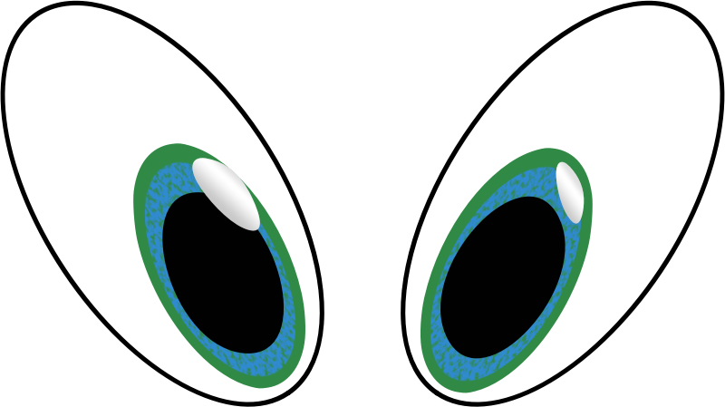
View Homes
Only the ones that THEY choose after doing their drive-bys & ONLY after you have a Pre-Approval Letter from their Lender

Slide 25
Help your Client Make a Decision
Get property Feedback
Ask them to Buy
  “Do you like this home?”
    If NO… “What are the things you didn’t like?”
  “Could you see yourself living here?”
    If NOT… “Why not?”
  “Is this the home you’d like to write an offer on first?”
    If we don’t ask, they probably won’t move forward on their own
  “Why didn’t we buy this one?”
    Take Notes… Keep honing down on their “likes” and “dislikes”
      Alter your “search” accordingly

Slide 26

Property Feedback Forms
Address… What I Liked… What I Didn’t Like…

Slide 27
Final Steps
Write the Contract
Deposit Earnest Money
Perform the Home Inspections
Give Them The Moving Checklist
Final Walk Through
Execute the Closing Documents
Home Delivery
CASH CHECK!!!!

Slide 28


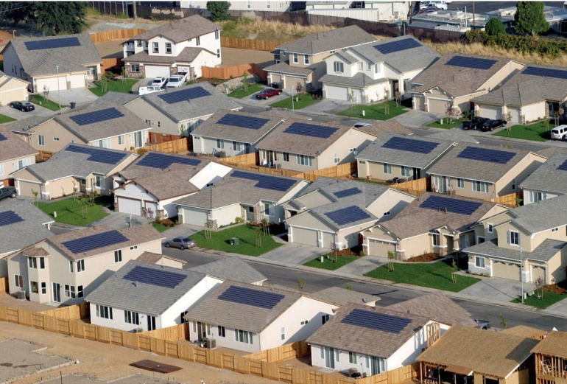
Upcoming Events
Wednesday, March 13 – Career Development Training – “Financial Systems for the Independent Contactor”
Thursday, March 21 – 1st Annual RMS Awards Presentations – Holiday Inn, St. Petersburg
Wednesday, March 27 – Career Development Training – “Geographic Farming”

