Slide 1


Slide 2
Homework Review
Are you using a Power Hour to “get things done”?
Have you sorted your Database:
  Top 120
  Best 25
  A+, A, B, C, D
Have you started making phone calls to your Database:
  Asking for that Referral
  &/or Making sure that they know you’re NEVER too busy for them or their referrals

Slide 3
Setting S.M.A.R.T. Goals
Plan the Actions Steps necessary to meet these Goals

Slide 4
S.M.A.R.T. Goals
Specific and WRITTEN
Measurable PROGRESS and COMPLETION
Achievable OUTCOME
Realistic in TIME and SKILL
Time-based ACHIEVEMENT

Slide 5

Goals Workshop
Write 2 or 3 S.M.A.R.T. Business Goals
  Monetary
  Transaction
  Professional
  Contacts

Slide 6
What are We Going to DO to make those Goals a Reality?
Make Phone Calls?
Write Personal Handwritten Notes?
Start a Direct Mail Campaign with Follow-up (Item of Value)?
Start an e-mail Campaign with Follow-up?
  Perhaps using the same Item of Value as an attachment
Start an e-card &/or card Campaign for the Holidays?
Have “regular” Face-to-Face Meetings with my very best contacts?

Slide 7
Hold effective Open Houses?
Have an effective Social Media presence?
Have a Personal Website?
Start a Geographic Farm Program?
Initiate a F.S.B.O. Program?
Tenant Calls?
Contact Expired Listings?
Tell 50?
Incorporate a Past Client Contact Program?
Use Specialty Products?
Be Community Active?

Slide 8

There’s MORE???????
Use Consumer Videos?
Have a Client Party?
Have a Business Mixer?
Sponsor a Local Sports Team?
Hold a Seminar?
Five Business Cards a Day Program?
Internet Leads?

Slide 9



This is WAY TOO MUCH!!

Slide 10


Many Agents try to do Everything & end up doing Nothing!!!!!
The Shotgun Approach
The Bumblebee Approach

Slide 11

YES… IT’S WAY TOO MUCH!! Let’s Start with 4 or 5 ACTION IDEAS!!
Let’s think about those “actions” that best suit our “strengths”…
Remember…
“Nothing can add more Power to your life (or your business) than concentrating all of your energies on a limited set of targets.”
Nido Qubein

Slide 12

An Action Plan Checklist…
Let’s go through this list with a little less speed, and a lot more thought
As you see something that you know you should include in your Business Plan, or want to include in your Business Plan… place a check mark next to the “Action”

Slide 13

Phone Calls
To Your Database
2 a day = 120 / Q = 480 Contacts / Year
5 a day = 300 / Q = 1200 Contacts / Year
There’s Always a Reason to Call
ASK for that Referral
  You already know how!!

Slide 14

Personal Handwritten Notes
They will ALWAYS be opened & appreciated
Remember to Remind them that you’re never too busy for them or any of their referrals
Don’t know what to write?
I’ll give you 100 ideas!
Looking for Note Cards?
  Google – Real Estate Note Cards

Slide 15

Direct Mail/E-Mail Program
Use the “Item of Value” mailing program we discussed last week
Mail to your TOP 24 Contacts
  “Sweet 16”
E-Mail to everyone you have an e-mail address for

Slide 16

Holiday Cards/E-Cards
One per month
There’s ALWAYS a Holiday
What a Great Reason to Keep in Touch
“I’m so thankful for you & that you trust me with your business and referrals”

Slide 17

Face-To-Face Meetings
Just Pop-By
Have a cup of coffee, breakfast, or lunch
Let’s play golf… other sports work too
Clubs / Organizations… be community active

Slide 18

Effective Open Houses
Know Why You’re There
Ask the right questions
Let visitors know how you can assist them
Get as much information as you can

Slide 19

An Effective Social Media Presence
Know how to use your Social Media
Be careful “what” you post!!
Be careful “what” you say
Have a Separate Facebook page for business

Slide 20

A Personal Website
Keep it Real Estate Commission (DBPR) Compliant!!
Use your web address on business cards, mailings, & in your “e-signature”

Slide 21
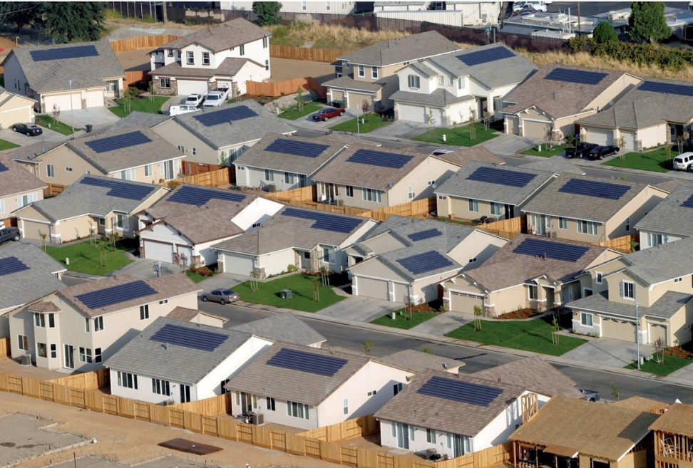
A Geographic Farm
What “area” or “neighborhood” would I like to have listings in?
Make sure you research your potential farm area for turnover
YOUR neighborhood makes a Great “Farm”
  “I’m your neighbor”

Slide 22
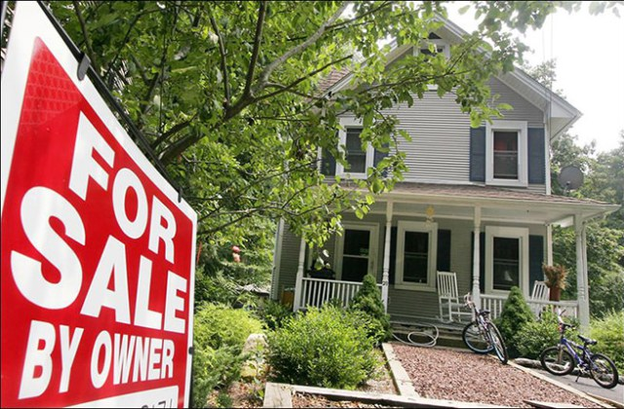
F.S.B.O. / F.L.B.O.
Turn this “cold” lead into a “warm” lead by the way in which you contact these owners
Be Picky
Be Professional
Be Persistent

Slide 23
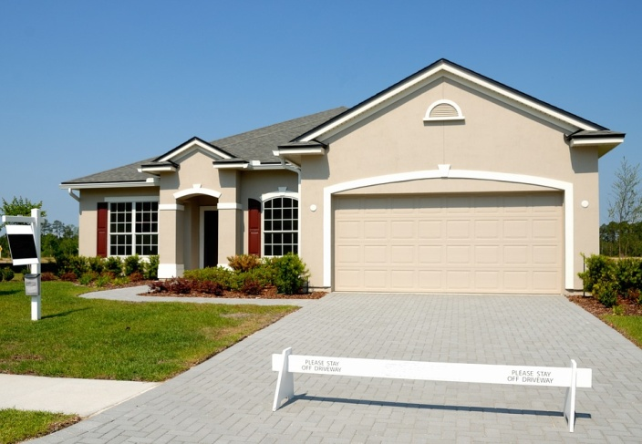

Expired Listings Program
Be Systematic
Have a Plan
Realize it’s going to take more than one contact
Be Picky
Be Professional

Slide 24

Tell 50 Initiative
Just Listed…
  Contact the closest 50 property owners to let them know
  “maybe you know someone who wants to move into your neighborhood “
Price Adjustment…
Just Sold…
Work these owners through the Psychology of Sales

Slide 25
Past Client Contact Program
Personal Marketing Program
  Client Follow-Up
    Five Years
    23 High Impact Mailings
      $25.00

Slide 26




Be Community Active
Give Back to the Community
It’s a Great Place to Network
As they get to know you… like you… & trust you… referrals WILL follow
  Even though this should not be your reason for joining

Slide 27
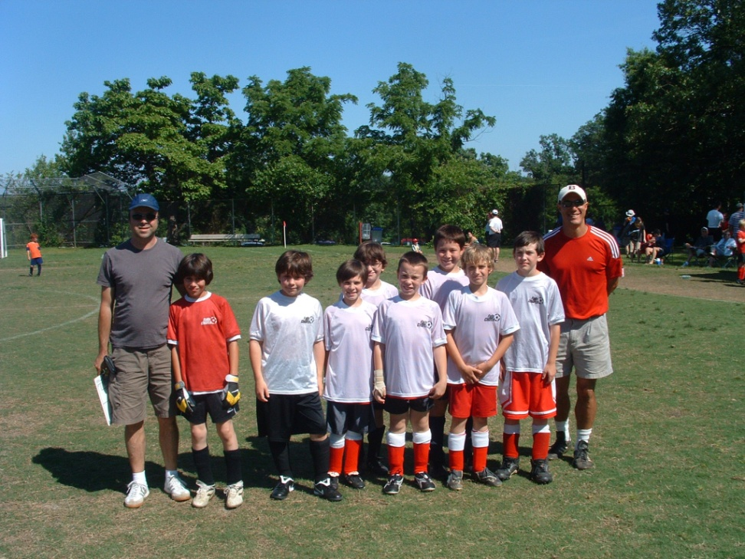
Sponsor a Local Sports Team

Slide 28

Use Specialty Products
  Magnets
  Door Hangers
Use Consumer Videos
  David Knox
Have a Client Party
Hold a Business Mixer
Hold a Seminar
  First Time Home Buyers
Have a Business Card Initiative
  5 Cards a Day
  Try to add someone to your database

Slide 29
OK… You get the idea right? You have Choices!!
Remember… 4 or 5 Action Ideas is a Good Start
Add an additional action as you get good at what you initially decided on

Slide 30
Home Work
Continue to work on your Database
Think about which 4 or 5 ACTION IDEAS you think you’d like to use in your Personal Business Plan to Reach (& exceed) your Personal Goals
Continue to make two phone calls a day to your Database
Write two personal handwritten notes a day to your Database

Slide 31
Home Work for Next Week
Action Planning – “What Have I done Today for Tomorrow’s Business?”
  Which of today’s Contact/Marketing Ideas caught your attention??
  Send me an e-mail in the next day or two telling me which of these Ideas you’d like to hear more about
I’ll Personalize next weeks class (as much as possible) to include CLASS interests!!
I’ll also start to assemble a Personalized Packet of information on all those programs YOU are interested in!!

Slide 32

Have a Great Week…

