Slide 1

Or Is It???

Slide 2

Price Reductions…
The Dangers of Overpricing

Slide 3


DANGERS OF OVERPRICING
Many potential buyers won’t even look, thinking it’s out of their range.
Those buyers who do look are shopping by comparison, and looking at your home may convince them to make a bid on a different property.
Since an appraisal is often required in financing a property, it’s futile to price a property for more than it’s worth.
Properties left on the market for extended periods of time usually become “shopworn”, causing many to believe something’s wrong.
Overpricing tends to dampen the other salesperson's attitude, making it less likely to be shown.
Overpricing lengthens marketing time, and invariably results in a lower selling price than would have been otherwise obtained.

Slide 4
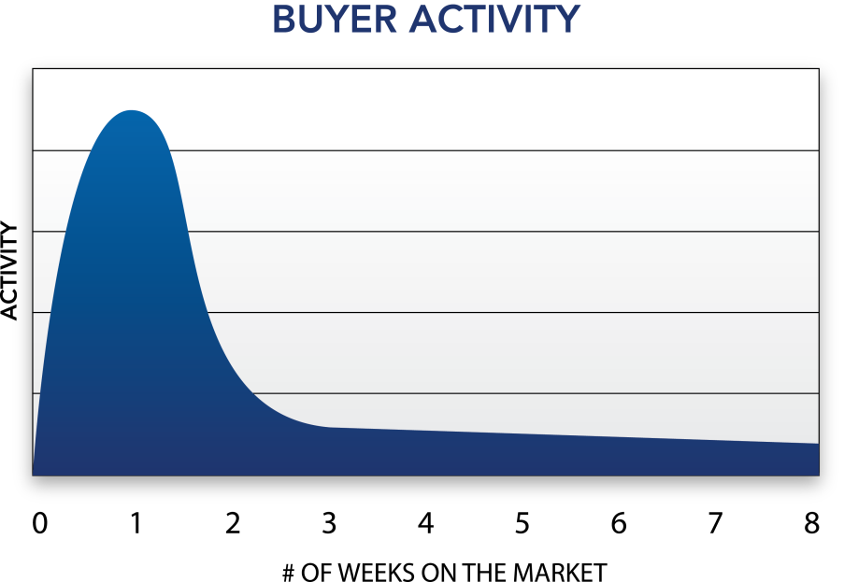
The Dangers of Overpricing
• An asking price beyond market range can adversely affect the marketing of a property
• Marketing time is prolonged and initial marketing momentum is lost
• Fewer buyers will be attracted

Slide 6
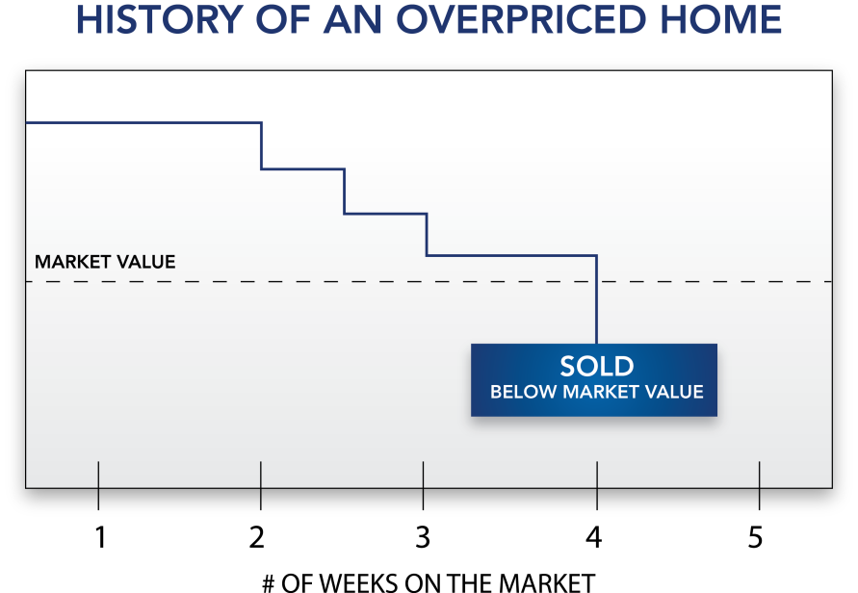
The Dangers of Overpricing
• Helps sell your competition’s home that is priced correctly
• Takes a longer time to sell
• The property may eventually sell
below market value

Slide 8

How to Handle a Price Reduction

Slide 9
How to Handle a Price Reduction
Selling a house can be one of the most stressful times in people’s lives. Your clients trust you as their real estate
professional to provide the leadership and insight necessary to help them reach their goals. However, an emotional connection to the property may make them hesitate to reduce the price, even when the market requires it. Navigating a price reduction can be tricky, but if done correctly, you’ll enhance your relationship
with your clients and help them achieve their objectives.

Slide 10
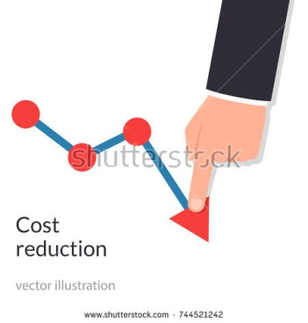
Price Reductions
This is just a reality that you will face during your career as a Real Estate Professional

Slide 11
The Debut is Key
More buyers are searching the internet for new listings than ever before. In fact, new listings get 4 times more web traffic!!
We know that if the home hasn’t received attention from buyers after the first 30 days on the market, then it’s likely the price needs to be adjusted to make it more competitive!!
Although you’ve done the research and have suggested a reasonable and competitive price for the listing, customers may still be reluctant to price it below their expectations.

Slide 12

The 5 Stages of a Price Reduction
It is important to have compassion for your clients and understand the stages sellers often go through when their home is not selling as quickly as anticipated and they must consider reducing the price.

Slide 13

Stage 1
Denial:
  Due to emotional attachment, many homeowners overestimate the market value of their home by 5-10%
    SmartMoney Magazine

Slide 14
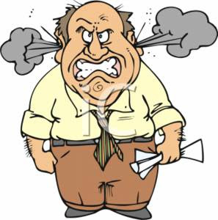
Stage 2
Anger:
  After a week or two of inactivity, your Sellers may be getting upset and looking for someone to blame.

Slide 15

Stage 3
Frustration:
  Your Seller’s pent up anger could now be directed at you and your skills as a professional salesperson.

Slide 16
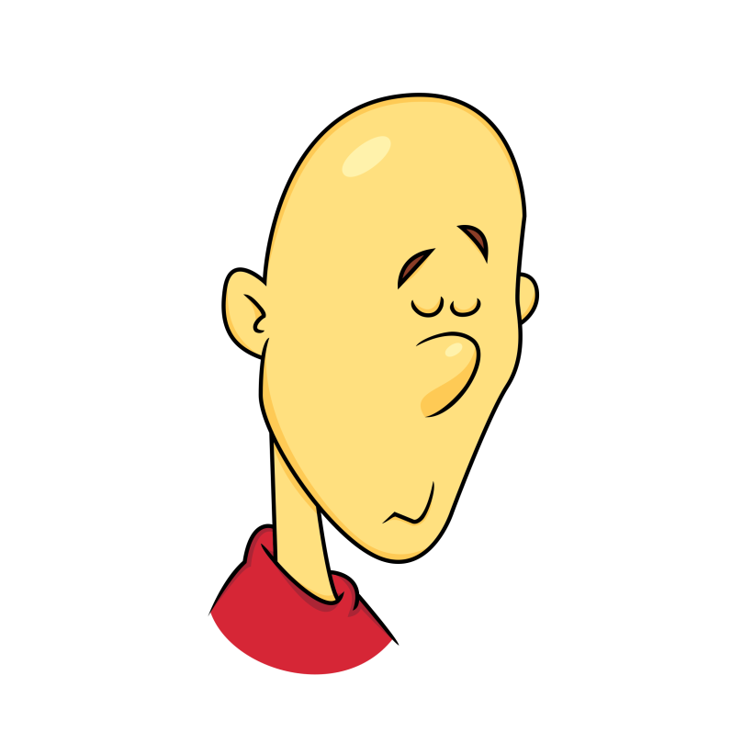
Stage 4
Disappointment:
  Through continued education on the neighborhood market, they discover that their price is unrealistic and they’ve missed out on their prime marketing opportunity.

Slide 17

Stage 5
Acceptance:
  Nearly 56% of Sellers said they reduced their asking price at least once. The average price reduction was 11%.
    NAR Profile of Sellers
    Turlia.com Price Reduction Report

Slide 18
Help your Sellers through the Process
Be Visible
  Communicate with your Sellers to show that you are doing all you can to sell their home.
    Call at least once a week to update them on all activity, feedback, and neighborhood information
      New Listing
      Price Reduction
      Sold
    Write a Personal Note to let them know you appreciate their business
    Every 21 days, do a face-to-face Pop-By to go over your marketing plan and to update your market analysis.

Slide 19
Listen
  The best way to make Sellers comfortable enough to let down their guard is to hear what they have to say and affirm their feelings
Put Them in the Shoes of a Buyer
  Go with them to view the other homes considered to be their competition. Talk through the decision process a buyer goes through when considering a home to purchase
Communicate Effectively:
  As you are giving your Sellers updates, use excellent dialogues to reassure them that you care and want to help them sell their home for as much as possible.

Slide 20
Price Reduction Dialogue
“Hi [Wendy], I just wanted to give you an update on your home. I want you to know that getting your home sold is
a high priority to me and we’re doing everything possible to get it sold. Here’s what we’ve accomplished this week.
We’ve looked at the activity on your home so far and while a number of folks have come through, when we followed
up with the agents representing these buyers, we discovered that they’ve actually gone and bought another
property. So, what the market’s currently telling us is that we’re priced a little on the high side. I believe if we adjust
the price downward, we’ll be taking a major step in the right direction to increase our chances of getting your
home sold. What would you like to do as we move forward?”

Slide 21
Typically the person will say, “Well, what do you think?”
“Well, I think if we reduce the price, we’ll be much more competitive in this market. My professional recommendation
would be to reduce the price to $_________.”
They may also say, “But [Brian], you’re the one who put the home on the market at this price...”
“You know, you’re right, [Wendy]. My goal is to get you top dollar. And I’ll always try to get you the best price. Now
that we’ve shown the home to several potential buyers, we know that it’s a little on the high side so it’s time to
adjust the price to what the market is telling us. My professional recommendation would be to reduce the price to
$_________. Why don’t we do that and let’s see what kind of response we get. And then every Friday, for your peace
of mind, I’m going to give you an update on what happened.”

Slide 22
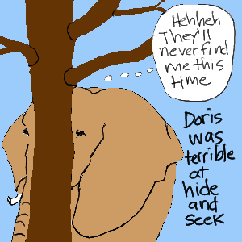
Don’t Hide

Slide 23

Thank You for Listening

