Slide 1

Shhhh… It’s a Secret!!

Slide 2
So…
What is the Secret to Real Estate Success??
The Secret to Real Estate Success, is that there is no Secret!!

Slide 3
It’s All About Getting Leads!!
How do we get leads??
We Pay for Them (Check Equity)
We Generate Them (Sweat Equity)
Do you have “A Lead A Week” mentality??

Slide 4
Paying for Leads…
Agents and Companies can spend an inordinate amount of money to “capture leads”.
The truth of the matter is that these Captured Leads are really not leads at all… They’re the result of someone merely “clicking through” to see a home on Zillow, REALTOR.com, or a thousand other places.
The R.O.I. for these leads is literally in the single digits, and is the source of frustration for agents and companies alike
Why do Agents like the concept of Paid Leads??

Slide 5
Generating Leads…
Database
Circle of Influence
Action Plans of all kinds:
  Phone Calls
  Personal Handwritten Notes
  Pop-Bys
  Coffee / Lunches
  Geographic Farming
  The R.O.I. is much greater, and much less costly, but it requires a little work… Sweat Equity!!

Slide 6


Slide 7
The Geographic Farm
Your Chance to Choose and Work a
Target Market

Slide 8
Definition
“Real Estate farming is choosing to specialize in one geographic area where you unlock the potential to become an authority in that real estate market and subsequently, a sought-after commodity in and of yourself!”

Slide 9
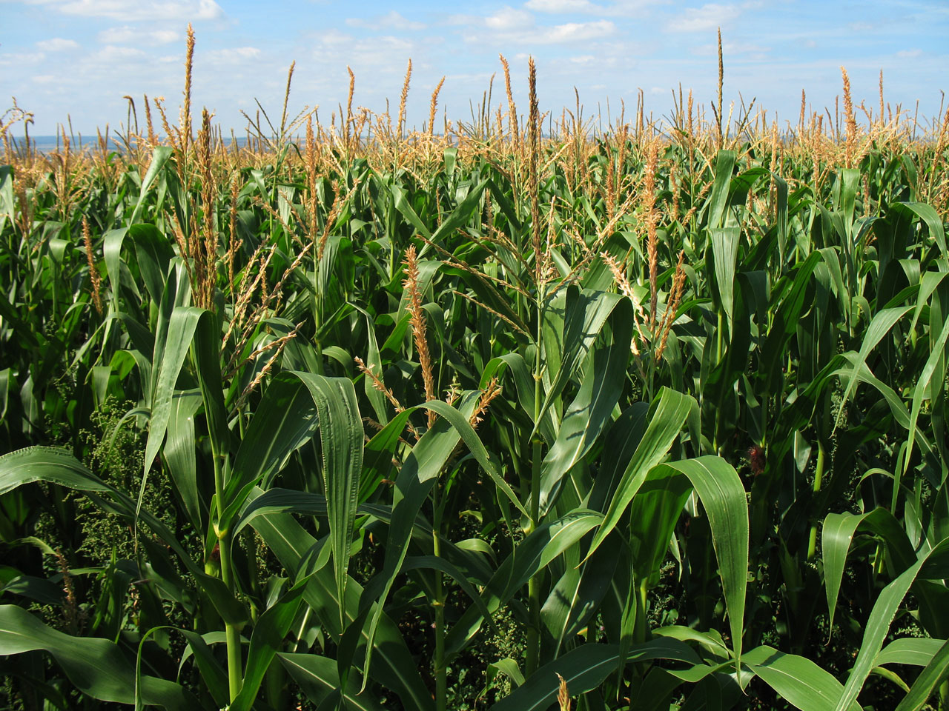
Farming
“If you view real estate farming as a real farm, every move you make within that market is like sowing a seed. Crops take time and patience to be fruitful, but if you’re willing to do the work in the beginning and wait for roots to take hold, you’ll find that the payoff is well worth the initial effort!”

Slide 10
Analyze & Select your Geographic Farm
Size
  Start Small – 50 to 100 Homes
    Grow Your Farm – when you become proficient
Turnover
  6% Turnover Rate - minimum
Price
  The more consistent the price, the more practical it becomes
Competition
  Choose an area that is NOT dominated by a particular agent

Slide 11
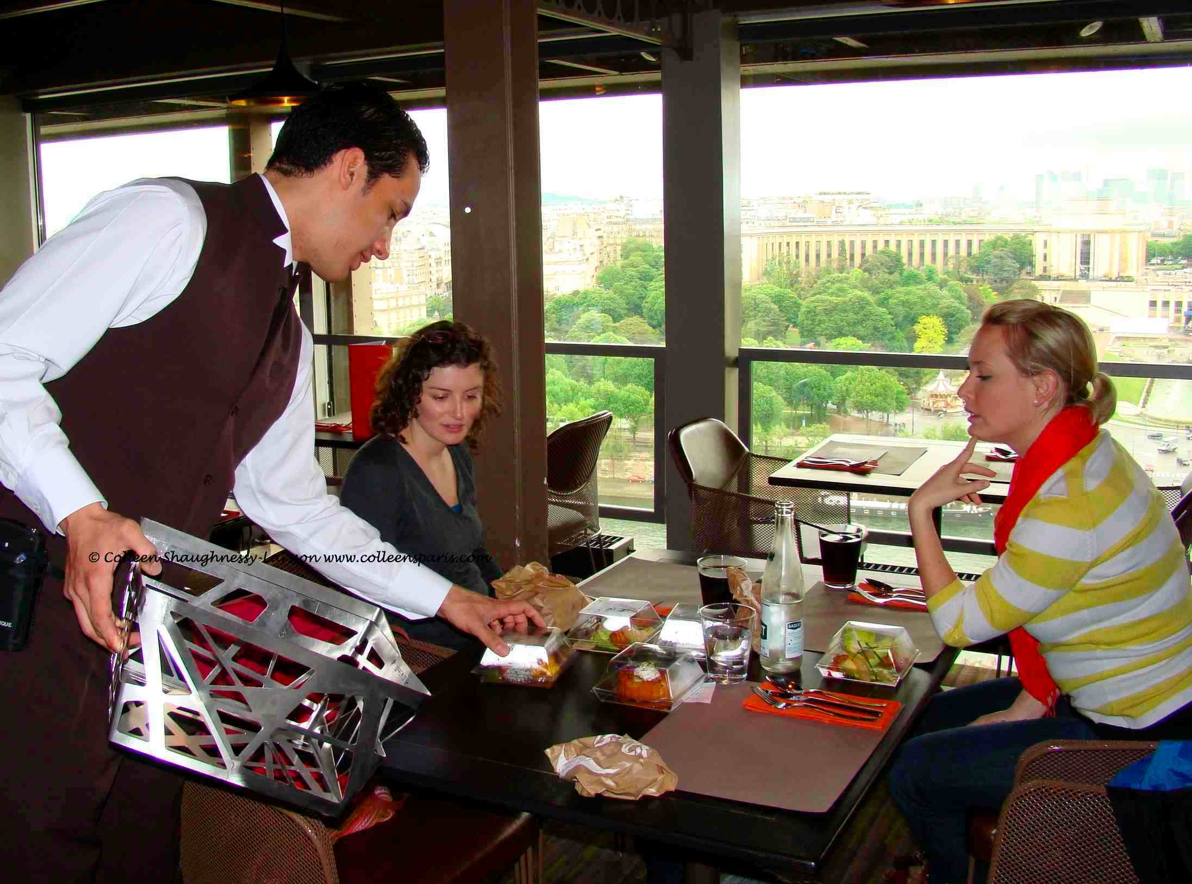
Other things to consider…
Local Demographics
Local Amenities
Your Knowledge of the farm area
Your Involvement in the farm area
  Shopping
  Restaurants
  Doctors
  Hair Dressers
  Etc.

Slide 12
Be IN Your Farm
Do things that will consistently put you IN & Around your farm
  #1 – Live in Your Farm
  #2 – Wear Your Name Badge whenever you’re OUT & ABOUT
  #3 – Use the local Grocery Stores
  #4 – Frequent the local Restaurants
  #5 – Walk your dog in “your” Farm
  #6 – Make Friends / Grow your “Database”
  #7 – Use your “picture” on all your marketing pieces
  #8 – Sponsor/or Coach a local sports team
  #9 – Food Drive (Will T.)
  #10 – Organize a Community Yard Sale / Event
  If you “invest” in your community, it will “invest” in you!!

Slide 13
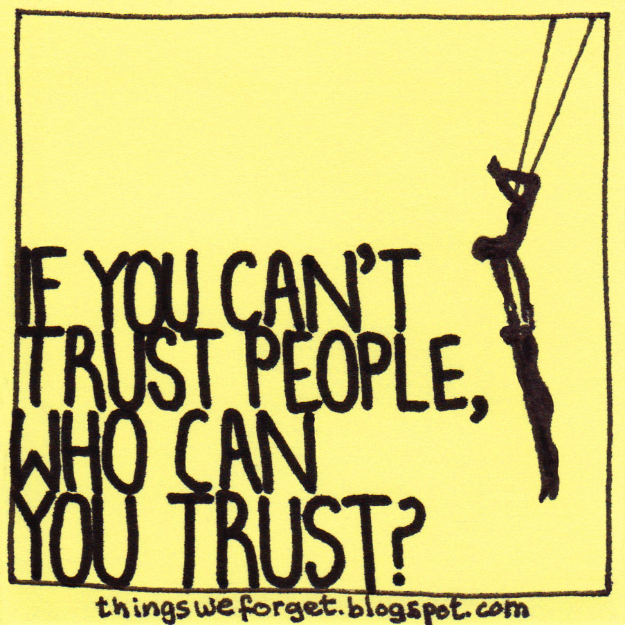

The Psychology of Geographic Farm Success
Getting People to Know You
Getting People to Like You
Getting People to Trust You

Slide 14
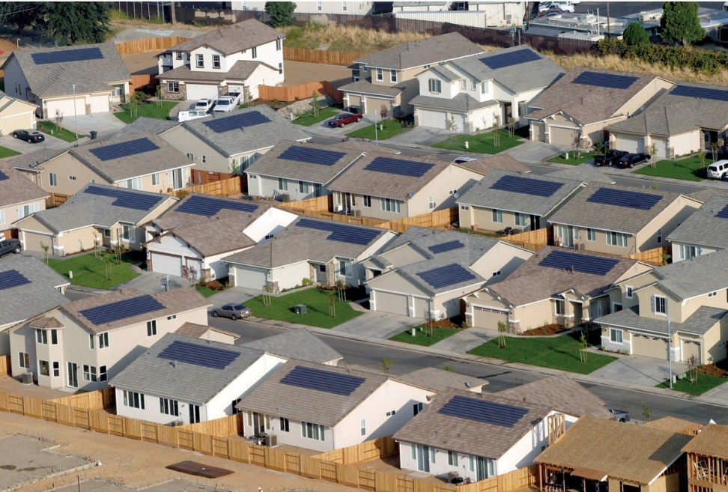
The Ideal Farm
YOUR Neighborhood
A Neighborhood adjacent to Yours
The Neighborhood you Grew up in
A Neighborhood with little or no other REALTOR presence
A Neighborhood you want Listings in!!

Slide 15

Budget
Start by doing a Bi-Monthly “Mailing”
As you create some traction with a new listing, increase your “mailings” by introducing “Just Listed” & “Just Sold” Programs
  Be Pro-Active
    Knock on Some Doors
As you continue to create traction, Increase your “Mailing” to 1 per month

Slide 16

It’s a Process!!
Letter or Postcard of Introduction
Handwritten Note
Your Item of Value
Mini-CMA
Personal Contact
Introduction
Consistent
Persistent

Slide 17

Introduction
Letter or Introduction
Handwritten Note with Business Card

Slide 18
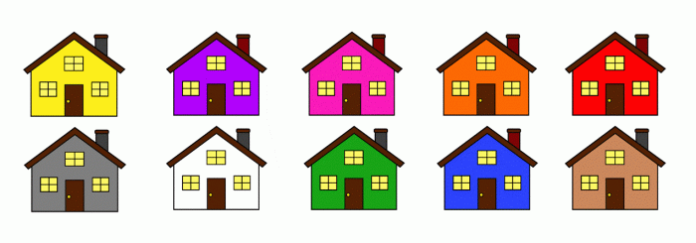
Item of Value
Mini-CMA
  People LOVE to know what’s happening in their neighborhood
  People WANT to KNOW what properties are selling for
  People REALLY want to know what THEIR home is worth in today’s Market

Slide 19
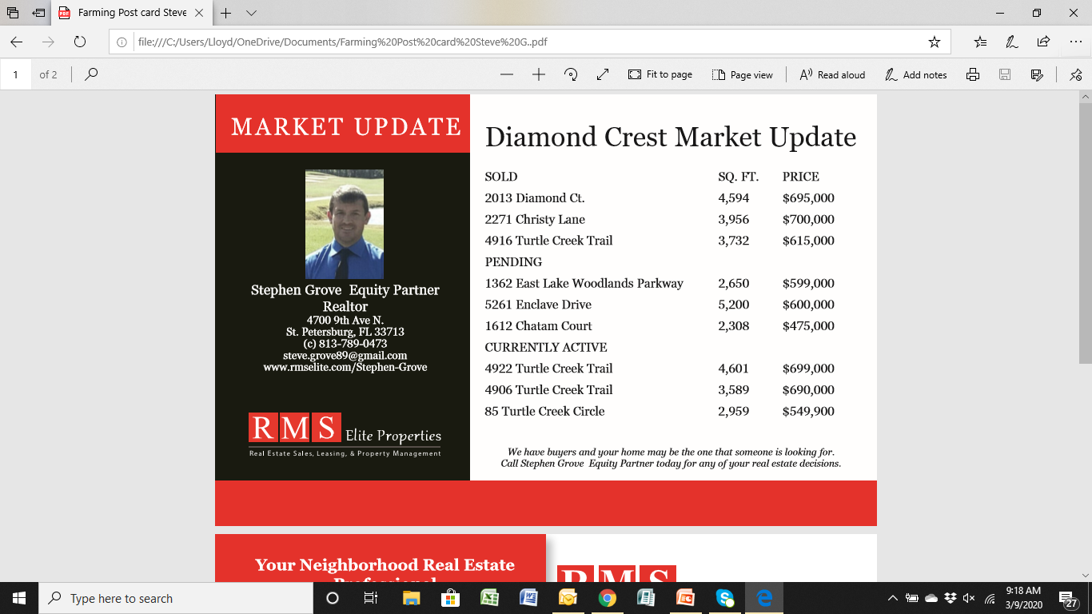

Slide 20
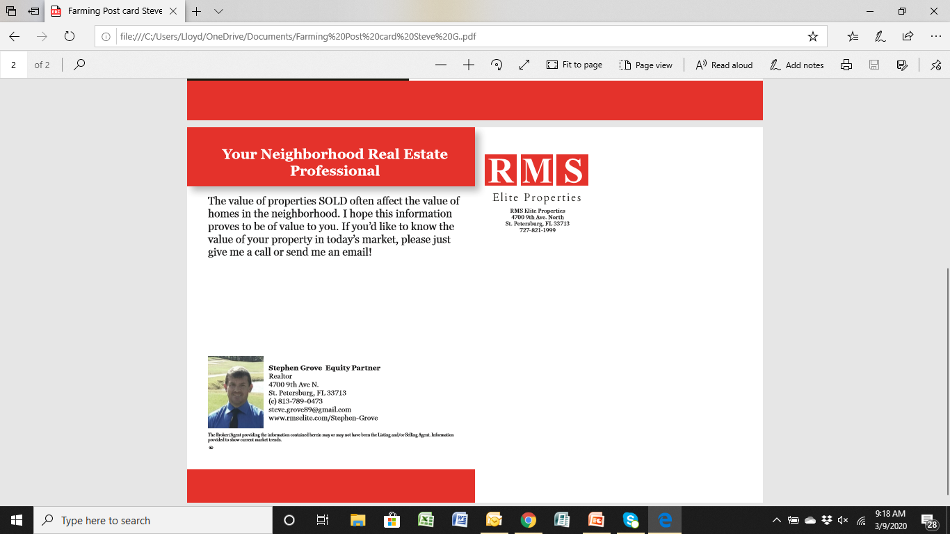

Slide 21


Sweat Equity vs. Check Equity

Slide 22
Consistency
Your must remember that farming is a long-term commitment… and CONSISTENCY of connecting with the people in your farm is KEY.
Homeowner’s need to hear from you, see you & receive information from you on a regular basis
  For example – After you’ve sent two or three pieces of “valuable information”, you should walk the neighborhood to introduce yourself as the person who has been sending the information. Let them know that what they get for their home is IMPORTANT to YOU!!
    Especially if you can honestly say that you’re a “Neighbor”!!

Slide 23

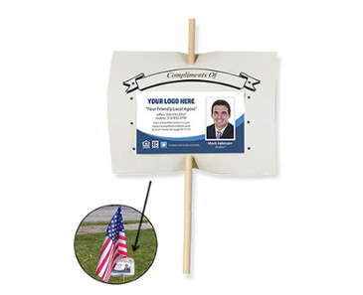

American Stick Lawn Flags
Real Estate Calendars.com

Slide 24
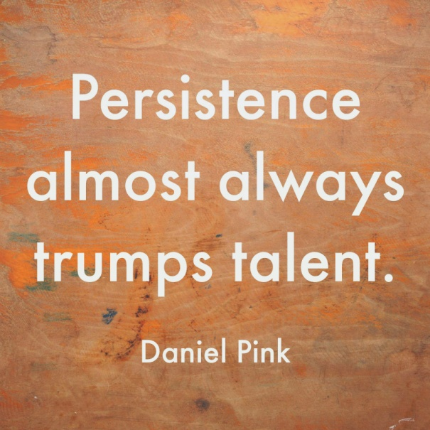
Persistence
You have to be Committed to the “Long Term” strategy
You have to understand that this is a “Process”
You have to understand that you have to continue this process to be taken seriously
Stopping or being inconsistent is the kiss of death

Slide 25
When you have a Farm…
Here are a few ideas for “working” your farm:
  Just Listed cards
  Just Sold cards
  Door Knocking… “Do you know anyone who would like to move in to your neighborhood?”
  Watch for FSBO’s
  Watch for Expired Listings
  Make sure you invite everyone to an open house you might be holding in your farm
  E-mail Campaigns

Slide 26
Websites…
www.GeographicFarm.com
  A Tom Ferry approved website and Farming process
www.TomFerry.com
  Member Case Study… “Direct Mail to Geographic Farm”
www.xpressdocs.com
  Will be the “location” of the CMA Farming Card designed by Lloyd

Slide 27
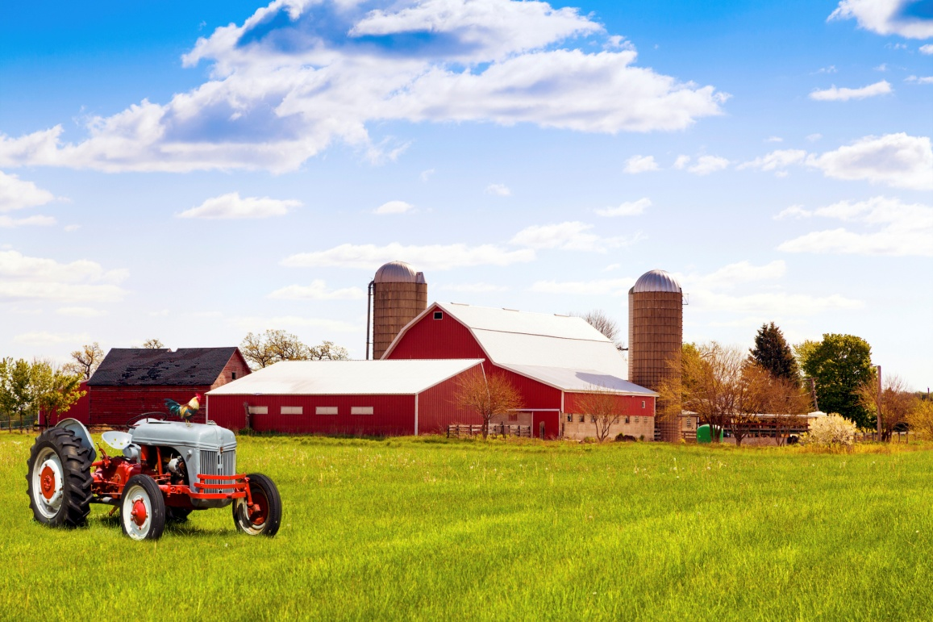
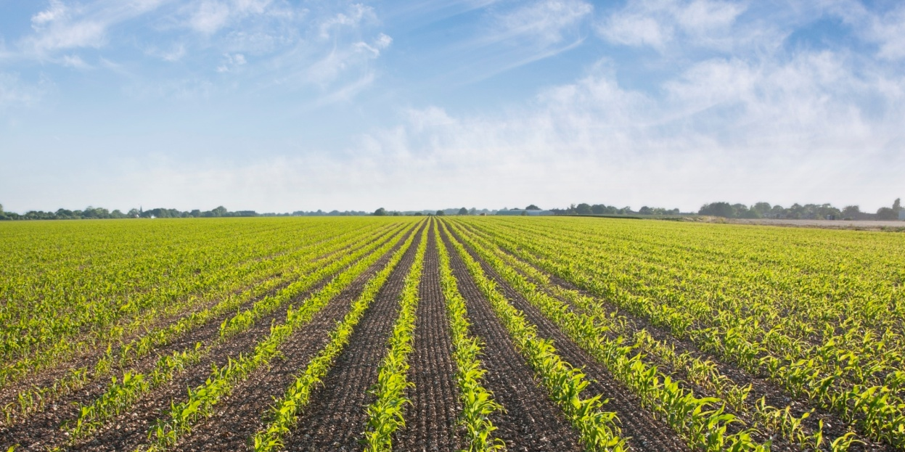

Slide 28

Career Development
  Holding the “Ultimate” Open House
  March 24th in St. Pete!!
  Don’t miss out on any Career Development Opportunity!

Slide 29

Do Some Pop-Bys…
After all…
  Everybody’s Irish on
  St. Patrick’s Day!!

