Slide 1

Pricing & Price Reductions…

Slide 2


Slide 3
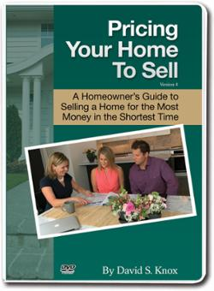

“Pricing Your Home To Sell” by David Knox (Consumer Video)

Slide 4
Your Market Analysis…
The Foundation of Your Pricing Presentation
Comparable Properties for Sale
Comparable Properties that have Sold
Comparable Properties that have Expired without Selling
There are so many “templates” for a Market Analysis
  MLS
  RPR (This will be the subject for an upcoming Career Development Session)
  And Others…

Slide 5
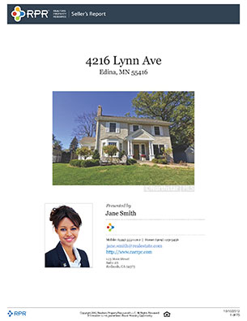

RPR
Realtor’s Property Resource

Slide 6




Putting Your CMA Into A Compelling “Visual”
As we know, Adults learn much better with the use of Visuals
Let me show you how to take your CMA information and put it into a Simple… yet Effective… Format

Slide 7
Dialogue to Best Position the Seller’s Home
“Mr. & Mrs. Seller, I just want you to know that I’m not here this evening to List your home… I’m here to ensure that we Sell it!! After all, that IS our goal, right??!!”
“I hope my Market Analysis helps you understand what the Market is saying about pricing your home.”
“This worksheet is to help us understand each other even more. You told me on our pre-listing phone call that you thought your property’s value was around $220,000.”
“Within your development there is a radius of about five (5) miles where buyers will also look for a similar home. As you’ve seen, there are 5 homes for sale within this area.”
“This is your competition.”

Slide 8

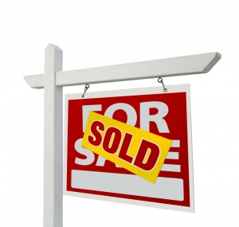

“You’ve also seen the four homes which have recently Sold and the five homes which have Expired, and are no longer listed for sale.”
OR

Slide 9

“At the bottom of this worksheet you can see a graph ranging from “Excitement” to “Risky”. “My job is to create excitement for Buyers to want to see and bid on your home.”

Slide 10
Determining Market Value
Price Positioning Tool
Sellers Estimated Price Objective $220,000
Area Proximity to Subject Home _____5____ miles
Total Available Homes for Sale within MLS _____5____ homes
Total Number of Sold Homes within MLS _____4____ homes
Total Number of Homes that Expired w/o Selling _____5____ homes
Priced to SELL |  |  |  | Priced to EXPIRE
Excitement | Moderate | Average | Below Average | Risky

Slide 11
Price Positioning
“The next chart shows how smart positioning and pricing created excitement (resulting in Sales), & how high positioning created risk for those Sellers who allowed their homes to expire. I don’t want you to be in a position to risk…
  that no one will view your home
  that your home will become old merchandise
  that your home will be used as a vehicle to sell other homes
  that your home will not sell!”

Slide 12
Price Positioning
Excitement Moderate Average Below Average Risky
$200,000 $205,000 $210,000 $215,000 $220,000 $225,000
Blue – For Sale Green – Sold Red – Expired without Selling

Slide 13
My Professional Advice
Based on everything we’ve seen, I believe we should list your property for sale at $210,000.
Let’s take another look at the chart with your home plugged in to the “mix”, understanding that we could go further to the left for more “excitement” or further to the right for a little more “risk”.
What do you think?

Slide 14
Price Positioning
Excitement Moderate Average Below Average Risky
$200,000 $205,000 $210,000 $215,000 $220,000 $225,000
Blue – For Sale Green – Sold Red – Expired without Selling

Slide 15
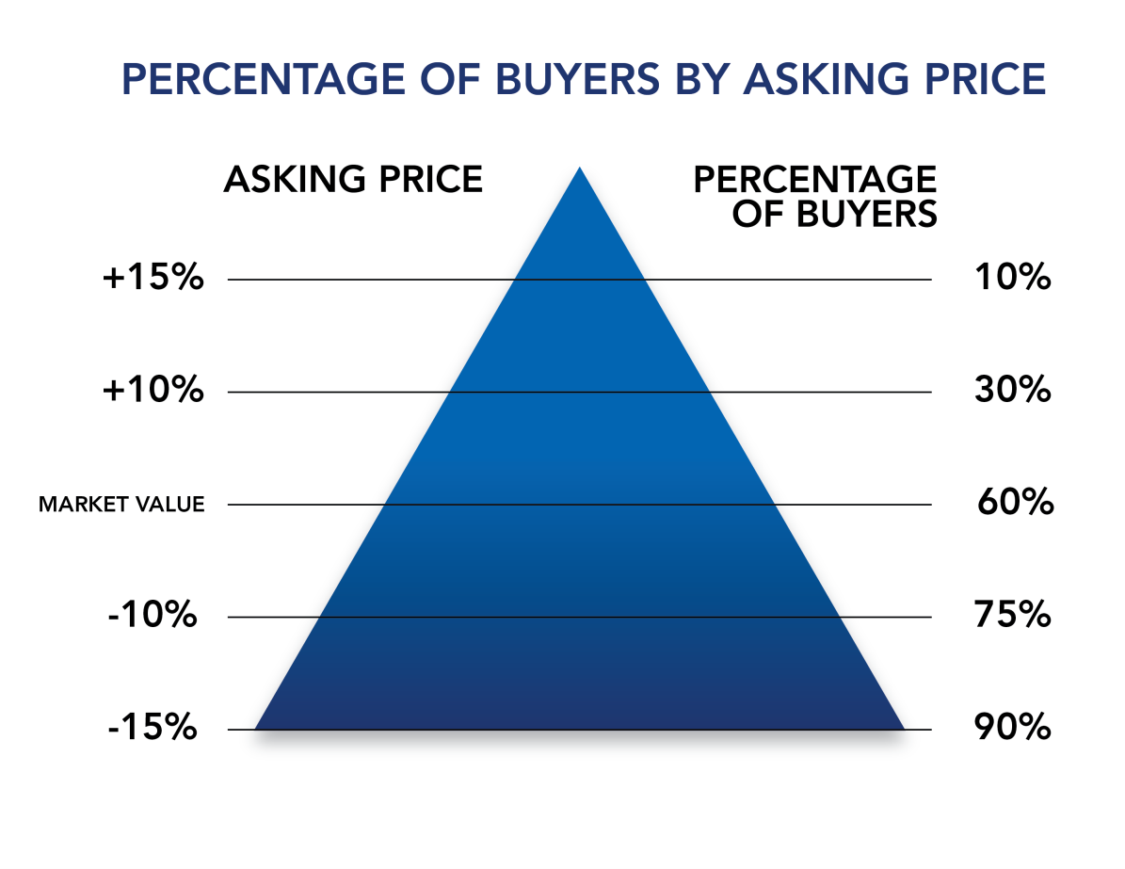
Sale Price vs. List Price
• Buyers are quicker to make an offer on a home if priced correctly
• The longer a home is on the
market, the less likely it is to
sell at full price
• It is imperative to review
activity and assess pricing on
a regular basis

Slide 16
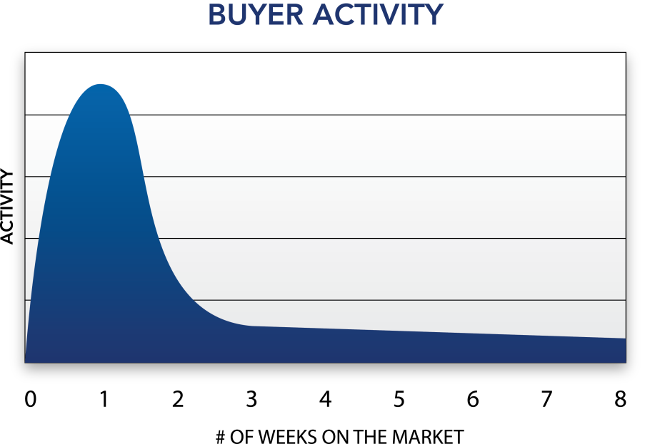
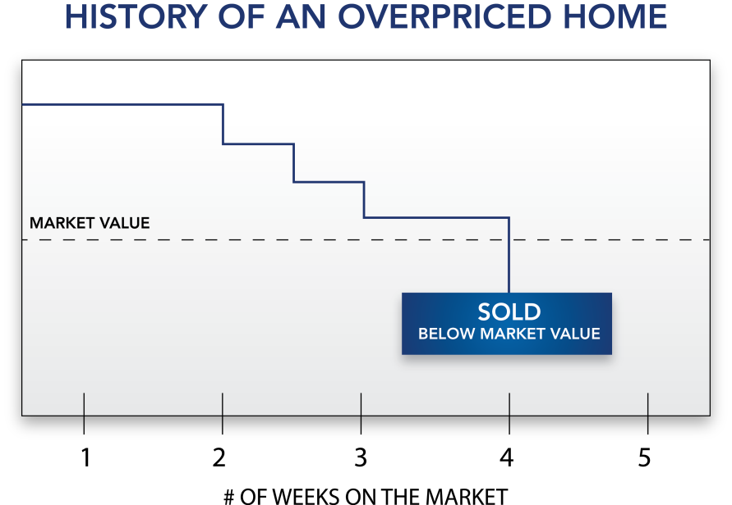
The Dangers of Overpricing
• An asking price beyond market range can adversely affect the marketing of a property
• Helps sell your competition’s home that is priced correctly
• Marketing time is prolonged and initial marketing momentum is lost
• Takes a longer time to sell
• The property may eventually sell
below market value
• Fewer buyers will be attracted

Slide 17
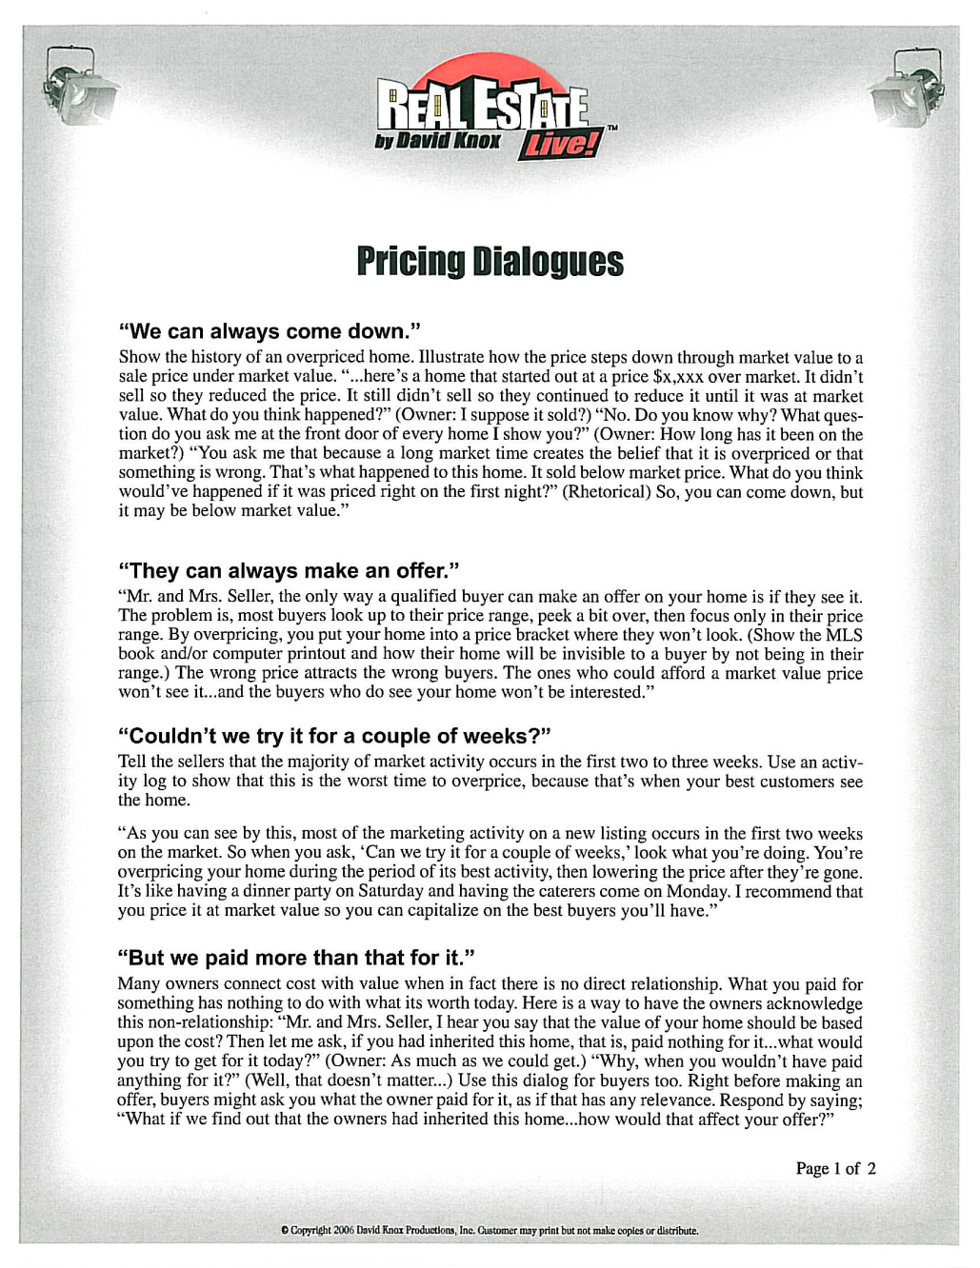

Slide 18
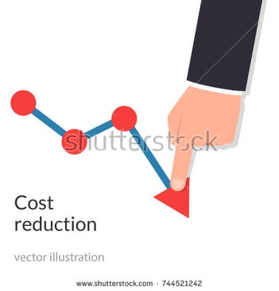
Price Reductions
This is just a reality that you will face during your career as a Real Estate Professional
Navigating a Price Reduction can be tricky, but if done correctly, you’ll enhance your relationship with your Sellers and help them achieve their objectives.

Slide 19

The 5 Stages of a Price Reduction
It is important to have compassion for your clients and understand the stages sellers often go through when their home is not selling as quickly as anticipated and they must consider reducing the price.

Slide 20

Stage 1
Denial:
  Due to emotional attachment, many homeowners overestimate the market value of their home by 5-10%
    SmartMoney Magazine

Slide 21

Stage 2
Anger:
  After a week or two of inactivity, your Sellers may be getting upset and looking for someone to blame.

Slide 22

Stage 3
Frustration:
  Your Seller’s pent up anger could now be directed at you and your skills as a professional salesperson.

Slide 23

Stage 4
Disappointment:
  Through continued education on the neighborhood market, they discover that their price is unrealistic and they’ve missed out on their prime marketing opportunity.

Slide 24

Stage 5
Acceptance:
  Nearly 56% of Sellers said they reduced their asking price at least once. The average price reduction was 11%.
    NAR Profile of Sellers
    Turlia.com Price Reduction Report

Slide 25
Help your Sellers through the Process
Be Visible
  Communicate with your Sellers to show that you are doing all you can to sell their home.
    Call at least once a week to update them on all activity, feedback, and neighborhood information
      New Listing
      Price Reduction
      Sold
    Write a Personal Note to let them know you appreciate their business
    Every 21 days, do a face-to-face Pop-By to go over your marketing plan and to update your market analysis.

Slide 26
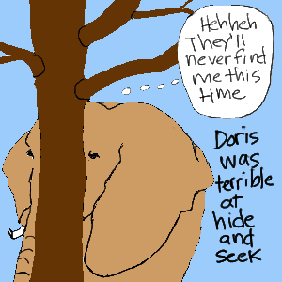
Don’t Hide

Slide 27
Listen
  The best way to make Sellers comfortable enough to let down their guard is to hear what they have to say and affirm their feelings
Put Them in the Shoes of a Buyer
  Go with them to view the other homes considered to be their competition. Talk through the decision process a buyer goes through when considering a home to purchase
Communicate Effectively:
  As you are giving your Sellers updates, use excellent dialogues to reassure them that you care and want to help them sell their home for as much as possible.
  (I’ve shared some GREAT dialogues for Price Reductions)

Slide 28

Thank You for being here

Slide 29
“Third Thursday”
February 21st – This Thursday!!
Holiday Inn, 1200 34th St. North, St. Petersburg
10 AM
Light Breakfast at 9:45 AM
Main Topic of the Day…
  Taxes and the Independent Contractor

