Slide 1

The RMS Elite Properties’
Pre-Listing Packet

Slide 2

Reasons for a
Pre-Listing Packet
Raises the acceptance level in advance
Establishes credibility in advance
Creates “You’re the agent…” recognition
Gets the Sellers involved with you before you ever meet them
Prepares the Seller for a “conversation” instead of a lecture

Slide 3
The Elements of a Powerful Pre-Listing Packet
Personalized Cover Sheet
Introductory Letter
Professional Resume’ or Personal Brochure
Company Information
  Mission Statement & Core Values
My Elite 20 Point Marketing Plan
  “Safely Listing, Marketing & Selling Your Home”
The Home Enhancement Checklist
The Home Improvement Log
“Things to Consider when Selling Your House”
  Educational Seller’s Guide

Slide 4
What is the Message You’re Seding
Professional
Prepared
Organized
Different
You Care
  About their needs & wants
  About their goals
  About their knowledge of the Selling Process
  About their questions
  About THEM & their HOME
  About RESULTS

Slide 5
Let’s take a look…
One Page At A Time…

Slide 6

The Actual Presentation
The Quality of your Presentation is a “First Impression Opportunity”… Take Advantage of That !!
Use Linen Paper… Use Color… Customize…
They WILL judge your Professionalism on the Quality of this marketing piece & ANYTHING else you may send to them!!

Slide 7
Pre-Listing Packet
Prepared for:
Mr. & Mrs. Smith
St. Petersburg, FL
Table of Contents
* Introductory Letter
* Professional Resume’
* RMS Company Information
* Mission Statement & Core Values
* 20 Point Marketing Plan
* Home Enhancement Checklist
* Home Improvement Log
* “Things To Consider When Selling Your House”

Slide 8

Real Estate Sales, Leasing, Property Management, Investment Services
April 21, 2020
Dear Mr. & Mrs. Smith:
Thank you for taking the time to review the enclosed materials I have prepared for you. In addition to some general home selling information, you will also find information on RMS Elite Properties and my written Marketing Plan showing how I propose to market your property.
You will receive competent and professional service when you select me and RMS Elite Properties to assist you in the sale of your home. We have assisted many Sellers in the area with successful results. Knowledge and Communication are the keys to a successful relationship, and we are committed to both.
I look forward to meeting with you, live or virtually, to discuss the enclosed materials as well as review a comprehensive marketing analysis that will assist us in determining the market value and pricing of your home. Our GOAL is to successfully sell your home for the most money the market will bear in the shortest amount of time.
I will contact you within the next few days to schedule our “meeting”.
Sincerely,
Lloyd Dreibelbis, BROKER, CRB, CRS, GRI RMS Elite Properties 4700 9th Ave. N. St. Petersburg, FL 33713
rmslloyd@gmail.com

Slide 9
Lloyd Dreibelbis, Broker
CRB, CRS, GRI
“Mastering Professionalism in Real Estate”
“Knowledge & Experience Matter”
30 Years of Real Estate Sales & Management Experience
  Past Regional President for a Top 10 National Company
Broker Licenses in Florida & Pennsylvania
Professional Real Estate Designations
  Certified Residential Brokerage Manager (CRB)
  Certified Residential Specialist (CRS)
  Graduate REALTORS Institute (GRI)
Real Estate Instructor for more than 20 Years
REALTOR® - Working under strict Code of Ethics
Member
  National Association of REALTORS
  Florida Association of REALTORS
  Pinellas REALTOR Organization
  Real Estate Association of Sarasota & Manatee Counties
Certified Real Estate Success Coach
  Ron Willingham’s Integrity Coaching Graduate
Real Estate Consulting Services
  Dreibelbis Consulting
Certified Mentor – Buffini & Company
  100 Days to Greatness
  Peak Producers

Slide 10

RMS Elite Properties, one of the fastest growing Real Estate Companies in the Greater Tampa Bay Area, is built on a very strong foundation. A foundation that includes an incredibly successful Real Estate Investment firm, and a Property Management Company second to none. Our company is unique by virtue of our relationships with ready, willing and very capable buyers of Real Estate at all times.
RMS Elite Properties is a company based on the premise that you & your needs are our Primary goals & responsibilities. We are committed to running our business with Honesty, Integrity & Professionalism that will last beyond the transaction, and realize that these traits are integral to our long term relationship.
We want you to be a Customer for Life! We don’t want to be just your Agent… we want to be your Elite Agent!!

Slide 11
My 20 Point Marketing Plan
“Safely Listing, Marketing & Selling Homes”
Now Offering – Virtual Seller Consultations / Listing Presentations via ZOOM
  Live Consultations & Presentations (as permissible)
Now Offering – An Informational/Educational Pre-Listing Packet via e-mail
  Hard Copy Available for Home Delivery
A Written Competitive Market Analysis on Pricing Your Home in Today’s Market
  We’ll take a look at your Competition, and what Homes like yours are selling for TODAY
A Home Enhancement Checklist Review in preparation to SELL your Home
  Indoor and Outdoor Tips to make your Home as marketable as possible
A Listing Contract Review & Signatures
  This will allow us to begin Marketing your Home
Professional Photography scheduled
Prepare Virtual Tour &/or Property Video
Add your Home to our Multiple Listing Service reaching thousands of Professional Real Estate Agents throughout Florida
Professional Yard Sign
  Still one of the most productive marketing techniques in Real Estate
Create a Professional Brochure on your home
Promotion of your Home on Social Media Sites
  Facebook, etc.
Notify Agents in my office & throughout my network
Tell 50 Program
  Physically knocking on doors in the neighborhood to see if anyone they know may be looking into buying a Home in the area
Now Offering – Virtual Open Houses for the Public
  Live Open Houses (as permissible)
Broker Open Houses / Neighborhood Open Houses (as permissible)
  Asking local Brokers and Agents to visit your Home for Feedback
Aggressive follow-up with Prospective Buyers
Constant Communication based on YOUR expectations
  Weekly Updates
  Feedback on Showings
  Tracking New Market Data for our analysis
Market Analysis Review every 30 Days – Now Offering Virtual Reviews
  Live Reviews (as permissible)
Complete Transaction Management from Listing to Closing to Moving
Add you to my Client Appreciation Program
  My “Customer For Life Program” to keep in touch and to assist with any of your referrals

Slide 12
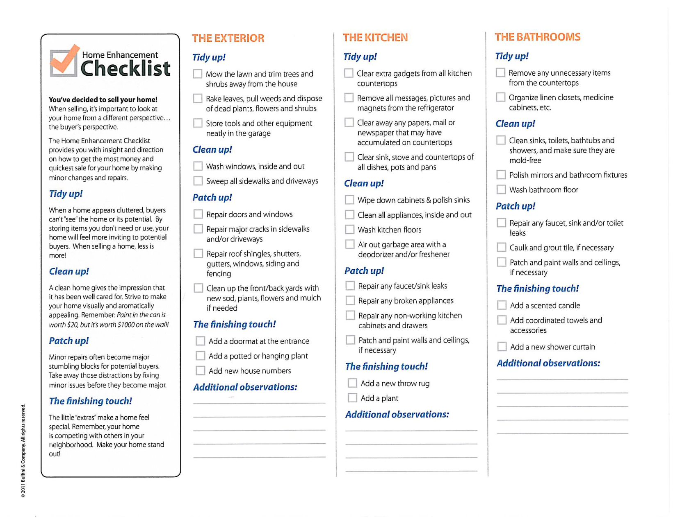
Home Enhancement Checklist

Slide 13
Home Improvement Log
Approximate Description Approximate
Date Cost
__________ ______________________ ________
__________ ______________________ ________
__________ ______________________ ________

Slide 14


Slide 15
Thank You!!

