Slide 1
Marketing with the Masters
Steve Harney, Founder / Keeping Current Matters
David Knox, CEO / David Knox Productions
Brian Buffini, CEO / Buffini and Company
Tom Ferry, CEO / Tom Ferry Coaching

Slide 2
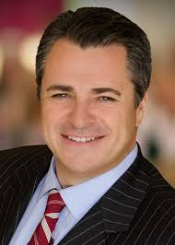
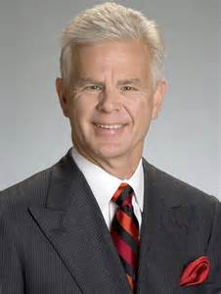
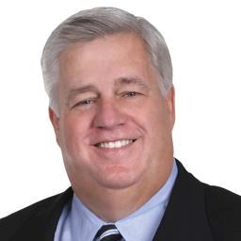

The Masters…
Brian Buffini
David Knox
Steve Harney
Tom Ferry

Slide 3
Marketing
What is it?
  For one, we know that it’s 5 times more important than ANYTHING else you do.
    Including Customer Service – where you’ll spend a majority of your time.
WHO am I marketing to?
HOW am I marketing?
HOW OFTEN am I marketing?
WHY am I marketing?
WHAT am I using to market?

Slide 4
What is Marketing?
“Marketing is based on thinking about the business in terms of customer needs and their satisfaction!”
Marketing differs from selling because (in the words of Harvard Business School’s retired professor of marketing Theodore C. Levitt)…
“Selling concerns itself with the tricks and techniques of getting people to exchange their cash for your product!”

Slide 5
Marketing… by definition
“Marketing is the study and management of exchange relationships. Marketing is the business process of creating relationships with and satisfying customers.
With it’s focus on the customer, marketing is one of the premier components of business management.”
Wikipedia

Slide 6

Who Am I Marketing To?
Based on the Psychology of Sales… & the Concept of Repeat & Referral Business
  My List of Relationships
    My Database
      Circle of Influence
        Friends
        Family
        Etc.
  Those with whom I Wish to do Business
    FSBO
    Expired Listing
    Geographic Farm
    Etc.
Psychology of Sales
  Know You
  Like You
  Trust You

Slide 7
How Am I Marketing?
Based on Your Personal Business Plan
  Phone Calls
  Personal Handwritten Notes
  Pop-Bys
  Social Media
  Direct Mail / e-Mail Campaigns
  Geographic Farming
  Open Houses
  Personal Encounters
    Coffee / Lunch / Golf / Tennis

Slide 8
How Often am I Marketing?
It depends on the Activity… “RULE of THUMB”
  Phone Calls & Personal Notes
    Your TOP 120 contacts should receive ONE phone call & ONE personal handwritten note every Quarter
      ALWAYS ASK for that REFERRAL
  Pop-Bys / Personal Encounters
    Your TOP 24 contacts should see you personally ONE time per Quarter
      ALWAYS ASK for that REFERRAL
  Social Media
    POST regularly
    Keep that Business Page Separate from your Personal STUFF… TMI
  Direct Mail / e-Mail Campaigns
    ONE mailing / Quarter is good
    ONE mailing / Month is Awesome

Slide 9

Why Am I Marketing?
LEADS!!!
Building Relationships
LEADS!!!
Top of Mind Awareness
LEADS!!!
To Enjoy a Successful Career
LEADS!!!
Survival

Slide 10
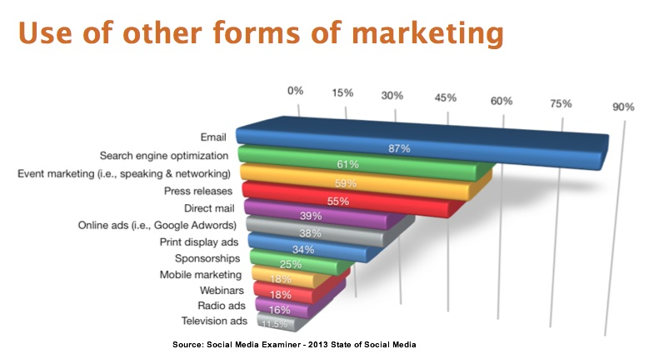
What Am I Using to Market?
Here’s where most Agents get bogged down… Then determine to do nothing!!

Slide 11

www.KeepingCurrentMatters.com

Slide 12
What’s Available On-Line?
Free Content
  Article Topics
    Content Marketing
    Sales & Leads
    Social Media Marketing
  Educational e-Guides
  Webinars
Members
  Monthly Fee - $24.95/month
    Personalization!!! & More Content!!!
Additional Content
  Personalized Videos - $15.00/mo. additional

Slide 13


Buyer & Seller Guides…
Quarterly Publications for Sellers & Buyers

Slide 14

Blogging / Posting Made Easy

Slide 15


www.DavidKnox.com

Slide 16
What’s Available On-Line
Free
  Scroll Down to the Bottom of David’s HomePage
    “Updates from David Knox in Your inbox”
      Sign-Up
Google “David Knox YouTube”
  There’s a Plethora of Great Content to Watch
Marketing
  Consumer Videos

Slide 17




Consumer Videos

Slide 18

www.BuffiniandCompany.com

Slide 19
What’s Available On-Line
Free on www.BuffiniandCompany.com
  Resources
    Blogs
YouTube
  Google Brian Buffini YouTube
    Tons of Content
Marketing
  Items of Value
  Pop By Tags & Ideas
  Real Estate Report
  Complete Marketing Plan (Listing Presentation)
  Membership Benefits…

Slide 20



Items Of Value…
Direct Mail to TOP 24
E-Mail to your ENTIRE Database
Use to “Display” at your Open Houses

Slide 21

Real Estate Report

Slide 22

THE
Complete Home
Marketing Plan
Place Your Picture
Here
Your Name
Your Information
(760) 123-4567
janedoe@example.com
© 2012 Buffini & Company. All rights reserved.

Slide 23

www.TomFerry.com

Slide 24
What’s Available On-Line
Free at www.TomFerry.com
  “Resources”
    Agent Tools
      Download Marketing Ideas
    Blog
    Video Library
YouTube – Google Tom Ferry YouTube
Join Tom’s VIP List for weekly tips & ideas

Slide 25
Marketing… by definition
“Marketing is the study and management of exchange relationships. Marketing is the business process of creating relationships with and satisfying customers.
With it’s focus on the customer, marketing is one of the premier components of business management.”
Wikipedia

Slide 26

What’s In Your Wallet??
What Marketing Ideas Have You Picked Up Today that will keep you on a Path to Success??

Slide 27
“Third Thursdays”
January 17th - 2019 Kickoff Meeting!!
“How to Incorporated Property Management into your Business Plan”… Mike D’Aloia
Don’t Miss out… I’d REALLY appreciate your attendance!!
Light Breakfast
Speaker
A Word from our Title Company
New Company Programs
Announcements
& More!!

Slide 28



Next Career Development Training Session…
January 21, 22, 23
  “The Listing Presentation”

