Slide 1

Managing Your Time & Productivity
Important Things First!!

Slide 2

Managing Your Time -
Big Rocks – with Stephen Covey

Slide 3
Manage Your Time / Plan Ahead
LAY OUT the year
PLAN the month
SCHEDULE the week
PRIORITIZE the day
  Put Your “Power Hour” in Session!!

Slide 4
Lay Out the Year
Year at a Glance Calendar
  Personal / Family / Relationship Time FIRST
    Mark Holidays – Even if you have nothing planned… yet
      Circle them
    Schedule Planned Trips – Block out the days
      Nothing Planned Yet?
      Block out a Proposed Trip/Vacation
    Schedule Planned Breaks – Block out the days
      Get-A-Way Weekend
      If nothing is planned… Block out a Proposed Break
    Schedule Planned Personal Time
      Date Nights

Slide 5
Schedule Quarterly Lead Generating Activities in your Annual Calendar…
Direct Mail to your Top 24 Contacts
  Be Specific to the Month and the Day
Geographic Farming
  Be Specific to the Month and the Day
    You might want to do this Quarterly Activity in different months than your Direct Mail

Slide 6
Plan the Month
What Monthly Activities have you put into your Business Plan?
Use the “Monthly Work Plan” to help you schedule them AHEAD of time
  Be Specific to a Date
    Item of Value e-mail to Database on the 15th of the Month
    Holiday e-mail to Database on the week prior to the Holiday
  Transfer your Quarterly Activities (from your Annual Calendar) to your Monthly Work Plan
    Item of Value Mailing to Top 24
    Geographic Farm Mailing

Slide 7
Schedule the Week
Use your “Weekly Work Plan” as you continue to schedule…
Personal “Stuff” First
  Morning Routine
  Son’s Soccer Game
  Daughter’s Softball Game
  Club Lunches (Kiwanis, Lions, Chamber of Commerce)
Now Fill in your Business Activities
  Power Hour(s)
  Training Sessions / Coaching Sessions
  Coffee with someone on your Database
  Seller Maintenance
  Buyer Maintenance
  Pop-Bys

Slide 8
Prioritize the Day
Use your “Daily Work Plan” as you start to Prioritize your Day…
Personal Time & Activities
  Morning Routine
  Coffee with someone (may only be one day/week)
  Dinner with the Family
Appointments – Listing Appointments/Buyer Showings
  As often as you can!!
Seller Maintenance (will probably not be every day)
Buyer Maintenance (will probably not be every day)
Training / Coaching
Power Hour(s) – These activities “may” include:
  Calls
  Notes
  Social Media Time
  Prep Time for Open House, etc.
Pop-Bys (as per your plan)

Slide 9
How to Schedule
Personal / Family / Relationship Time FIRST
Schedule Appointments Next
Schedule Buyer & Seller “Maintenance”
Schedule Training & Business Meetings
Schedule Lead Generating Activities in the time you have left each day
  One / Two Hours a Day of FOCUSED TIME is Ideal for Lead Generation
  Power Hour (s)
    Can be in 30 minute segments

Slide 10
Power Hour
If you only have a limited amount of time left in your daily schedule:
  CHOOSE the Activities you want/need to do
    Phone Calls
    Pop-Bys
    Direct Mail
    Personal Handwritten Notes, etc.
  CHOOSE the People you’d like to provide the activities to
    Start with your A+ contacts, A’s, B’s… then C’s (as you have time)

Slide 11
Non-Negotiable vs. Negotiable
What’s Important
  1) Personal (Non-Negotiable)
  2) Lead Generation (Non-Negotiable)
    Power Hour
      Doing the Activities in Your Business Plan
  3) Client Follow-up (Non-Negotiable)
  4) Everything else… (Negotiable)
  A “Commitment Affirmation”: I will make the non-negotiable things in my schedule a Priority today… NO MATTER WHAT!

Slide 12
Keep things moving forward
Tracking
Keeping Accountable
Who did I contact
How did I contact them
When did I contact them
Get a Coach
Find an Accountability Partner
SOMEONE

Slide 13
Manage Your Energy
The Energy Equation
  Energy DRAINERS
  Energy GIVERS
  Energy SUSTAINERS

Slide 14
Energy Drainers
Fear*
Worry*
Indecision* – *The BIG Three
Drama
Personal Conflict
Poor Physical Condition
Lack of Direction – No Plan
  “Before you can manage your time, you need to have something to manage!!” Lloyd D.

Slide 15
Energy Givers
Associations – Those individuals you most associate yourself with…
  “You take on the personality and attitude of the 5 people you spend the most time with”…
Mental Intake
Taking Care of Yourself
Alignment of Values
Written Goals
Structure
  Structure is your FRIEND!!

Slide 16
Energy Sustainers
Tracking your Progress
Visual Anchors
Consistency
Taking a Break
Accountability
  “You just need someone who understands where you want to go & how you plan to get there… it’s called a Coach!!” Lloyd D.

Slide 17
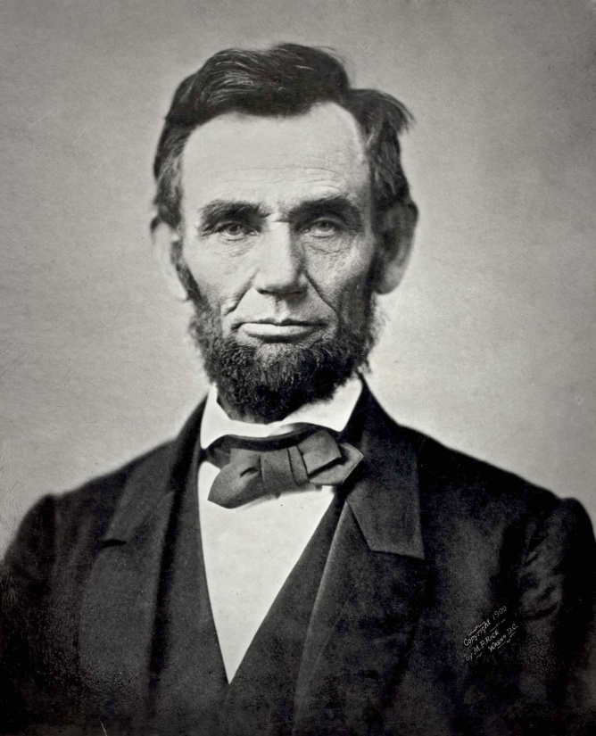
Words of Wisdom…
Every Success Story has Chapters of Failure!!
  Look at the Life of Abraham Lincoln
Don’t Worry About the Results
  Worry about the Activities!!
    Calls
    Notes
    Pop-Bys
    Open Houses
    Geographic Farming
    Face-to-Face Contact
      Coffee
      Lunch

