Slide 1
Keys to Selling Your Listing “Virtually”
From a Keeping Current Matters BLOG

Slide 2
Two Post COVID Realities
1)Virtual Marketing
2)Virtual Selling
“Virtual” will has become the “New Normal”
Lloyd D.

Slide 3
Virtual Marketing
In today’s rapidly changing market, it’s more important than ever to make sure you have a digital game plan and an effective online marketing strategy when listing a home for sale.
  Game Plan & Marketing Strategy
    Photos and Virtual Tours must Stand Out from the crowd
      Professional Photos
      Professional Tour using Professional Photos &/or Video
      Give Potential Buyers a detailed and thorough VIEW of the Listing

Slide 4
Technology
According to a recent realtor.com survey, when asked to select what technology would be most helpful when deciding on a new home, here’s what today’s DC (During COVID) homebuyers said, in order of preference:
Virtual Tour of the home
  Virtual Open Houses
Accurate and detailed listing information
Detailed neighborhood information
High-quality listing photos

Slide 5
Virtual Selling
In the same survey by realtor.com (Would-You-Buy-a-Home-Without-Stepping-Foot-Inside), people thinking about selling their homes indicated they’re generally willing to allow their agent and some potential buyers inside if done under the right conditions.
“The Right Conditions”
  Pre-Approved Buyer(s) ONLY
  Buyer has physically “seen” the property by “driving past the house & through the neighborhood”
    Nothing worse than going through the COVID-19 hassle of preparing for a showing only to find out the Buyer doesn’t want to see the home for either of these reasons.

Slide 6
Physically Going to the Property
After leveraging technology, if you have serious buyers who now want to see your listing in person, keep in mind that according to the N.A.R., there are ways to proceed safely (https://www.nar.realtor/coronavirus-a-guide-for-realtors).
  Understand that the top priority should always be to obey state and local restrictions first!
  Have “In-Person” Guidelines in place for any showing

Slide 7

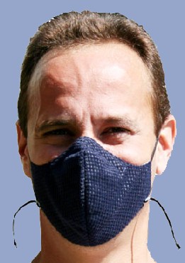
In-Person Guidelines
Limit in-person activity
  Hands OFF Visit
Require guests to wash their hands or use an alcohol-based sanitizer
Remove shoes or cover with booties
Follow CDC guidance on social distancing and wearing face coverings

Slide 8
The “Digital Sale”
Learn how to make a “sale” happen by putting the necessary digital steps in place
  Put together a Digital Marketing Plan
    Make “digital” a “normal” part of your “Post COVID” marketing plan
  Remember what Technology a digital homebuyer thinks is Important?
    These things will make a great “template” for that marketing plan

Slide 9
Nate Johnson, CMO at realtor.com
“As real estate agents and consumers seek out ways to safely complete these transactions, we believe that technology will become an even more imperative part of how we search for, buy and sell homes moving forward.”
It sounds like some of these “new” practices might be here to stay!!
Why not prepare NOW!!

Slide 10



