Slide 1
How to be a Successful Entrepreneur
An RMS Career Development Training Module

Slide 2
“Entrepreneur”
By definition
BusinessDictionary.com
    defines an entrepreneur as “someone who exercised initiative by organizing a venture (business) to take benefit of an opportunity and, as the decision maker, decides what, how, and how much of a good or service will be produced or provided”
    “a person who builds &/or operates a business or businesses, taking on a greater than normal amount of risk than someone who is an employee of a business”
      RISKS
        Financial risk, Career risk, Emotional risk & overall Business risk

Slide 3
“Independent Contractor”
By definition
Merriam-Webster defines an Independent Contractor as
  “a person hired to do work who controls how the work is done; one that contracts to do work or perform a service for another and that retains total and free control over the means or methods used in doing the work or performing the service”
    An “entrepreneur” is usually a sole proprietor, a partner, or the one who owns the majority of shares in an incorporated venture… I would add “independent contractor” to that mix!

Slide 4

So… do you consider yourself an “Entrepreneur”?

Slide 5

66%
Did you know…
  According to the Small Business Administration, 66% of new businesses fail within their first 10 years!!

Slide 6


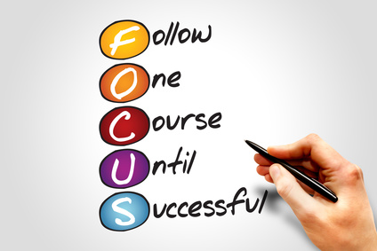


Skills of a Successful Entrepreneur
A Great Entrepreneur must be able to effectively:
  Communicate
  Sell
  Focus
  & Strategize

Slide 7

Traits of a Great Entrepreneur
I think a great entrepreneur must have these traits:
  Self Motivated
  Self Reliant
  Confident
  Highly Optimistic
  & Driven by the quest for excellence

Slide 8

So…
Do you still consider yourself an “Entrepreneur”?

Slide 9


The Real Estate Entrepreneur
One of the first things you need to realize is that this is YOUR business
  YOU are in charge
  YOU are your biggest asset
  YOU are the only employee

