Slide 1
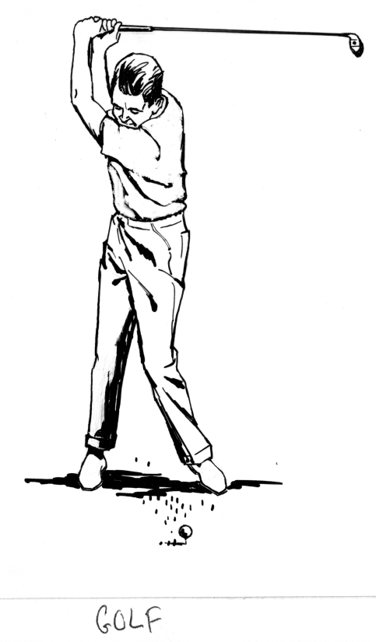

So… What does your perfect Sunday Look Like??
Coffee in the Florida Room
Brunch at the Siesta Key Oyster Bar
A Round of Golf
Watching Football
Puttering around outside
An Open House… Really????

Slide 2

Holding a Mega
Open House
Go Big or Don’t Go!!

Slide 3

What is Your Definition of the Perfect Open House??

Slide 4
Here’s the deal…
I’m going to give you a lot of Suggestions!
I’m ready for all the excuses as to why you can’t (don’t want to) do them!
  Some legitimate… Some not so much…
So here’s the question I’m going to be asking throughout the presentation today
If you can’t do this, what CAN you do??
  Because we have to do something to make our Open Houses more worthwhile!!

Slide 5
The definition of Insanity…
Insanity… Madness… Lunacy… Psychosis…
“Doing the same things and expecting different results!!”

Slide 6
Why Do An Open House
The Seller wants one!!
  That’s GOOD
You Need Buyers!!
  That’s a FACT
This is Valuable Time…
  Use it wisely!!
  GO BIG or STAY HOME

Slide 7


What Was Your Last Open House Like?
Most agents set a date on their calendar and pray to the Real Estate Gods that people will show up!

Slide 8

Get Real…
You & I both know that you have to be intentional with your actions
If you are, you can create an Open House that Generates Leads and/or finds the right Buyer!

Slide 9
What is a Mega Open House?
It’s a fun and creative way to maximize your next Open House…
Have food (snacks) & entertainment (even taped)…
Make sure it’s a FUN & engaging atmosphere…
Invite ALL the neighbors to your Mega Open House!!

Slide 10
How to Host a Mega Open House
The goal of an Open House is to of course sell the home & find Buyers (don’t tell the Sellers)… but an added benefit of the Mega Open House is the shear number of connections you will make because you’re also making valuable connections with people in the neighborhood who might want to sell their homes!!

Slide 11
Reasons to Host a Mega Open House
#1 Reason: The House is in your Farm!!
#2 Reason: This is a HOT Property
#3 Reason: You don’t Really Need a Reason
  Remember… You can use parts of this Mega Open House Plan for ANY Open House!! The “better” the house, the more “parts” of the Mega Open House Plan should be considered!!
  PROMOTE the HECK out of your MEGA OPEN HOUSE!!

Slide 12
How to Make Your Mega Open House Stand Out
BECAUSE OF ZONING &/OR HOA RESTRICTIONS, you may not be able to do all of these things.
  Do the BEST you CAN under each circumstance
6 days before
  Place tall, bright colored flags in the front yard and some kind of sign rider that says…
    OPEN HOUSE SUNDAY 1 – 4
5 days before
  Make sure you POST your Open House in the MLS
    If you can’t do this, what CAN you do??

Slide 13
Four…
4 days before
  Send out Open House Flyers, especially if the property is in your farm. (If they are being mailed they must go out 3 days before the Open House) If they are being dropped off, a much better idea, it’s better to go out 2-3 days before. Inviting neighbors is a great reason to go door knocking!!!
    Introduce Yourself. Tell them your hosting an Open House in the neighborhood.
    Ask them if they know anyone who might want to move into the neighborhood!!
    Invite THEM!!
  Create a short (30 second) video inviting people to your Open House. Email it to your database (within a radius).
  Learn how to do this… it’s a great marketing idea!
  If you can’t do this, what CAN you do??

Slide 14

Three…
3 days before
  Place an ad for the Open House in the local newspaper
  Place the Open House on your Facebook page – Add the video you just made!!
If you can’t do this, what CAN you do??

Slide 15
Two…
2 days before
  E-mail or deliver an Open House preparation “checklist” to your Seller
  Go door knocking in the area to invite neighbors.
  Prepare items necessary for a successful Open House!!
    Sign-in sheet
    Business Cards
    Flyers
    Water / Coffee / Snacks / Be Creative
    Financing Information from your lender / Maybe your lender would even join you and share the expense!
    Display Items of Value, and Welcome Message, in plastic sleeves
    If you can’t do this, what CAN you do??

Slide 16
One…
1 day before
  Review Your Dialogs and Scripts
  If it’s a HOT property hold a “by invitation only” Open House from 6 – 8 the evening before the main Open House. Invite the neighbors from a 3 – 4 block radius. If you know that you will have a very large turn out the next day, it’s a very effective way to deal with the neighbors first.
  If you can’t do this, what CAN you do??

Slide 17
Blastoff…
Open House Day
  8 AM – Set up multiple Open House signs (strategically placed). Have additional flyers dropped off at any local coffee shops and restaurants that have a big breakfast crowd.
  Balloons…
  Welcome every visitor personally and focus on making connections.
  Have a lead capture System in Place
    Use Display Items to get good database information
  If you can’t do this, what CAN you do??

Slide 18

Your Lead Capture System
Welcome your “Guests”
Have them Sign-In
  The Seller Requested it
Have your “Displays” in a prominent place
Engage Your Guests
  Use Dialogs

Slide 19
Day After
Follow Up with All Leads!!
Add leads to database. Be sure to tag them with the date and home where you met.
  Now that you have added everyone to your database you must treat them with the same care and follow up that you would any other client.
    Like monthly emails, quarterly phone calls &/or Pop-Bys
Send Personal Handwritten Notes along with business cards
If you can’t do this, what CAN you do??

Slide 20
The Follow Up Plan…
We know that on average most people move about every 10 years.
Open House leads will typically breakdown like this:
  10% are interested in selling soon
  10% have no desire to sell whatsoever
    But they know people who might be
  40% have selling on their long term plan
    Get them into your Database!!
  40% will sell in the future based on an event (kids going to college, job, retirement, etc.

Slide 21
Remember…
Think Long Term
  You’re doing this Mega Open House so that the neighbors remember you when they want to sell their home.
  You are setting yourself apart
  You can create that connection by taking time to get to know your guests, and welcoming everyone into the home with a memorable experience.
  If you can’t do this, what CAN you do??

Slide 22


