Slide 1

Getting listings in a changed market
COVID-19 has Changed our World… but the World goes on!

Slide 2

Where do Listings come from?
There is no “Silver Bullet” when it comes to finding listings
  The “Silver Bullet” is YOU… and you need to know how to find them
    Here’s How… Remember, it’s not magic; it’s not by accident; it’s by Action… “Systematic Persistence”

Slide 3

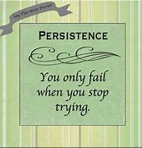
Systematic Persistence
Systematic
  Methodical
  Organized
  Regular
  Efficient
Persistence
  Constant
  Unrelenting
  Determined
  Continuous

Slide 4

An Actionable Plan of Attack
Doing Nothing… Waiting for Someone to Call You…
Having NO PLAN… is NOT Actionable!!

Slide 5
Listing Generating Activities
Database Phone Calls
Database Texts
Neighborhood / Farm Canvassing
E-Mail Campaign
Pop-Bys
  Covid-19 Compliant
Personal Handwritten Notes
Holiday Food Drive
Coffee with an “A” Contact
  Covid-19 Compliant
Zoom / Facetime
Video Message to Database
For Sale by Owner Contact
Expired Listing Contact
Open Houses

Slide 6


Database Phone Calls
This is a great way to generate better relationships & more business
  You should be making a minimum of 2 – 5 calls a day to your Circle of Influence (database)
    Make the call “Personal”
      “How are You & the Family?”
    End the call by ASKING for a Referral

Slide 7
Quick Phone Call Script
Hey Scott… This is Lloyd… How are you?
  Chit Chat… Keep it personal
How are you and the family doing these days?
Are the kids back in the classroom?
  Chit Chat… Keep it personal
Good to talk to you Scott… Listen, I don’t want to tie you up, but before I let you go, do you know of anyone who might be considering either buying or selling a home?
  Chit Chat… Move into a business / market conversation
    “The Market is HOT… We Need More Homes to Sell”
Remember Scott… “I’m Never Too Busy for You or any of your referrals”… Take Care my friend

Slide 8
Four Easy Ways to Ask for a Referral
One:
  “I’m sure you know this, but I’m never too busy for any of your referrals.”
Two:
  “If you know of someone who would appreciate the kind of service I give, please call me with their name and number. I’ll be happy to follow-up with them.”
Three:
  “Please do me a favor.” “If you ever hear of anyone interested in Buying or Selling a home, can you keep me in mind?”
Four:
  “I really enjoy working with you… and with people like you. If any of your friends or family has a need for real estate service, you know they could count on me. It would be an honor to work with any of your referrals. Just give me a call.”

Slide 9

Database Texts
This is a great way to generate a quick response
  Copy and Paste a Message that you can send to everyone in your Circle of Influence (database)
  Most always, a text will generate a response & an OPPORTUNITY

Slide 10

Quick Text Script
Hey Scott… Lloyd here… Do you happen to know anyone thinking about selling their home right now? The market is crazy hot and we have very little inventory. You know I appreciate your help! I hope you are safe and well…

Slide 11
Neighborhood / Farm Canvassing
Being the #1 Go To Guy in my farm (my neighborhood) was very important to me
  I kept my neighbors informed about our market by sending out quarterly market update postcards
  I invited my neighbors to my Open Houses
  I sponsored an annual Community Yard Sale
When I needed listings or when I had a buyer looking to buy in my farm, I would simply visit (pop-by/canvas) my neighbors “in person” to ASK a simple question
  I realize this may be difficult in today’s world, but I’d find a way to get in front of my neighbors (mail works)

Slide 12
Quick Canvassing Conversation (or letter)
“Hi Sue… I’m not going to keep you long, but I’ve got a buyer who is just crazy to find a home here in our development, and there’s just not much for sale! Do you know of anyone who might be thinking of Selling in the near future?
  You can “customize” this conversation into a letter format.
    Insert Your Business Card
    Include an Item of Value with your letter
    Thank them for their help

Slide 13

E-mail Campaign
A monthly email to your database should be a regular part of your Business Plan
  Monthly Item of Value
  Monthly Holiday Message
  An occasional Market Update
    I.e.: Low Inventory / High Demand

Slide 14
Market Update Email Message
Hi Everyone… I hope this message finds you safe and well during the COVID-19 pandemic. Many of you have asked me about the real estate market during these unusual times. Well, interestingly enough, the “market” is on fire! We only have one problem… a lack of homes to sell. Do you know of anyone currently thinking about Selling? If so, you know I would gladly get in touch with them to talk about why NOW is a great time to sell. Stay well & know that I’m here to answer any of your real estate questions!

Slide 15

Pop-Bys (Personal Visits)
A Quick “Stop” at the homes of some of your VERY BEST contacts is a great way to keep top of mind
  Make it COVID-19 compliant
  Drop off a small “fall” gift with a pop-by tag attached
  Include a Personal Note
  This will almost always result in a phone call to say Thanks
    That’s an opportunity to have a conversation about the market & to ask for a referral

Slide 16

Personal Handwritten Notes
This is yet another way to get a quick response
  Keep it personal
  Keep it short
  Include Your Business Card
  BE PREPARED for a return phone call
    A Great Opportunity to ASK for a referral before the end of the call

Slide 17

Holiday Food Drive
What would happen if each of us held a Food Drive in our neighborhoods during the holidays… Branded to you & RMS
  OPPORTUNITY
What if we would include RMS information on our promotional material
  MORE OPPORTUNITY
    Not to mention we’d be helping others!!!!!

Slide 18
Coffee with an “A” Contact
Your VERY BEST (“A”) contacts would probably love to have a cup of coffee with you
Take one person a week out for a cup of coffee
Build that Personal Relationship with some normal, everyday “chit chat”
  The conversation will always (& naturally) include the “how’s work” conversation
    The PERFECT opportunity to discuss the market and ASK for a referral

Slide 19

Zoom or Facetime someone you haven’t seen for a while…
Using Zoom or Facetime to meet up with someone in your Circle of Influence is a nice idea… right?
Make the call… have the conversation. It will surely include the “how’s work” conversation.
  OPPORTUNITY!!

Slide 20
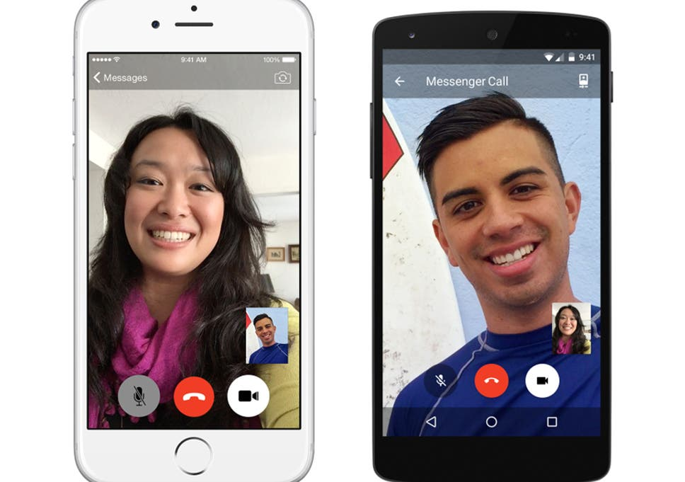
Record a Video Message on your Phone
Record a quick video on your phone
  Send it to everyone in your database / Circle of Influence
  Make it Personal
  Add a Business Tag at the end
  Watch for a response
    OPPORTUNITY

Slide 21

Quick Video Script
Hey Everybody… Lloyd here from beautiful Siesta Key Beach in Sarasota. I just couldn’t resist sending you a quick message to say Hi. I truly hope you are safe and well, and able to enjoy a little bit of life during these unusual times. Get in touch with me sometime… I’d love hearing from you. In the meantime, if you or anyone you know is thinking about buying or selling a home… I’m your guy! You know I’ll take care of you or any of your leads as if they’re family! OK… enough for now! I’m headed for my favorite weekend spot here at the beach… Stay safe and be well… All the Best!!

Slide 22
For Sale By Owner Contacts
There are a variety of ways to make contact with For Sale By Owners (FSBOs)
  Realize that MOST agents make one contact with a FSBO… that’s NOT enough
    Be Persistent with Weekly Contact
      The vast majority of FSBOs will actually list with an agent
      Usually the agent who is the most persistent
    Always try to Provide them with Helpful Material
    Build that Relationship
    Ask Lloyd for his FSBO Programs
      Just Stop By
      Letter Campaign

Slide 23
Expired Listings
Expired Listings are Opportunities
  They obviously wanted to sell
  The reasons for not selling were most likely Price &/or Condition
  Learn how to make Contact with those Expired Listings by asking Lloyd for his Expired Listing Programs and Presentation Ideas

Slide 24

Open Houses
Yes… Open Houses
  Who Visit’s Open Houses?
    People Thinking of Buying
    People Who Need to Sell BEFORE they Buy
    People Interested in the Market
    People Who Will Test Your Knowledge of the Market
    People Looking for HELP

Slide 25
Ready, FIRE, Aim…
That’s right!!
  Ready
  FIRE
  Aim
  The problem with Ready, Aim, Fire… is that we tend to spend way to much time aiming and never firing!!
  FIRE!! Take Action… Action may actually be the Silver Bullet!!

Slide 26

Conclusions
There ARE Listings out there
We Need to take action & ASK for Them
Our Circle of Influence Will Help Us
Sellers are Afraid of the Market
& We can help them Sell
Realize that it takes about 40 Contacts to generate 1 Lead. How many Contacts did you make this week?
Take ACTION
Get STARTED… NOW!

Slide 27
