Slide 1
Doing the Unexpected Extras
What are YOU doing to provide EXCEPTIONAL SERVICE?
This is the KEY to MORE Repeat & Referral Business!

Slide 2
Why Do People Refer??
1) An In-built desire to share something good with friends and family
2) They have a sense of trust in someone’s character and competence
3) They know someone’s motivation is a true desire to serve
Do you exude “Energy”, “Enthusiasm” & a Positive Attitude??

Slide 3
The Unexpected Extras
Unexpected
  Not Anticipated
Extra
  Better than Expected
  Above & Beyond
What do Consumers Expect? (From N.A.R. Survey)
What do they consider to be Unexpected?
  And Appreciated!

Slide 4

Examples of Unexpected Extras
Phone Calls – Messages Not “Maintenance” Calls…
Personal Handwritten Notes
Pop-Bys
Special Mailings or E-Mails
  Item of Value
  Holiday Greeting
  Birthday Card
  Anniversary Card
  Coffee / Breakfast / Lunch
  Client Appreciation Party
  Business Mixer
  Education… Consumers Want to Know the Process of Buying and Selling… Especially 1st Time Home Buyers
    33% of All Home Buyers

Slide 5

Have Coffee with Someone
Have Coffee with one of your TOP 24 Contacts
  Your A+ or A Contacts!!
Use a Great Dialogue to invite them
  Take a Look at the Dialogue
Keep your Coffee time together Short
Have a Place in Mind
  Be Flexible / Present Options
During Coffee, be looking for an opportunity to fill a need
Afterwards… send a “Personal Handwritten Note”

Slide 6
Coffee Invitation Dialogue
“Good Morning Bob, it’s Lloyd here – just checking in to say hello and see how you’re doing. I’ve been so busy lately keeping up with this market and I’m just trying to set aside some time to connect with my favorite folks. How’ve you been? (chit chat – keep it brief)
Well Bob, I’d love to catch up in person. Maybe we can grab a quick cup of coffee down at the Starbucks on Main Street. I don’t know about you, but if I don’t put it in my schedule it won’t happen. What times and days work for you?
OK great… Wednesday at 8 looks good for me too. Let’s plan on it. Look forward to catching up. Buy for now!”

Slide 7
Have Breakfast or Lunch
Past Clients & your Top 24 are Great to Break Bread with!
  Use a Great Dialogue to Invite them to Breakfast/Lunch
    See Example
  Share Awesome Real Estate Information with them
    Buffini Real Estate Report**
  Offer to provide them with a Current C.M.A.
    Even take one with you and share it with them
  Ask for Referrals
    “Remember….. You know the rest!!
Afterwards, write them a “Personal Handwritten Note”

Slide 8
Breakfast/Lunch Invitation Dialogue
“Good Morning Bob, it’s Lloyd here – just checking in to say hello and see how you’re doing. I’ve been so busy lately keeping up with this market and I’m just trying to set aside some time to connect with my best clients (contacts). How’ve you been? (chit chat – keeping it brief)
I have some insightful information on the market that I think might be very helpful. I’d like to treat you to a bite to eat and get this material into your hands. Do you have any availability for breakfast or lunch in the next couple of weeks? I don’t know about you, but if I don’t put it in my schedule it won’t happen. What times and days work best for you?”

Slide 9
Client Appreciation Party – Tips!
What is a “Client Appreciation Party”?
Set a Budget
Pick a Theme, a Venue and start planning early
  Ask for Help – Partner with your Vendors
Send out Invitations with time, location, etc.
Follow-up with a phone call to those who didn’t RSVP
Use Name Tags and introduce people to each other
Take Lots of pictures
Get Feedback from your guests an send each a Personal Note
Have Fun!!

Slide 10

Start Small
No more than 5 or 6 couples (to start)
  Past Clients
  Current Clients
Grow your event by growing your customer/client base
  10 or 12 couples

Slide 11
Business Mixer - Before
What is a Business Mixer?
  Make a list of those you want to Invite
  Plan in Advance
  Decide on an exact date, time & location
  Email invitations and make follow-up calls
    Sample e-mail
    Sample Dialogue
  Keep Costs to a Minimum
    Share the Cost
  Confirm food and beverage
  24 Hours in advance, confirm attendees

Slide 12
Business Mixer Invitation e-mail
Hello ______
  Networking is vital to a thriving business. However, it may be difficult to find the time to meet other business professionals in the area.
  Due to my involvement in the local community, I am in regular contact with businesspeople in a variety of industries. I’m hosting a mixer to provide my network the chance to meet and share ideas, while cultivating new and existing business relationships.
  When… Where… Cost ($___ - A suggested contribution to cover the cost of drinks and snacks)
  I hope to see you there!
  Best Regards,

Slide 13
Business Mixer Invite Dialogue
“Hi _____, it’s Lloyd here from RMS Elite Properties Real Estate. Wanted to check in and see how you’re doing. How’s business? (chit chat)
Just recently I decided to connect the most professional business people I know in this area. I’m arranging a mixer at a local restaurant and I expect _____ people to get together, brainstorm, network and hopefully develop good business relationships. Does this sound like something you’d be interested in attending?
There’s no charge, but I’m asking everyone to contribute $____ each to cover the cost of the coffee and muffins.
(Wait for response)
Okay, that’s great. Bring a bunch of business cards and any brochures if you have them. This will be a great opportunity for all of us. I look forward to seeing you there.”

Slide 14
Business Mixer - During
Act like a Host… Not a Guest
Set a Goal for the Number of People you want to meet
Be Relational
Talk about Why you wanted to get together
  Synergy
  A chance to meet qualified people we can refer to each other as opportunity arises
Collect Business Cards
Write pertinent notes on the back of the card

Slide 15
Business Mixer - After
Write each one a “Personal Handwritten Note”
Add each one to your “Dynamic Database”
  Become the “Trusted” Real Estate Professional
    Send them regular Articles or Posts of Interest
Look for Opportunity to GIVE Referrals
  Initiate the Goal of Referring each other

Slide 16

Practice Reciprocity and Get More Referrals!!**

Slide 17
Education
According to the National Association of REALTOR recent survey of Buyers & Sellers:**
Buyers & Sellers want to know the Process of Buying or Selling
Buyers & Sellers want to have a Checklists of “what happens when”
Buyers & Sellers want to know how you will “serve” them to reach their Goals
Buyers & Sellers want to know what makes you different from other Real Estate agents
Are you Prepared to Educate your Customers and Clients

Slide 18
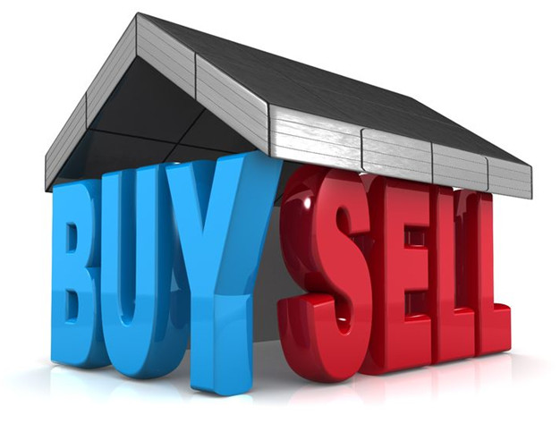
Don’t Miss Either of the Next Two Sessions…
Working With Today’s Sellers
  Week of December 10
Working With Today’s Buyers
  Week of December 17

Slide 19

More Unexpected Extras
Take a Personal Interest in your very TOP database contacts
  Remember
    Birthdays
    Anniversaries
    Holidays
    Interests
    Favorite Sports Teams
    Pets
    Children
    Notice a Need
    Client Connection List**

Slide 20

The Not-So-Common Courtesies
Exude Positive Energy
Look People in the Eye
Use the Magic Words
Be an Attentive Listener
Remember your Clients Names & Preferences
Don’t make Promises you Can’t Keep
Pay attention to what’s Important to your Customer/Client

Slide 21
Words of Wisdom…
“You don’t have to be that good to be different anymore.”
The “standard” for many agents today is very low as it relates to doing the unexpected extras!!
Go the “extra mile” and your Customers & Clients will see how much you care!!
Believe me… in today’s world, the little extras mean a LOT!!
Be Different!!
Have an Awesome week!!

