Slide 1

Dangers of Overpricing a Listing
Charts:
A) History of an Overpriced Home
B) Buyer Activity Over Time

Slide 2
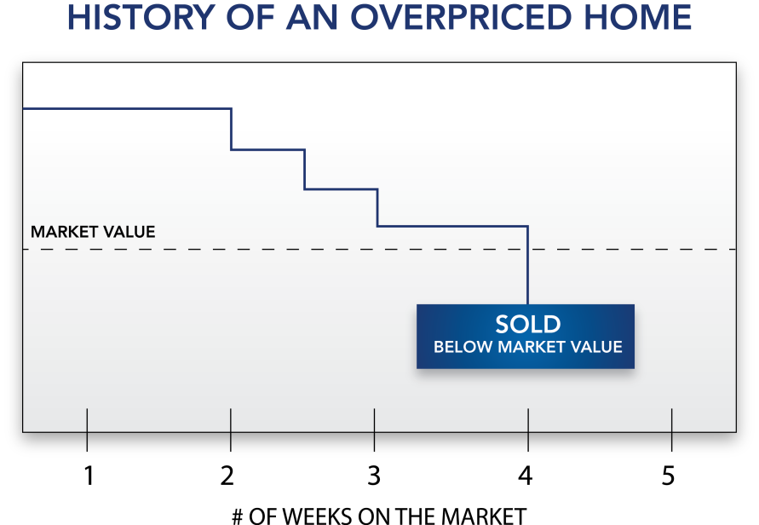

Slide 3
