Slide 1
Building a Dynamic Database
The Importance of Prioritization
The Importance of Contact
The Three “R’s” of Real Estate

Slide 2
The Three “R’s” of Real Estate
Relationships
  Building relationships through consistent contact and communication with our very best “network” of people
Referrals
  Asking for referrals is the Key to Success. Don’t assume that our “relationships” know how much we need them
Results
  Results speak for themselves… And, results lead to more results

Slide 3
The Foundation for Success…
Your Database – Your list of Relationships
  Family & Friends
  Current Clients
  Past Clients
  Personal Circle of Influence
  People YOU Refer
  New Additions
    Always look for opportunities to GROW your Database

Slide 4

Database Information
Names
Address
Phone Contacts
E-mail(s)
Birthdays
Special Occasions
A Simple Spreadsheet will
suffice

Slide 5
Top 120
For the purpose of regular, consistent follow-up & contact
Then… Top 24
* For the purpose of extreme follow-up & contact

Slide 6
Prioritization… the key to top performance
Prioritize your people so that…
you can prioritize your time so that…
you can prioritize your activities!!

Slide 7
Prioritize our People
Prioritize your “list” of Relationships (Your Database)
  “A+”
  “A”
  “B”
  “C”
  “D”
This will allow us to spend our time, and the contact activities we plan to use during that time, with our very best people!!

Slide 8
The Psychology of Sales
Three Phases
  Getting to Know You
    This is probably the simplest of the three phases. Getting to know you is as simple as a letter of introduction and a business card.
  Getting to Like You
    This phase may take a bit more patience. Getting to like you means that you will have to find a way to make regular “positive” contacts.
  Getting to Trust You
    This is by far the most difficult phase to attain. By being visible, active, friendly and informative it is however very attainable.

Slide 9
Warm vs. Cold Lead Generation
WARM
COLD
Working With People Who Know, Like & Trust You!!
  Family
  Friends
  Current Customers & Clients
  Past Customers & Clients
  People You Refer
  Fellow Club Members
Working With People You Don’t Know – You’ll have to work them through the Psychology of Sales!!
  Phone Book Cold Calls
  FSBO’s
  Expired Listings
  Open House Visitors
  Floor Calls
  Walk-Ins

Slide 10

So…..
Which list do you think would be the BEST and MOST likely to refer you??

Slide 11
Contacts result in Referrals
A recent NAR statistic shows that more than 87% of all real estate transactions were the result of repeat or referral business.
  What does it take for someone to refer you?
    Respect
    Trust
    Having done a good job
    A Relationship
    No Further Psychology Necessary!!!

Slide 12
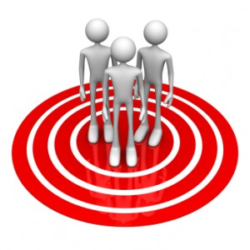
That’s Our Target Market
Working by Referral is a systematic way to target market your database.

Slide 13

Prioritize Your Database
Let’s take a look at how to Prioritize
one “category” at a time
A+ A B

Slide 14

Target Market
“A”+ Clients: People who have sent you multiple referrals
  Advocates
“A” Clients: People most likely to refer you
  Circle of Influence
  Family
  Friends
A+ A B C D

Slide 15

“B” Clients: People who would refer you, if asked
and shown how.
“C” Clients: People who might refer you in the future.
  New people you meet
A+ A B C D

Slide 16
“D” Clients: People to be deleted from your database.
A+ A B C D

Slide 17
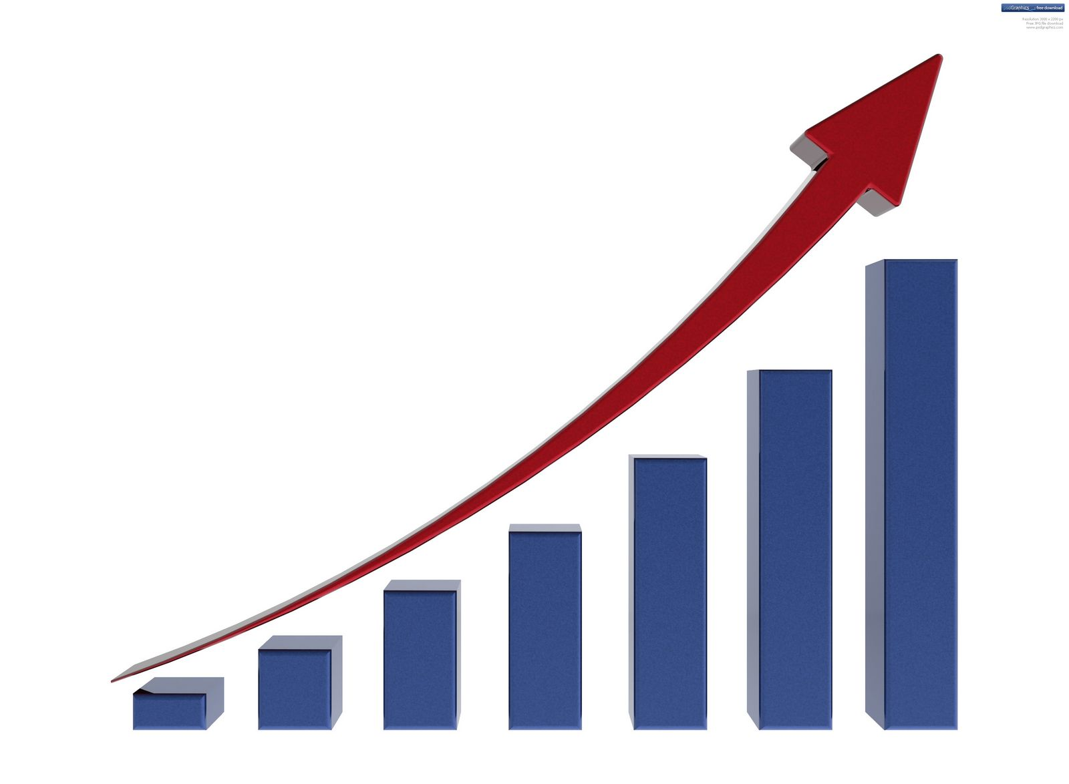
Always be Looking for ways to Grow your Database
Never Miss an Opportunity
Know What to Ask & How to Ask it

Slide 18
Building and Sorting Your Database
The “Mayor” Campaign “Dialog”
“Oh, by the way, if you were buying or selling a home, or had a friend or family member who was, do you have an agent you would refer them to?” OR
“Oh, by the way, if you were buying or selling a home, or had a friend or family member who was, AM I the person you’d refer them to?”

Slide 19
The Answer can only be
YES or NO
If it’s YES…
  “That’s great, it’s important that you have a qualified professional to work with.”
If it’s NO…
  “ Well, I’d like to be that person…
    Now get them into your database by offering them something of value
    “From time to time I come across valuable real estate information that everyone finds helpful. Would you like to receive that?”

Slide 20
Contact That Database!!!!!!
Sales is a Contact Sport and WE are supposed to initiate contact…
and we can’t stop…
Contact needs to be consistent, scheduled, and made with purpose!!
The purpose of the contact is three fold…
1) To keep in touch
2) To remind your contacts that you want and appreciate their Business &
3) To ASK for their Referrals…

Slide 21
The Gentlest of Reminder Dialogs
“Remember… I’m never too busy for You or Any of Your Referrals!!”
After every call…
After every voice mail…
At the end of every text…
At the end of every e-mail…
make it a part of your “e-signature”

Slide 22
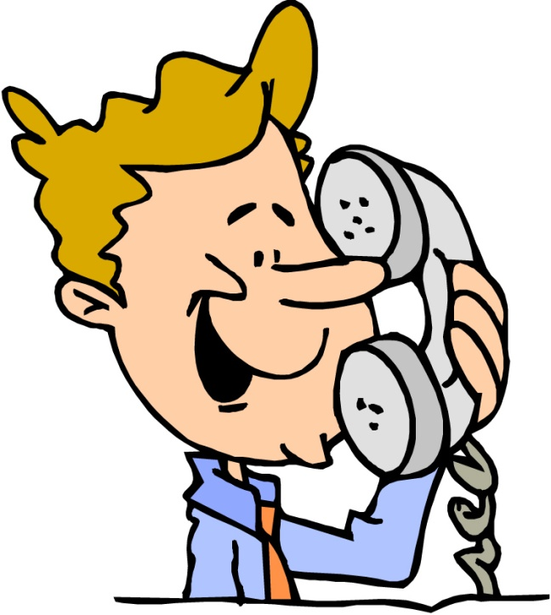
Dialogs & Reasons to Call
Just to say Hi
Birthday
Anniversary
Let’s go for coffee
Let’s play golf
How are the kids
Hey, I saw you got a promotion
I saw that you just… whatever

Slide 23
The Ugly Truth
Most agents stop contact with their customers and clients at closing
Most customers and clients don’t remember their agents name
Many customers and clients would refer their agent if they could remember their name

Slide 24

A “Must Have” Goal…
Outgoing Phone Calls
  Consistent
  Scheduled
  Purposeful
How Many? Think about this…
  5 per day =
  25 per week =
  100 per month =
  1200 per year!! (30 Leads is Probable)

Slide 25


Slide 26

Tracking
It is important to track:
  Who did I contact
  When did I contact them
  How did I contact them
    Phone
      Live
      Message Left
    E-mail
    Direct Mail
    Text

Slide 27

Have That One Lead a Week Mentality

Slide 28
Action Steps (Homework)
Sort your database into categories
  A+, A, B, C, D
Determine the Top 120 and the Best 24 from that list
Start making 2 Phone Calls a Day from your Top 120 List
    Hey… Remember what I do for a living?
    Hey… I’m so excited that I recently completed my course of study and have received my Real Estate License!
    ASK for a Referral
    Make sure they know that your never too busy for them or for their Referrals

