Slide 1
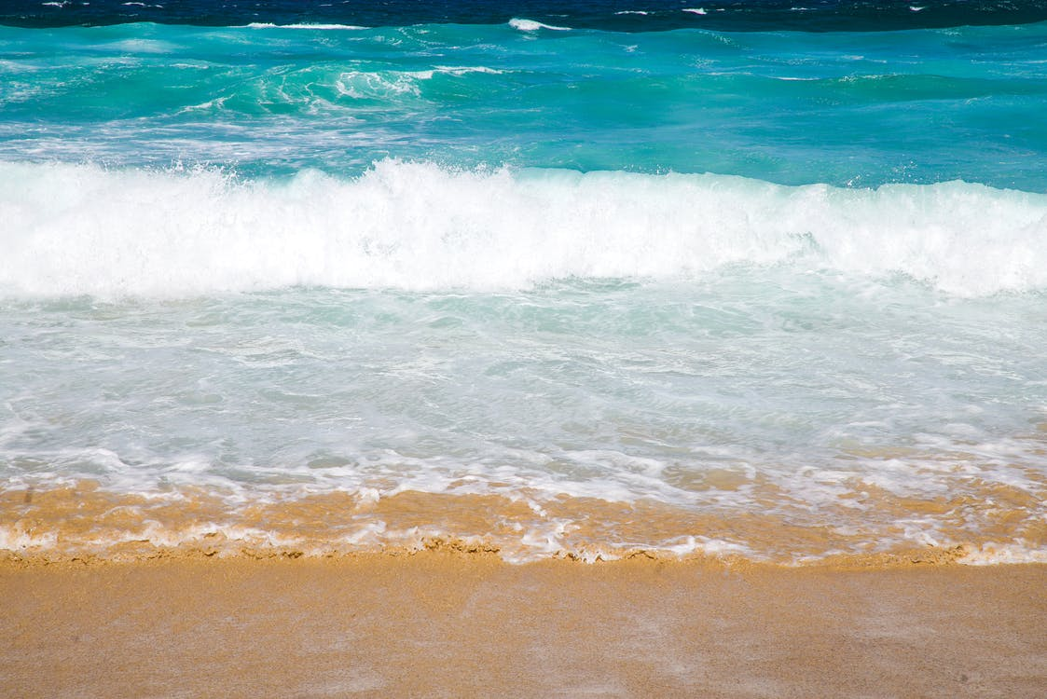
Life’s a Beach…
Enjoy the Waves!!

Slide 2

A Morning Routine…

Slide 3
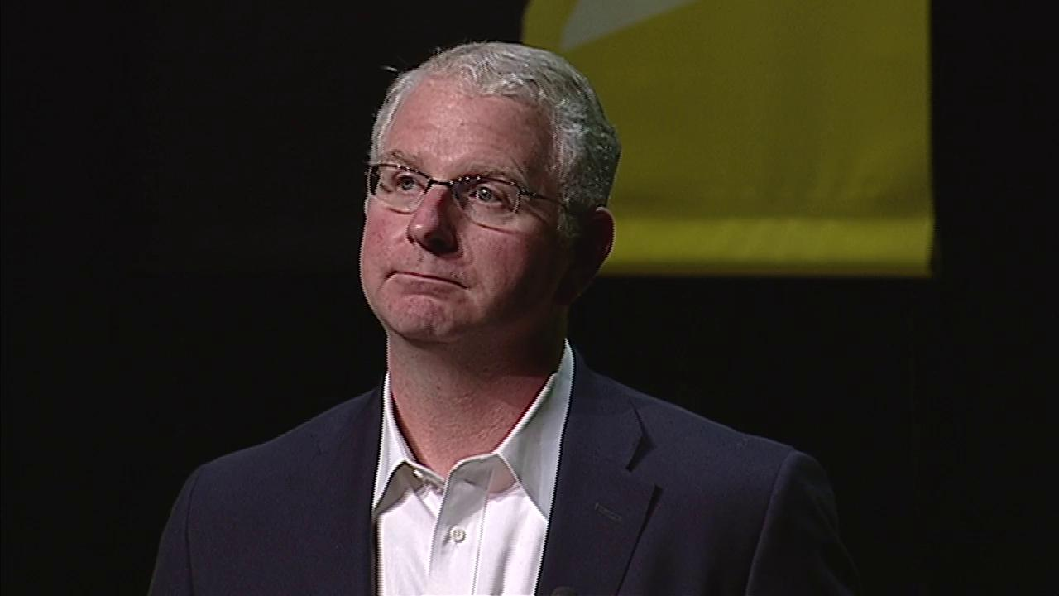
Bob Bowman, Coach
(Michael Phelps)
“The Key to Victory for Michael was creating the right routines!” Bob Bowman

Slide 4
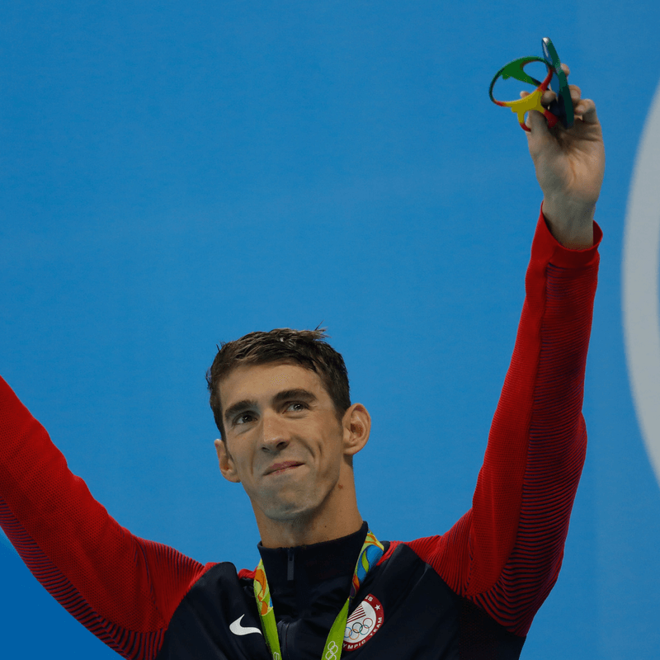
Routines & Habits
Synonyms for Routines/Habits
  Customs
  Traditions
  Patterns
  Schedule
  Practice
  Everyday
  Regular
  Habitual

Slide 5
Day in the Life: Michael Phelps
The Routine…
6 AM – Wake Up
7 – 9 AM – Swim
9 – 10 AM – Weight lift
10 – Noon – Eat!!
Noon – 1 PM – Nap
4 – 6 PM – Swim
6 – 8 PM – Eat!!
8 – 10 – Time with fiancé
10 – Bed
*

Slide 6
My Belief…
“I believe the key to victory in the real estate business (or any business for that matter) is creating the right routines!” Lloyd D.
  In listening to some of my mentors & friends; Brian Buffini, Tom Ferry, Anthony Robins, Zig Ziglar, Gino Blefari, Rick Doyle (my coach & mentor for many years)… I learned:
    In order to succeed in real estate, and in life, I needed to work harder on myself than on my job
    I needed to change my mindset to one of gratitude
    I needed a routine that would create balance in my life… all of which would allow me to find the mental and physical strengths to succeed when others around me failed

Slide 7
Life…
Words of Wisdom…
  “I always thought that work was my life! Then I found out, the hard way, that work was only a part of my life! Don’t wait too long to learn this life lesson!”
      Lloyd Dreibelbis
  “Your life gets better… ONLY after YOU get better!”
      The Miracle Morning for Real Estate Agents

Slide 8
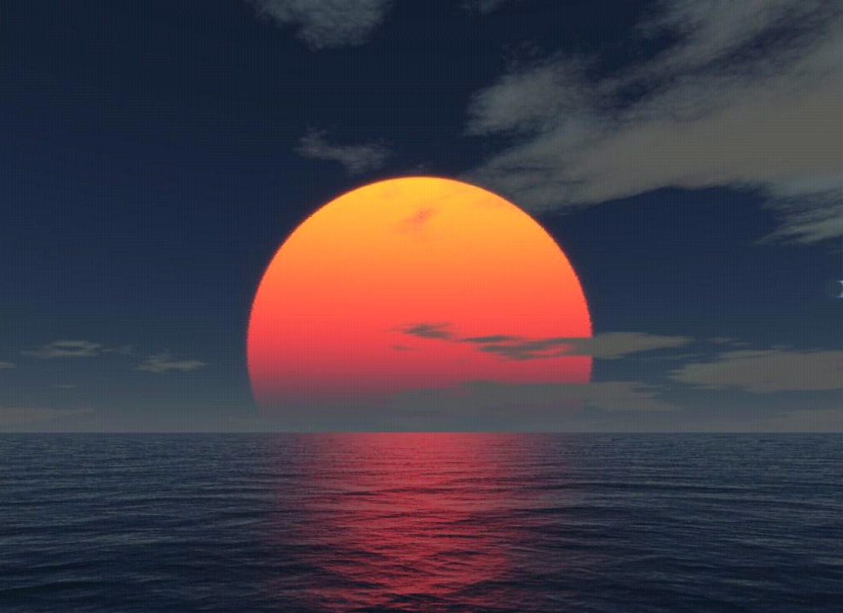
Have a Good Morning Routine
Develop Keystone Habits
    M.E.D.S.

Slide 9



Morning Routine: Keystone Habits
M.E.D.S.
  Meditation / Prayer / Silence/ Reading
    What you think about, you bring about
  Exercise
    Your Health is Your Wealth
  Diet
    You are what you eat… Who are you going to be today?
  Sleep
    “Fatigue makes cowards of us all.”
      Vince Lombardi

Slide 10
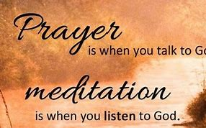
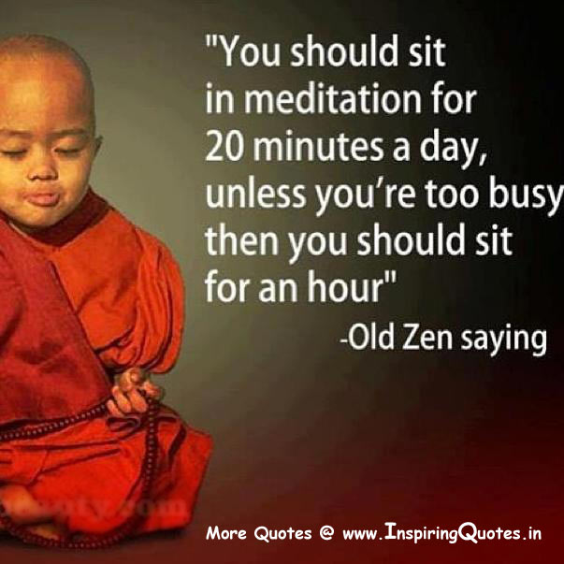
Meditation

Slide 11
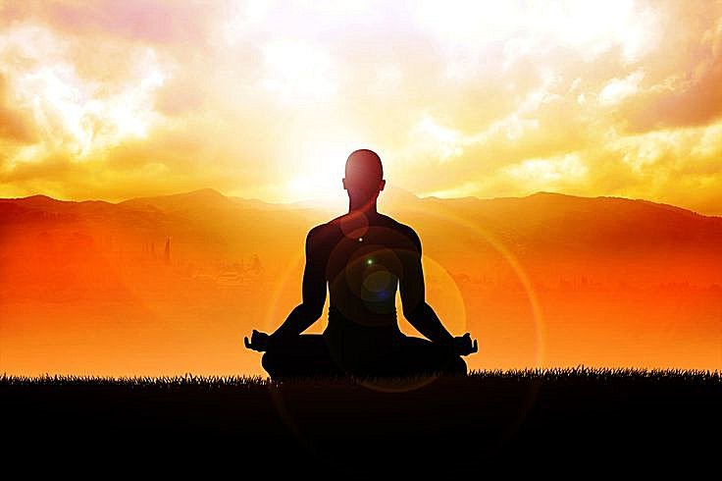
Silence
Enjoy the Beauty of “Quiet Time”
Reflect
Quiet Your Mind

Slide 12
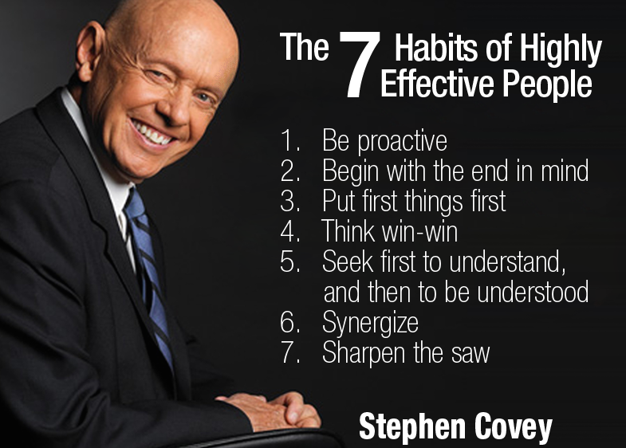
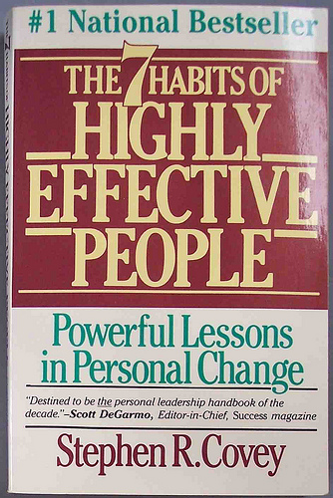
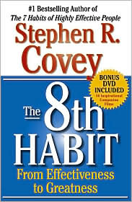
Reading
Feed Your Mind…
“There is very little difference between someone who is illiterate and someone who can read and yet doesn’t!”

Slide 13
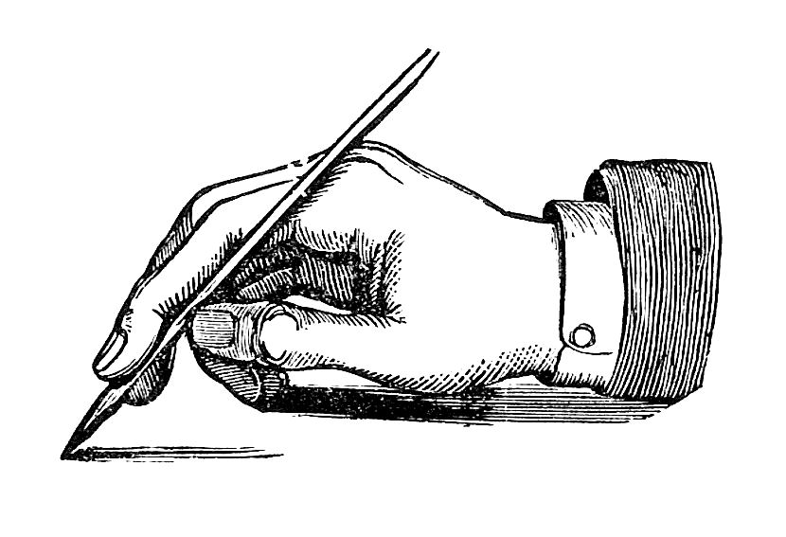
Journaling
1) Write 10 things you are grateful for
2) Write 3 things that made you happy in the last 24 hours

Slide 14
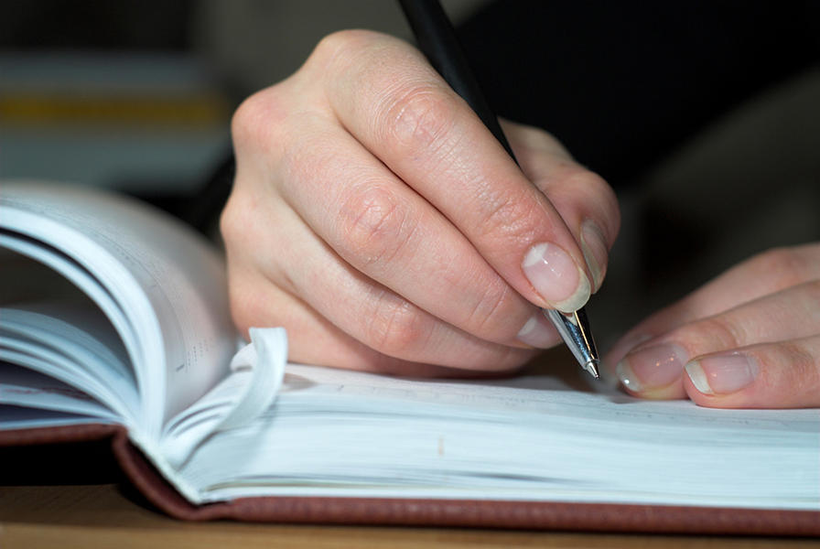
Journaling /Scribing
Document your insights, ideas, breakthroughs, realizations, successes & lessons learned.
Write down those people or things that you are most grateful for.
Write down a few of your affirmations.

Slide 15


