Slide 1


Slide 2
Sooooooooooooo…
How are things going with your business?
Are you where you thought you would be 5 months into the year?
Before we get started this morning, let’s answer a couple of questions:
Do you have a Morning Routine? (Gratitude – Great Attitude)
Do you have Goals? (Annual, Monthly, Weekly, Daily)
Do you have a Business Plan (& a Coach) to Guide you to those Goals? (Accountability)
Do you Schedule your Daily Actions/Activities? (Calendar… perhaps color coded) (Power Hours)
Do you Implement your Plan Every Day?

Slide 3

Implementation….
My Favorite “Floyd Quote”
Floyd Wickman…
“Education without Implementation is Worse than Worthless!”

Slide 4
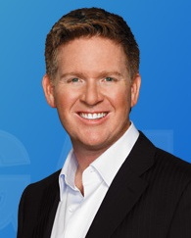
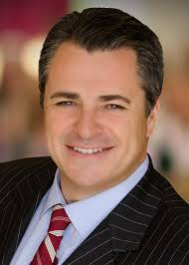
A Day in the Life of a Top Producer!
Tom Ferry’s “5 to Thrive” Program
  View an Introduction from Tom Ferry
  Review each of the “5” elements of the Program
  Transition “5 to Thrive” to Brian Buffini’s “Summertime Blitz”

Slide 5

5 to Thrive
Daily Habits of the Ultra-Successful

Slide 6
#1: 10/10 Visualization
Gratitude and Goals
  Two great things to remind yourself of on a daily basis.
  All it takes is a few minutes of discipline every day.
  Time to sit down and write out 10 things you’re grateful for, PLUS…
  10 of your most important goals that you’re fixated on every day.
Do this every morning, and I know you’ll find yourself locked in to the right emotional state to dominate your day!!

Slide 7
#2: Plan Your Day
It’s time to ditch your To-Do List
  Or, if you’re unwilling to ditch it completely, at least make it serve a more important daily list…
Every day, plan your day by answering this question and writing down your answer:
  What are the specific measurable results I want to produce today?
    Write down those specific outcomes you’re pursuing.
    The more specific you can be, the better.

Slide 8

This approach allows you to achieve a laser focus on what needs to happen to achieve the desired result. It’s a small change that will make a huge difference in how you look at your day!

Slide 9
#3: Study Your Market
There are few things more impressive to a homeowner than an agent who obviously knows the market inside and out.
When you demonstrate deep market knowledge, you build trust faster, people feel more comfortable with you, and they’re more likely to agree to your suggested price.
All of this is why it’s absolutely critical to review your market activity on (at least) a daily basis.

Slide 10

Look at the new listings that came available, the price reductions, the expireds, etc.
Do your do diligence every day and become the knowledge broker for your marketplace!

Slide 11
#4: Role Play
You’ve gotta practice. Pure and simple, it’s a necessity.
  And here’s the thing… You DO practice.
  But the question is this:
    Are you practicing with a peer or are you – gulp – practicing on your clients?
You’re helping people with one of the biggest investments they’ll make in their lifetime, yet you’re willing to “wing it” with your scripts, presentations and objection handlers?

Slide 12
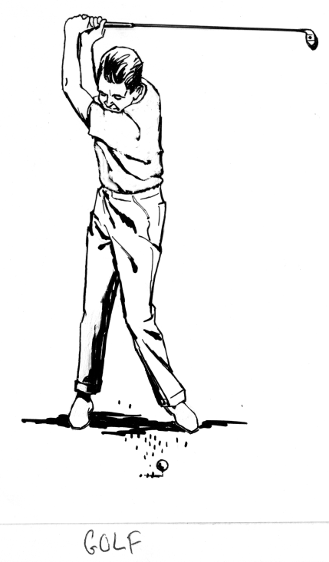
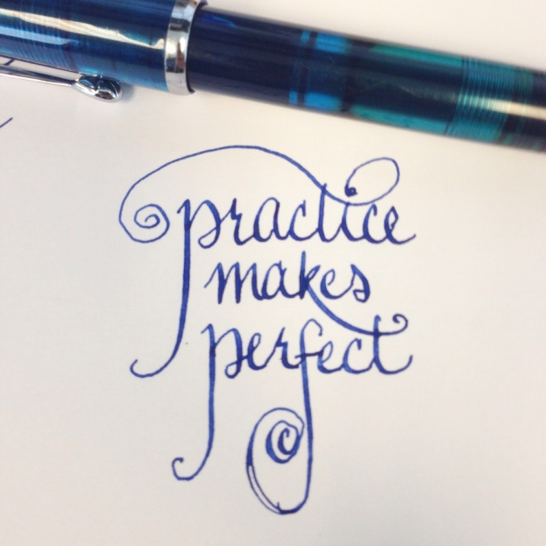
“Winging It” is NOT a strategy for success.
Build role play time into your schedule every day and reap the rewards as you improve your skills exponentially… and never make the costly mistake of practicing on your clients again!!

Slide 13



#5: Pick Up the Phone & Do Your 5-5-4’s
You need to be willing to get on the phone every day and talk to people.
  As a salesperson, you simply have to be in communication.
Tom Ferry’s 5-5-4 system requires you to:
  Talk to 5 people from your database and / or sphere (circle) of influence
  Talk to 5 new people – Open House leads for example
  Follow up on 4 leads you’ve spoken to previously…
  EVERY DAY!!

Slide 14
Are You Willing to Do the Ordinary Every Day?
Are any of these five tasks difficult? (If you say yes, you might want to re-think what business you’re in.)
Remember: Doing the ordinary every day is what will make you extraordinary!!
How hard would it be to make doing all five a daily habit?

Slide 15
Do “5 to Thrive” for 12 months
Your Business Will Be Unrecognizable!!!
I truly believe that in 3 – 4 months, you’ll be able to see the beginnings of that transformation…
  You’ll be working with multiple Buyers in different stages of the Buying Process
  You’ll have multiple listings especially if you incorporate the “5-5-4” plan in your Geographic Farm
  The Buffini Summer BLITZ… Do you have any interest in “getting started”??

Slide 16


Slide 17
Upcoming Career Development
June 10
  Day 1 of “The Blitz”
June 10, 11, 12
  The Power of Personal Handwritten Notes

Slide 18


